Slide 1

Prehospital: Emergency Care
Eleventh Edition
Chapter 33
Eye, Face, and Neck Trauma
Slides in this presentation contain hyperlinks. JAWS users should be able to get a list of links by using INSERT+F7
Copyright © 2018, 2014, 2010 Pearson Education, Inc. All Rights Reserved
Notes:
If this PowerPoint presentation contains mathematical equations, you may need to check that your computer has the following installed:
1) MathType Plugin
2) Math Player (free versions available)
3) NVDA Reader (free versions available)
During this lesson, students will learn about the roles and responsibilities of an EMT.
Advance Preparation
Student Readiness
Assign the associated section of MyBRADYLab and review student scores. Review the chapter material in the Instructor Resources, which includes Student Handouts, PowerPoint slides, and the MyTest Program.
Prepare
Make copies of course policies and procedures, the syllabus, handouts from the Instructor Resources, and other materials for distribution or post them in your learning management system.
Preview the media resources and Master Teaching Notes in this lesson.
Preview the Case Study presented in the PowerPoint slides.
The total teaching time recommended is only a guideline. Take into consideration factors such as the pace at which students learn, the size of the class, breaks, and classroom activities. The actual time devoted to teaching objectives is the instructor’s responsibility.

Slide 2
Learning Readiness
E M S Education Standards, text page 998.
Chapter Objectives, text page 998.
Key Terms, text page 998.
Purpose of lecture presentation versus textbook reading assignments.
Notes:
Explain to students what the National EMS Education Standards are. The National EMS Education Standards communicate the expectations of entry-level EMS providers. As EMTs, students will be expected to be competent in these areas. Acknowledge that the standards are broad, general statements. Although this lesson addresses the listed competencies, the competencies are often complex and require completion of more than one lesson to accomplish. The student is also expected to review the chapter objectives to foreshadow what will be in the chapter. By mastering the key terms the EMT student will better understand the learning and be able to communicate more clearly.
Additionally, explain to the students that the purpose of using these slides is to help keep the instructor focused on highlighting important portions of the material, explain interrelationships of topics, and discuss how to apply this information. It’s not the intent of the presentation (or slides alone) to include every component in the chapter. This presentation still requires the student to thoroughly read the chapter.
Additionally, explain to the students that the purpose of using these slides is to help keep the instructor focused on highlighting important portions of the material, explain interrelationships of topics, and discuss how to apply this information. It’s not the intent of the presentation (or slides alone) to include every component in the chapter. This presentation still requires the student to thoroughly read the chapter.

Slide 3
Setting the Stage
Overview of Lesson Topics
  Anatomy of the Eye, Face, and Neck
  Eye, Face, and Neck Injuries
  Specific Injuries Involving the Eye, Face, and Neck
Notes:
These bulleted points are the major headings from the chapter, in order. Their purpose is to provide a basic lecture navigation for the student.

Slide 4
Case Study Introduction
E M T s Paul Ellis and Jeremy Dowling have responded to a report of an injured person at a tire shop. A technician was attempting to take a tire off a rim when the tire exploded and struck him in the face. The scene is safe, and their general impression is that of a patient is in his 20s with massive facial trauma, who is combative and seems to have difficulty managing his airway.
Notes:
Case Study
Present the Case Study Introduction provided in the PowerPoint slide set.
Lead a discussion using the Case Study questions provided on the subsequent slide(s).
The Case Study with discussion questions continues throughout the PowerPoint presentation.
Case Study Discussion
Use the Case Study content and questions to foreshadow the upcoming lesson content.

Slide 5
Case Study
What are the priorities of management in this patient?
What specific steps are required in the management of this patient?
Notes:
Use the Case Study content and questions to foreshadow the upcoming lesson content. Gauge the student’s responses as a guide of how well versed they are on this topic.

Slide 6
Introduction
Injuries to the eye and face can cause emotional distress, as well as pain.
Injuries to the face and neck carry risks of airway compromise, bleeding, and cervical spine injury.
Management priorities are establishing an airway and controlling bleeding.
Notes:
During this lesson, students will learn special considerations of assessment and emergency care for a patient suffering eye, face, and neck injuries.

Slide 7
Anatomy of the Eye, Face, and Neck (1 of 3)
The Eye
  The globe of the eye is a sphere approximately one inch in diameter.
  It is covered with a tough outer coat called the sclera.
  The cornea is the clear front portion.
  The dark center is the pupil, and the colored portion is the iris.
Notes:
A superficial scratch or the smallest foreign object can cause extreme pain with redness and tearing.
Teaching Tips
Use anatomical models to review the structures of the eye, face, and neck.
Discussion Questions
What is the pupil of the eye?
What is the orbit of the eye?
Class Activity
Have each student, without opening the book, draw and label the anatomy of the eye. Then have groups of students compare and compile their drawings and come up with a revised, labeled drawing to turn in for review.

Slide 8
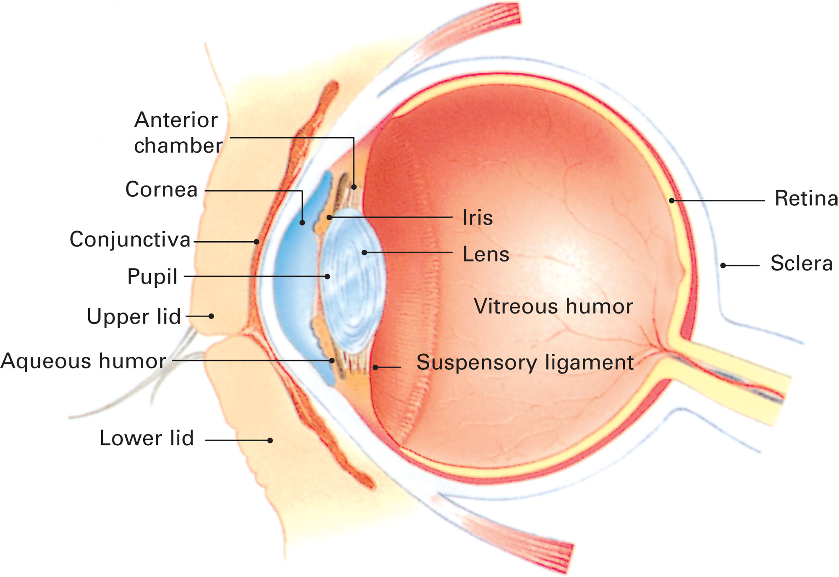
The Eye
Notes:
The pupil is the opening that expands or contracts to allow more or less light into the eye through the lens, just behind the pupil. The lens focuses light on the retina, or the back of the eye. The inner surface of the eyelids and the exposed portion of the sclera are lined with a paper-thin covering called the conjunctiva. The conjunctiva does not cover the cornea.
The interior of the eye contains the anterior chamber, which is anterior to the iris and is filled with a watery fluid called the aqueous humor. Behind the lens is the large vitreous body, which is filled with a clear jelly called the vitreous humor. The bony structures of the skull that surround the eyes are called the orbits, or eye sockets.

Slide 9
Anatomy of the Eye, Face, and Neck (2 of 3)
The Face
  There are 14 facial bones.
  Only the mandible is movable.
  The face is highly vascular.
  Facial injury can lead to airway compromise and may be associated with brain and spine trauma.
Notes:
The EMT should suspect and continuously assess the blunt anterior trauma patient for airway compromise.
Discussion Question
What bones make up the face?

Slide 10
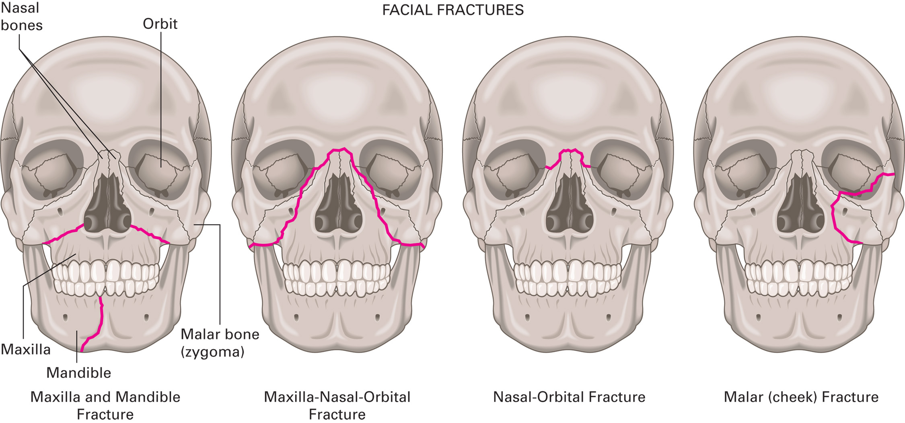
Facial Fractures
Notes:
The face is extremely vascular. Facial injuries, even otherwise minor ones, may bleed profusely. Blood and pieces of broken bone, teeth, and other tissues can cause airway compromise when the face is injured.

Slide 11
Anatomy of the Eye, Face, and Neck (3 of 3)
The Neck
  Contains vital vascular, airway, and nervous system structures.
  Damage to the vital structures is life threatening.
    Injuries to the neck can cause life-threatening bleeding and airway compromise.
    The neck contains the cervical spine, which houses the proximal spinal cord.
Notes:
Discussion Question
What structures are contained in the neck?
Critical Thinking Discussion
What would be the consequences of injury to the thyroid gland in the neck?

Slide 12
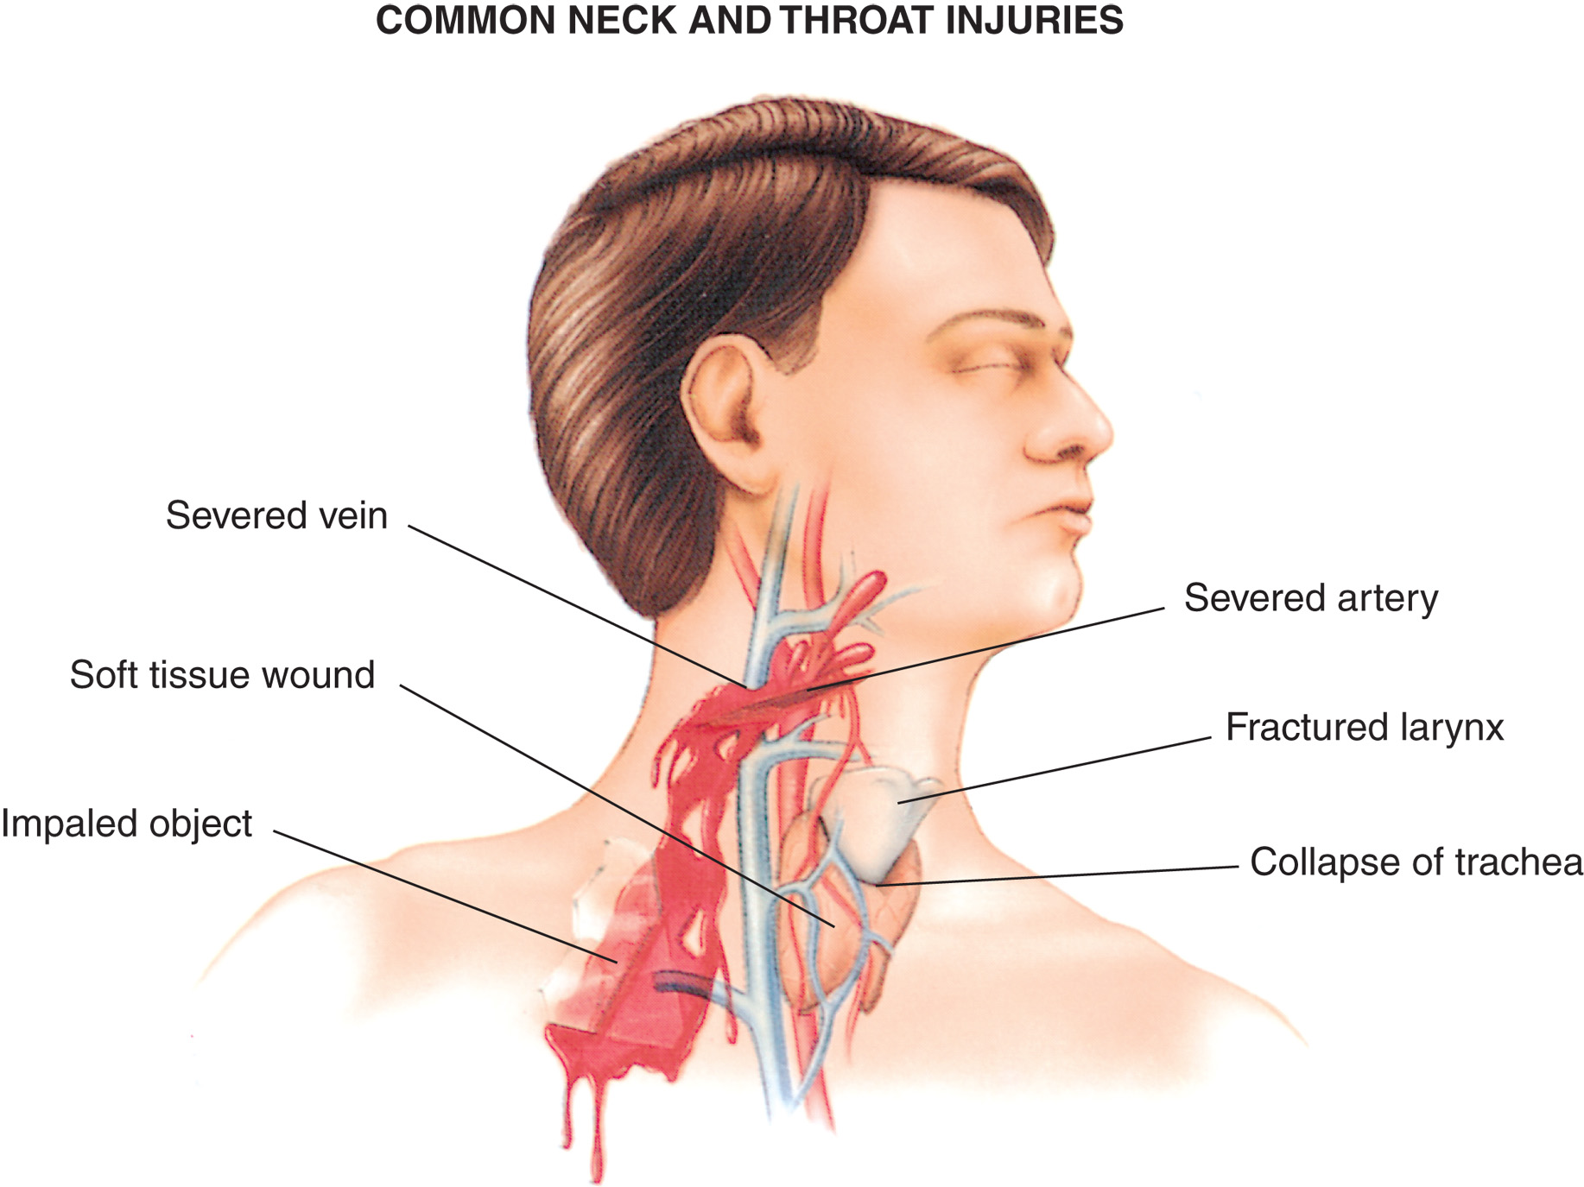
Common Neck and Throat Injuries
Notes:
The neck contains the major arteries (carotid) and veins (jugular) that carry blood to and from the head. It also contains major structures of the airway, including the trachea and the larynx.

Slide 13
Eye, Face, and Neck Injuries (1 of 6)
The Neck
  Management challenges include:
    Profuse hemorrhage.
    Many injuries to the eyes, face, and neck are the result of assault.
    You might need to treat emotional trauma as well as physical trauma.
Notes:
A face injury arouses fear of permanent facial disfigurement or scarring. A neck injury might cause fear of immediate lethal bleeding or breathing difficulty. These patients and their friends and family at the scene can be emotionally distraught or panicked.
Discussion Question
What are some causes of airway compromise in the patient with injuries to the eye, face, or neck?

Slide 14
Eye, Face, and Neck Injuries (2 of 6)
Assessment-Based Approach: Eye, Face, and Neck Injuries
  Scene Size-Up
      Motor vehicle crashes, assaults, and sports injuries are common causes of facial trauma.
      Assault may be involved; ensure your safety.
Notes:
The assessment procedures and considerations described here apply to specific eye, face, and neck injuries.

Slide 15
Eye, Face, and Neck Injuries (3 of 6)
  Assessment-Based Approach: Eye, Face, and Neck Injuries
  Primary Assessment
    In-line spinal immobilization
    Jaw-thrust maneuver, if necessary
    Control major hemorrhage
    Suction as needed
Notes:
Open the airway with a jaw-thrust maneuver and suction vomitus and other substances as needed.

Slide 16
Eye, Face, and Neck Injuries (4 of 6)
  Assessment-Based Approach: Eye, Face, and Neck Injuries
  Primary Assessment
    Maintain an S p O₂ greater than or equal to 94%.
    Positive pressure ventilation for inadequate breathing.
    Consider A L S for airway management.
    Establish transport priority.
Notes:
In making a priority decision, consider any patient with chemical burns to the eye, an impaled object in the eye, an extruded eyeball, respiratory distress, severe injuries to the face or neck, major bleeding, suspected spinal column or cord injury, or airway compromise to be a high priority for immediate transport with assessment and emergency care continuing en route.

Slide 17
Eye, Face, and Neck Injuries (5 of 6)
  Assessment-Based Approach: Eye, Face, and Neck Injuries
  Secondary Assessment
    Inspect and palpate for signs of injury.
    Use a penlight to inspect the eyes.
    Do not push directly on the eye.
    Obtain vital signs.
    Obtain a history.
Notes:
Obtain a history of the patient. Particularly in the case of eye injuries, where time can mean the difference between sight and loss of vision, ask the patient or bystanders questions about the events leading up to the injury.

Slide 18
Eye, Face, and Neck Injuries (6 of 6)
Assessment-based approach
  Reassessment
    Every five minutes for unstable patients.
    Every 15 minutes for stable patients.
    Be alert to changes in the mental status, airway, or breathing.
Notes:
Conduct a reassessment and check interventions. Monitor especially for deterioration of mental status, airway, or breathing.

Slide 19
Specific Injuries to the Eye, Face, and Neck (1 of 26)
Injuries to the Eye
  Assessment and Care Guidelines
    Assess the eyes separately and together to evaluate the:
      Orbits
      Eyelids
      Conjunctivae
      Globes
      Pupils
Notes:
When you conduct the physical exam on a patient with an eye injury, assess the eyes separately and together with a small penlight.
Discussion Question
What should you look for in the assessment of an injured eye?
Class Activity
To assess students' ability to integrate the knowledge in this section, have groups of students write five to ten questions they predict would be on an exam covering this material. Have each group quiz the rest of the class.

Slide 20
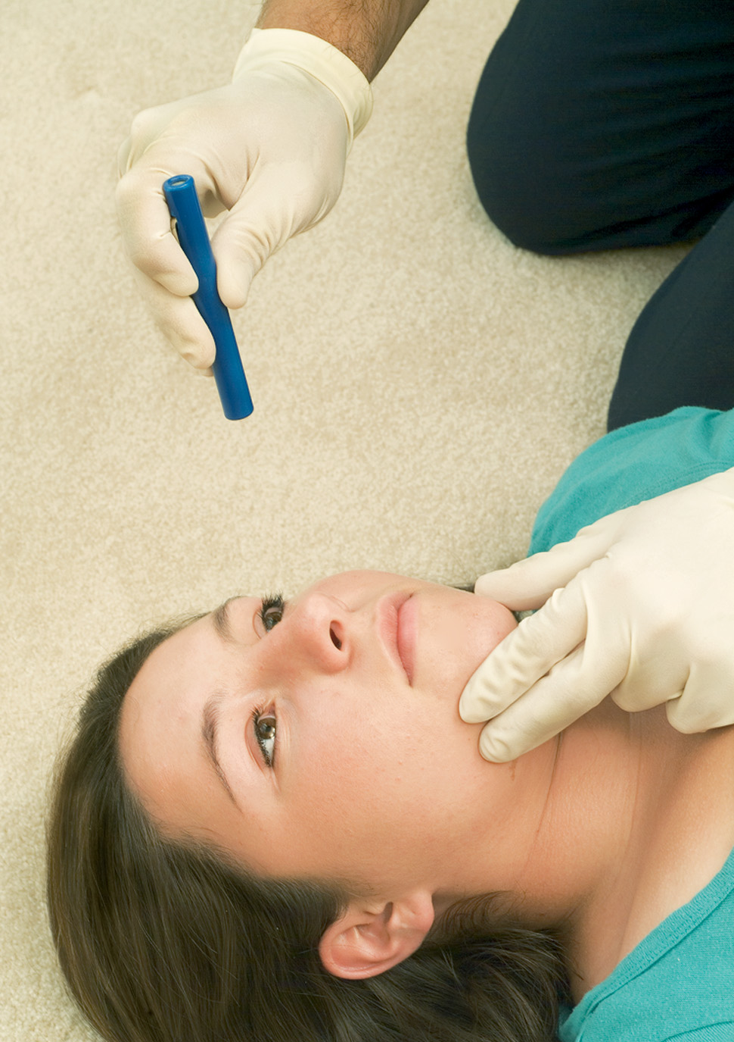
Inspect the Eyes for Any Abnormality
Notes:
Inspect the pupils for size, shape, equality, and reactivity to light.

Slide 21

Assess the Patient’s Ability to Move the Eyes in any Direction
Notes:
Additionally, ask the patient to follow your finger as you move it left and right, up and down, to evaluate eye movements in all directions for abnormal gaze, paralysis of gaze, or pain on movement.

Slide 22
Specific Injuries to the Eye, Face, and Neck (2 of 26)
Injuries to the Eye
  Assessment and Care Guidelines
    Suspect significant eye damage if the patient:
      Has loss of vision that does not improve with blinking
      Loses part of the visual field
      Has severe pain
      Has double vision
      Is unusually sensitive to light
Notes:
If the eye is swollen shut, avoid any unnecessary manipulation in examining the eye.
Do not try to force the eyelid open unless you must wash out chemicals.
Consult medical direction or local protocol before irrigating the eye. Some jurisdictions do not permit irrigating an injured eye, except in the case of a chemical burn.
Do not put salve or medicine in an injured eye.
Do not remove blood or blood clots from the eye. Sponge blood from the face to help keep the patient comfortable, but leave the eye alone.
Have the patient lie down and keep quiet. Never let a patient with an eye injury walk without help, especially up or down stairs. The patient should be transported with the head elevated unless other injuries preclude this from occurring.
Limit use of the uninjured eye. It is usually best to cover it, along with the injured eye. Eyes move together, and if the patient is using the uninjured eye, chances are the injured eye is moving too.
Give the patient nothing by mouth in case general anesthesia is required at the hospital.
Every patient with an eye injury must be transported for evaluation by a physician.
Never apply direct pressure to an injured eye.
If possible, bring the liquid or material to which the eye was exposed with the patient. If it is too dangerous or not possible to do so, clearly note the substance and ensure that the information is left with the receiving medical facility personnel.

Slide 23
Specific Injuries to the Eye, Face, and Neck (3 of 26)
Injuries to the Eye
  Assessment and Care Guidelines
    Foreign object in the eye
      A variety of foreign particles can enter the eye.
      It is safer to transport than to attempt removal of the object in the field.
      If possible, flush the eye with clean water.
      For an embedded foreign object; bandage both eyes and transport.
Notes:
Foreign objects, such as particles of dirt, sand, cinders, coal dust, or fine pieces of metal, can be blown or driven into the eye and lodged there.
To remove an object from the white of the eye, pull down the lower lid while the patient looks up or pull up the upper lid while the patient looks down. Then remove the object with a piece of sterile gauze or a swab.
If a foreign object becomes lodged in the eyeball, do not attempt to disturb it. Place a bandage over both eyes and transport the patient as soon as possible.

Slide 24
Foreign Object Lodged in the Eye
Notes:
Do not remove an embedded foreign object; bandage both eyes and transport.

Slide 25

Flushing a Foreign Particle from the Eye
Notes:
If possible, flush the eye with clean water, holding the eyelids apart. If you cannot flush the eye, the removal technique depends on where the object is located.

Slide 26
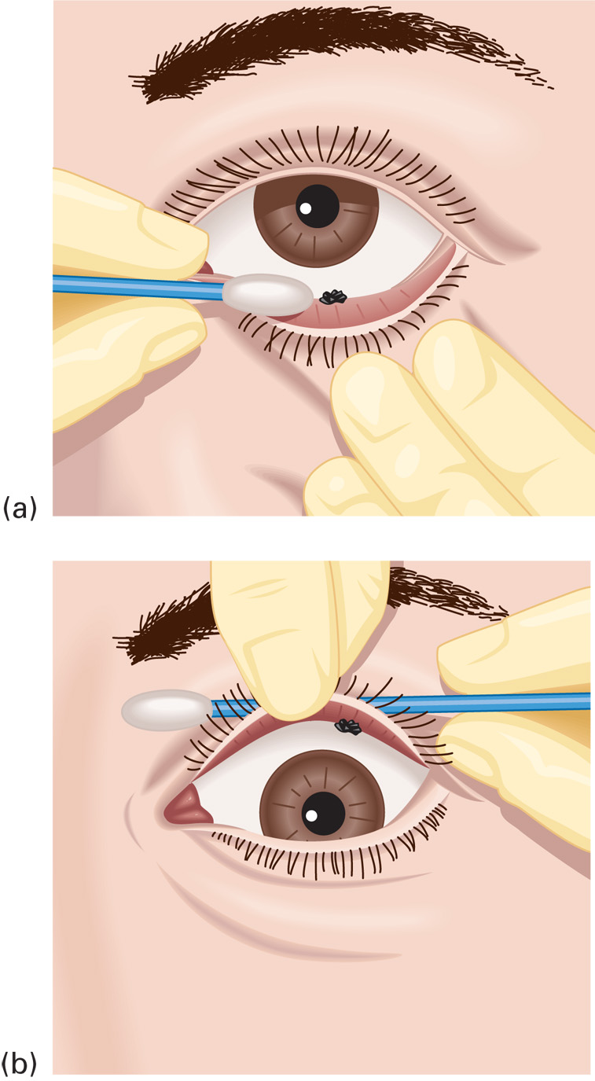
To Remove Particles from the White of the Eye, (a) Pull Down the Lower Lid While the Patient Looks up or (b) Pull up the Upper Lid While the Patient Looks Down
Notes:
If the object is under the upper lid, draw the upper lid down over the lower lid. As the upper lid returns to its normal position, the undersurfaces will be drawn over the lower lashes, possibly removing the object. If the object remains, grasp the lashes of the upper lid and turn the lid upward over a cotton swab or a similar object, which is called lid eversion. Carefully remove the object with the corner of a piece of sterile gauze or a swab. If the object is under the lower lid, pull down the lid and remove the object with sterile gauze or a swab.

Slide 27
E M T Skills 33-1
Removal of Foreign Object—Upper Eyelid

Slide 28
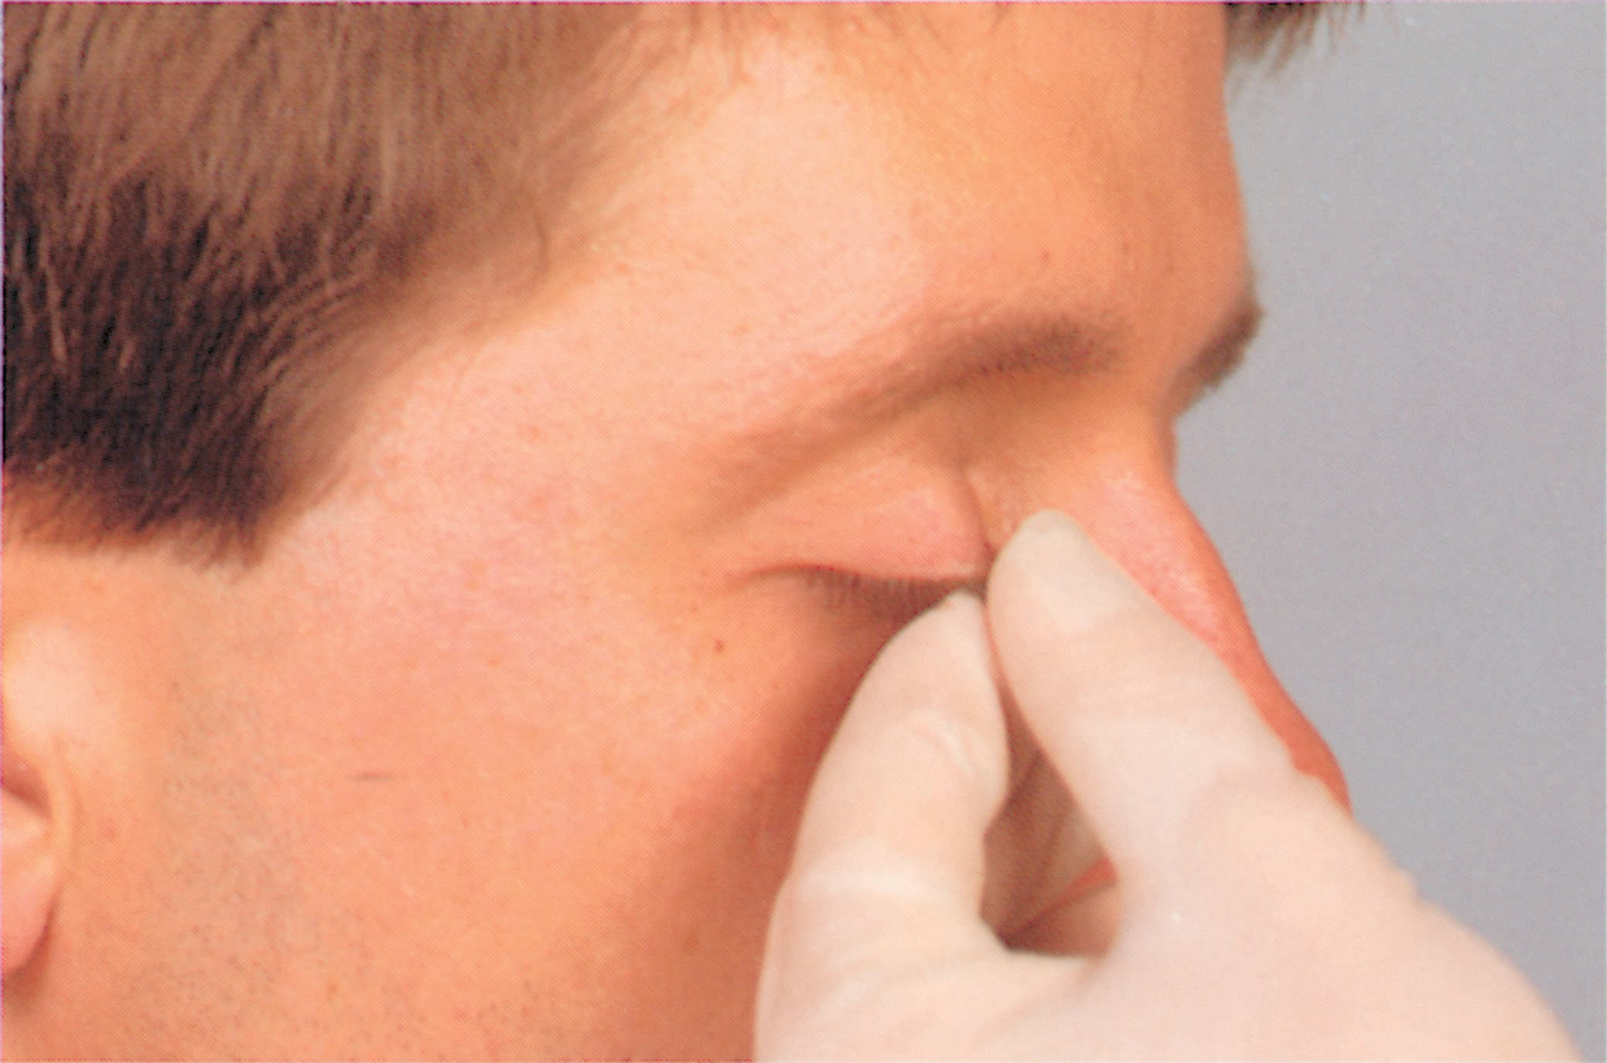
Grasp Eyelashes between the Thumb and Forefinger and Tell the Patient to Look Downward
Notes:
If the object is under the upper lid, draw the upper lid down over the lower lid.

Slide 29
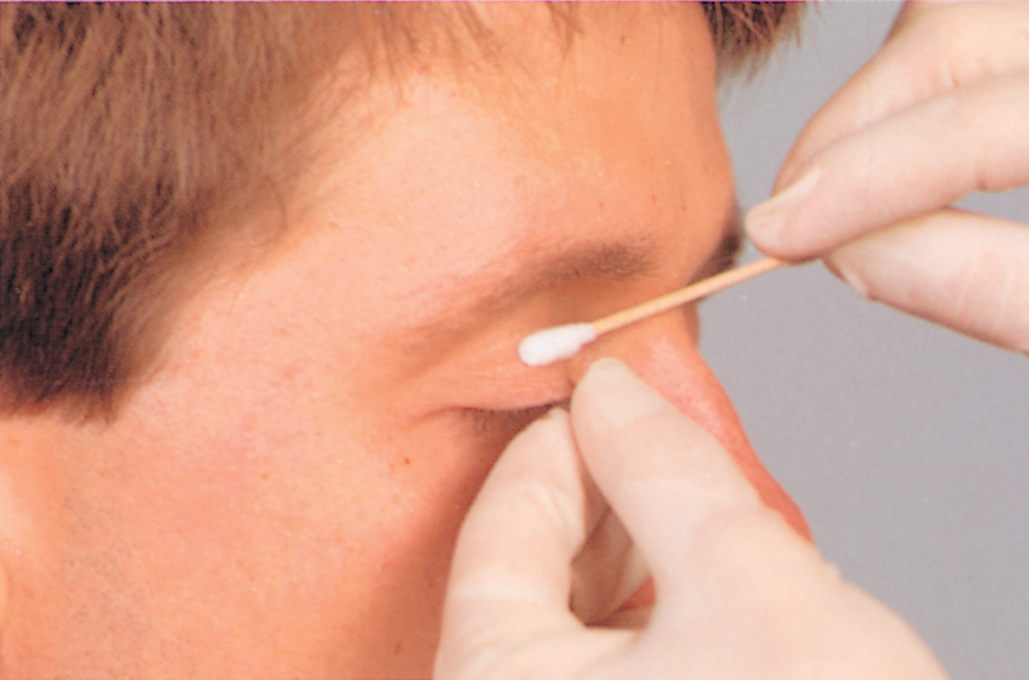
Place an Applicator Swab along the Center of the Upper Eyelid
Notes:
If the object remains, grasp the lashes of the upper lid.

Slide 30
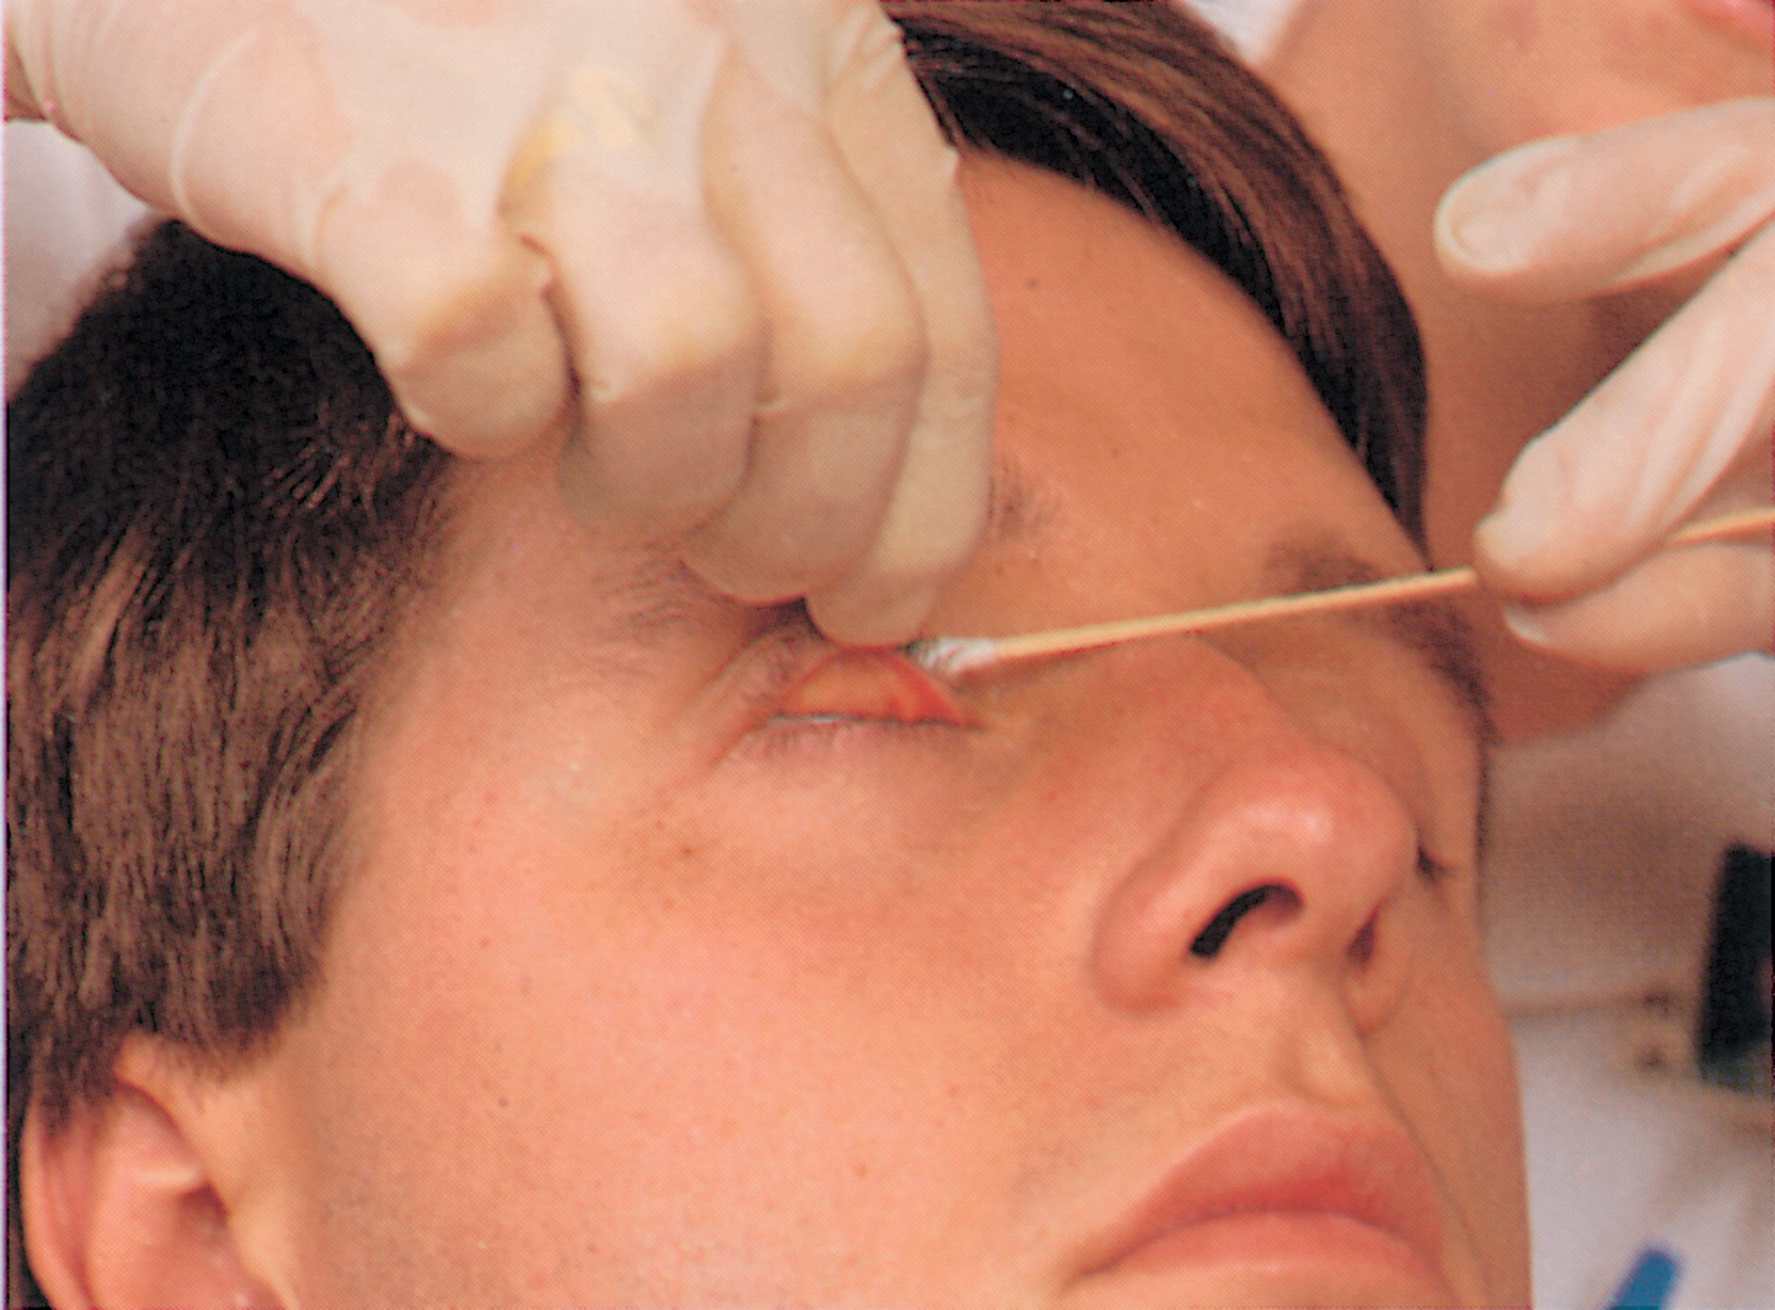
Pull the Eyelid Forward and Upward over the Applicator Swab
Notes:
Turn the lid upward over a cotton swab or a similar object, which is called lid eversion.

Slide 31
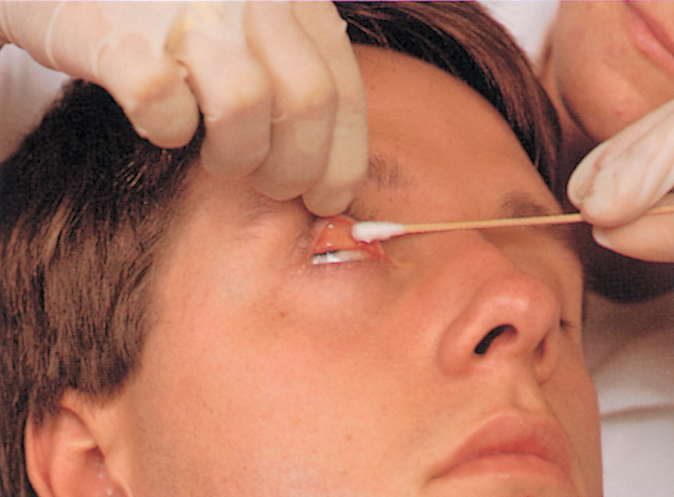
The Undersurface of the Eyelid is Exposed and the Foreign Object can be Gently Removed with a Sterile, Moistened Applicator Swab
Notes:
Carefully remove the object with the corner of a piece of sterile gauze or a swab.

Slide 32
Specific Injuries to the Eye, Face, and Neck (4 of 26)
Injuries to the Eye
  Assessment and Care Guidelines
    Injury to the orbits
      Orbital fractures can be associated with cervical spine injury.
    Signs of orbital injury include:
      Decreased vision or double vision (diplopia).
      Sensation loss above the eyebrow, over the cheek, or in the upper lip.
      Nasal discharge.
Notes:
Injuries serious enough to cause orbital fractures can also cause cervical spinal trauma.

Slide 33
Specific Injuries to the Eye, Face, and Neck (5 of 26)
Injuries to the Eye
  Assessment and Care Guidelines
    Signs of orbital injury include:
      Tenderness to palpation or bony deformity.
      Paralysis of the upward gaze.
    For suspected orbital injury:
      Apply a cold pack.
      Transport the patient in an upright position.
      If eyeball injury is suspected, do not use cold packs; transport in supine position.
Notes:
Orbital fractures can require hospitalization and possible surgery. If the signs and symptoms lead you to suspect a possible orbital fracture, take the above emergency care steps.

Slide 34
Specific Injuries to the Eye, Face, and Neck (6 of 26)
Injuries to the Eye
  Assessment and Care Guidelines
    Eyelid injury
      Control bleeding with light direct pressure.
      Do not apply pressure if eyeball injury is suspected.
      Use a moist dressing for open wounds.
      Cover both eyes to decrease movement.
Notes:
Lid injuries include bruising, burns, and lacerations. Because the eyelid is richly supplied with blood vessels, lacerations can cause profuse bleeding. Anything that lacerates the lid can also cause damage to the tear drainage system or eyeball, so assess the injury carefully. Inspect the area around the lid for evidence of injury.

Slide 35
Eyelid Injury
Notes:
Control bleeding with light pressure from a dressing; use no pressure at all if the eyeball itself may be injured. Cover the lid with a sterile bandage soaked in saline to keep the wound from drying.

Slide 36
Specific Injuries to the Eye, Face, and Neck (7 of 26)
Injuries to the Eye
  Assessment and Care Guidelines
    Injuries to the globe
      Includes lacerations, foreign objects, abrasions.
      There may be blood in the anterior chamber of the eye.
      Avoid any pressure on the eye.
      Lightly bandage both eyes.
      Transport.
Notes:
Deep lacerations and penetrating injuries can cut the cornea, causing the contents of the eyeball to spill out.

Slide 37
Specific Injuries to the Eye, Face, and Neck (8 of 26)
Injuries to the Eye
  Assessment and Care Guidelines
    Corneal Injury
      Ocular pain.
      Sensation of a foreign body.
      Decrease in visual acuity, blurred vision, or photophobia.
      If an object is seen, flush it with sterile water or saline.
      Cover the affected eye and transport.
Notes:
An injury to the cornea is common and often results from a direct blow to the eye or from a foreign body under the eyelid that irritates the corneal surface.
Do not attempt to remove the object if flushing is not effective.

Slide 38
Ruptured Globe. The Patient was Using Needle-Nose Pliers, Which Slipped, Piercing the Globe and Causing Blindness in that Eye
(© Charles Stewart M D Emdm Mph)
Notes:
Do not use a patch or any kind of pressure if you suspect a ruptured eyeball, because pressure can force the eye
contents to leak out. Avoid the use of cold packs over the globe. If you apply an eye shield to the injured eye, be sure that it puts no pressure on the injury.

Slide 39
Specific Injuries to the Eye, Face, and Neck (9 of 26)
Injuries to the Eye
  Assessment and Care Guidelines
    Chemical burn to the eye
      Burning continues as long as the substance is in the eye.
      After the scene size-up and primary assessment, begin treatment immediately.
Notes:
The signs and symptoms of chemical burns to the eye include a history consistent with exposure; irritated, swollen eyelids; redness of the eye or red streaks across the surface of the eye; blurred or diminished vision; excruciating pain in the eyes; or irritated, burned skin around the eyes.

Slide 40
Trauma to the Corneas from Hot Sodium Hydroxide
(© David Effron, M D)
Notes:
If, during your scene size-up and primary assessment, you determine the MOI is a chemical to the eye, you must begin treatment immediately.

Slide 41
Specific Injuries to the Eye, Face, and Neck (10 of 26)
Injuries to the Eye
  Assessment and Care Guidelines
    Chemical burns to the eye
      Hold the eyelids open.
      Continuously irrigate for 20 minutes; one hour for alkali.
      Avoid contamination of the unaffected eye.
      Use only plain water or saline.
      Flush out or remove contact lenses.
Notes:
Following irrigation, avoid contaminating your own eyes by washing your hands thoroughly and using a nail brush to clean under your fingernails.

Slide 42
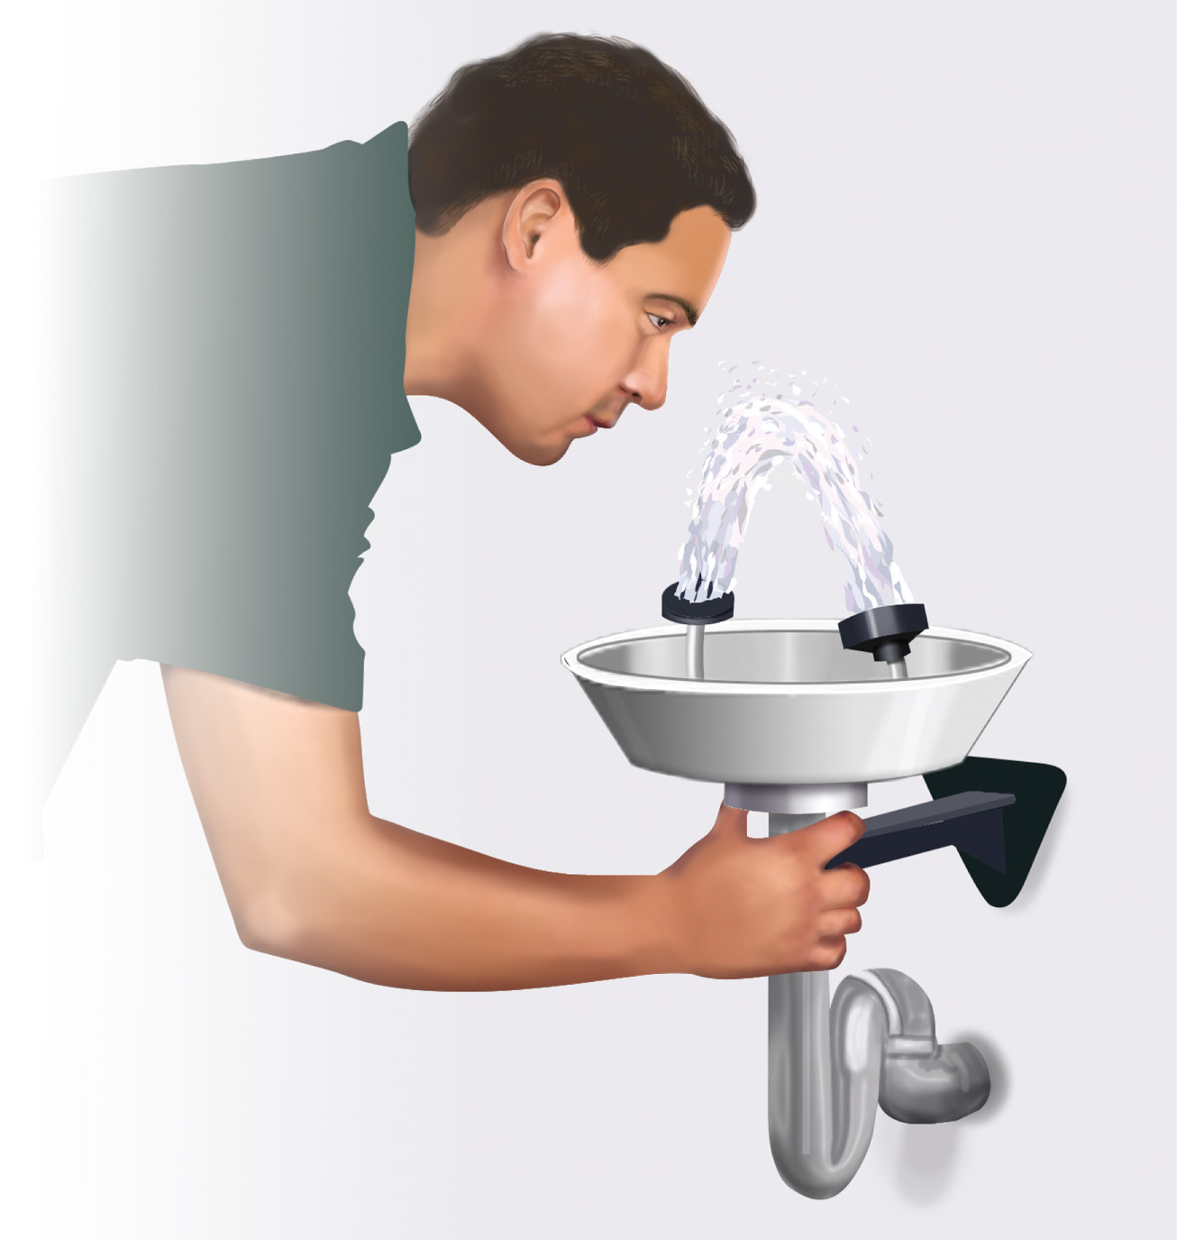
Irrigate the Chemical Burn to the Eye with Large Amounts of Water
Notes:
Do not use any irrigants other than sterile saline available on the ambulance or clean tap water.

Slide 43
Specific Injuries to the Eye, Face, and Neck (11 of 26)
Injuries to the Eye
  Assessment and Care Guidelines
    Impaled object or extruded eyeball
      Do not remove an impaled object; stabilize it in place.
      Do not manipulate the eye.
      Protect the injured eye with an eye shield or cup.
      Bandage both eyes.
Notes:
Treatment for both is the same. Place the patient supine and immobilize the head and spine. Encircle the eye and the impaled object or extruded eyeball with a gauze dressing or other suitable material, such as soft, sterile cloth. Do not apply pressure.

Slide 44
Extruded Eyeball
(© David Effron, M D)
Notes:
Although an impaled object in the eye or extruded eyeball should be treated with great urgency, you should not manipulate the eye during treatment.

Slide 45
E M T Skills 33-2
Emergency Care—Impaled Object in the Eye

Slide 46
Place Padding around the Object
Notes:
Encircle the eye and the impaled object or extruded eyeball with a gauze dressing or other suitable material such as soft, sterile cloth. Do not apply pressure.

Slide 47
Bandage the Cup in Place
Notes:
Place a metal shield, crushed paper cup, or cone over the impaled object or extruded eyeball. Do not use a Styrofoam cup because it can crumble. The impaled object or eyeball should not touch the top or sides of the cup.

Slide 48
Emergency Care Protocol: Eye Injury (1 of 5)
Consider spine motion restriction based on mechanism of injury.
Establish and maintain an open airway. Insert a nasopharyngeal or oropharyngeal airway if the patient is unresponsive and has no gag or cough reflex.
Suction secretions as necessary.
If breathing is inadequate, provide positive pressure ventilation with supplemental oxygen at a minimum rate of 10–12 ventilations/minute for an adult and 12–20 ventilations/minute for an infant or child.
If breathing is adequate and other injuries are present, in addition to the eye injury, with suspected bleeding or poor perfusion, administer a high concentration of oxygen to maintain an S p O2 of greater than 95%.

Slide 49
Emergency Care Protocol: Eye Injury (2 of 5)
Control any major bleeding.
Place the patient in a supine position.
Treat the specific eye injury as follows:
  Foreign Object in Eye:
    If possible, transport the patient for further evaluation and removal of object by emergency department staff.
    Only attempt removal of objects in the conjunctiva. Do not attempt removal of objects on or lodged in the cornea.
    To remove a foreign object from the conjunctiva: Flush with water.
    If not successful and the object is under the upper lid, draw the upper lid down over the lower lid.

Slide 50
Emergency Care Protocol: Eye Injury (3 of 5)
If the object remains, lift the lid with a cotton swab or similar object and remove with a corner of the sterile gauze or swab.
Orbital Injury:
If the eyeball has not been injured, place ice packs over the injured eye.
If the eyeball is injured, do not use cold packs. (Refer to the following information on management of a globe injury.)
Lid Injury:
Control bleeding with light pressure; do not use pressure if the eyeball is injured.
Cover the lid with sterile gauze soaked in saline. Preserve avulsed skin and transport with the patient.
If eyeball injury is not suspected, cover the lid with a cold compress. Patch both eyes.

Slide 51
Emergency Care Protocol: Eye Injury (4 of 5)
Injury to the Globe:
Apply patches to both eyes.
Do not apply any type of pressure.
Apply an eye shield to the injured eye.
Keep the patient supine.
Chemical Burn to Eye:
Begin irrigation with water or saline immediately and for at least 20 minutes or until arrival at the hospital
Do not contaminate the uninjured eye.
Force the lids open if necessary to flush.
Remove contact lenses.
Remove solid particles from the eye surface with a
moistened cotton swab.

Slide 52
Emergency Care Protocol: Eye Injury (5 of 5)
Continue to irrigate en route to the medical facility.
Provide continued spine motion restriction if you suspect spine injury.
Transport.
Perform a reassessment every 5 minutes if unstable and every 15 minutes if stable.

Slide 53
Specific Injuries to the Eye, Face, and Neck (12 of 26)
Injuries to the Eye
  Removing Contact Lenses
    Contact lenses may need to be removed when there is an eye injury.
    Check both eyes; patients may wear one contact lens or wear both contact lenses and glasses.
    Consult medical direction about removing contact lenses.
Notes:
Generally, you should remove contact lenses if:
There has been a chemical burn to the eye.
The patient is unresponsive and is wearing hard contact lenses, and transport time will be lengthy or delayed.
Generally, you should not remove contact lenses if:
The eyeball is injured (other than a chemical burn).
Transport time is short enough to allow emergency department personnel to remove the lenses.

Slide 54
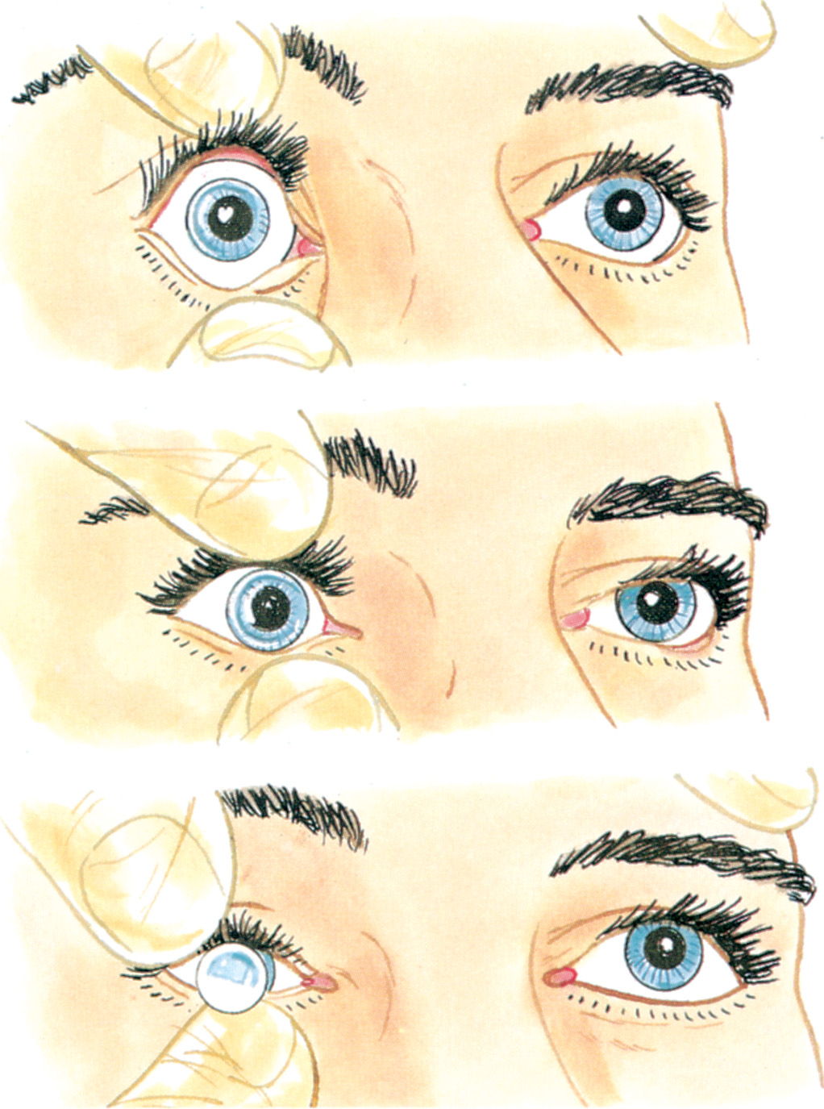
Removing Hard Corneal Contact Lenses
Notes:
You can remove soft lenses with the following method:
With your middle fingertip on the lower lid, pull the lid down.
Place your index fingertip on the lower edge of the lens, then slide the lens down to the sclera, or white of the eye.
Compress the lens gently between your thumb and index finger, allowing air to get underneath it, and remove it from the eye.
If the lens has dehydrated on the eye, run sterile saline across the eye surface, slide the lens off the cornea, and pinch it up to remove it.
Store the removed soft contact lens in water or a saline solution.

Slide 55
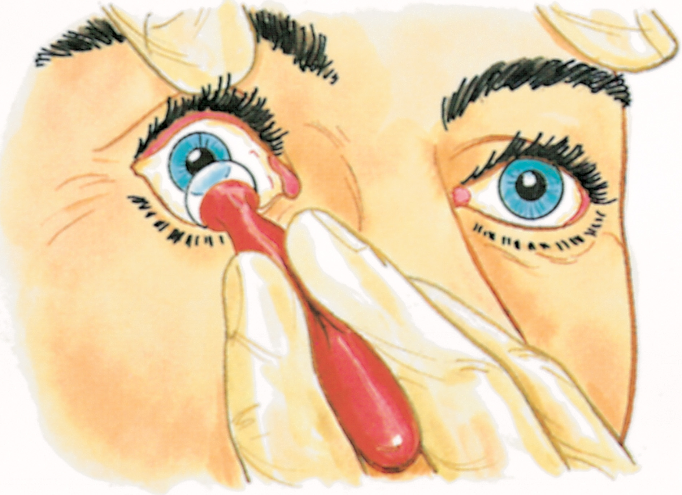
Using a Moistened Suction Cup to Remove a Hard Contact Lens
Notes:
Removing hard contact lenses:
Separate the eyelids.
Position the visible lens over the cornea by manipulating the eyelids.
Place your thumbs gently on the top and bottom eyelids, and open the eyelids wide.
Gently press the eyelids down and forward to the edges of the lens.
Press the lower eyelid slightly harder and move it under the bottom edge of the lens.
Move the eyelids toward each other, then slide the lens out between them.

Slide 56
An adult patient presents with a complaint of eye pain after being struck in the eye by debris from a metal grinder
His right eye is watery and red, and he has difficulty keeping it open. You are able to see a metal shaving that appears to be superficially embedded in the cornea. Click on the action that is most appropriate in the prehospital management of this patient.
A. Use a cotton-tipped applicator to dislodge the metal shaving.
B. Aggressively irrigate the eye with normal saline to dislodge the metal shaving.
C. Bandage both eyes.
D. Cover the right eye with a metal eye shield taped in place.

Slide 57
Specific Injuries to the Eye, Face, and Neck (13 of 26)
Injuries to the Face
  Facial injuries pose a risk of airway compromise.
    Pay particular attention to airway management.
    Be prepared to suction.
  With significant facial trauma, suspect cervical spine trauma and brain injury.
Notes:
Discussion Question
What are the primary complications of facial injury?
What are your concerns for a patient whose injury results in missing teeth?
Critical Thinking Discussion
A patient received a glancing shotgun blast to the right side of the face, which was largely destroyed. They are alert and oriented, though extremely distraught. They have a large amount of bleeding from the wounds, but are able to manage their airway as long as they are sitting up. Given the mechanism of injury, you are aware that there is some risk of cervical spinal injury. How will you balance airway management with concern over the cervical spine?

Slide 58
Soft Tissue and Bone Injury to the Mandible
(© Edward T. Dickinson, M D)
Notes:
The specialized structures of the face, prone to injury because of their location, can be permanently damaged.

Slide 59
Injury to the Face (1 of 2)
(© David Effron, M D)
Notes:
Many injuries of the face stem from impacts strong enough to cause cervical spinal damage or a skull fracture.

Slide 60
Injury to the Face (2 of 2)
(© David Effron, M D)
Notes:
Many such injuries are life-threatening because they compromise the upper airway.

Slide 61
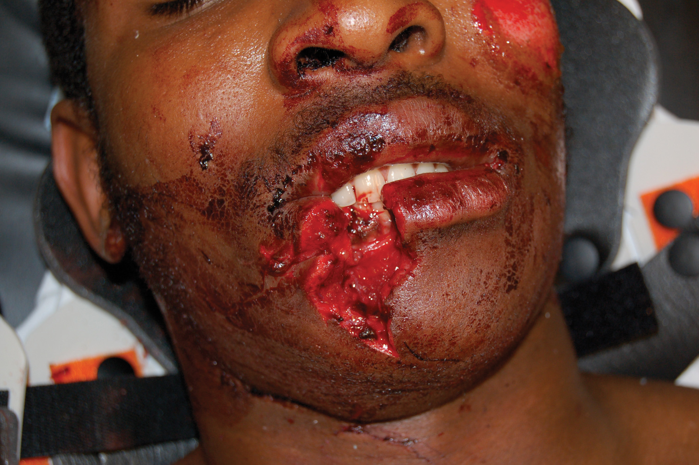
Injuries to the Mouth, Jaw, Cheek, and Chin
(© Edward T. Dickinson, M D)
Notes:
Facial injuries might need aggressive maneuvers to establish and maintain an airway.

Slide 62
Injuries to the Jaw, Cheek, and Chin
(© David Effron, M D)
Notes:
Injuries to the face are quite common. Approximately 75 percent of all those involved in motor vehicle accidents sustain at least minor facial trauma.

Slide 63
Specific Injuries to the Eye, Face, and Neck (14 of 26)
Injuries to the Face
  Assessment and Care Guidelines
    Establish and maintain in-line spinal stabilization.
    Establish and maintain a patent airway.
    Be prepared to suction the immobilized patient.
    When the mandible is fractured, it is generally broken in two places and will be unstable.
Notes:
In any case of severe facial trauma, suspect possible cervical spinal injury. Take the necessary spinal motion restriction precautions.

Slide 64
Specific Injuries to the Eye, Face, and Neck (15 of 26)
Injuries to the Face
  Assessment and Care Guidelines
    In establishing and maintaining an airway:
      Inspect the mouth for fragments of teeth, bone, soft tissue, or foreign objects.
      Leave dentures in place if they are secure; remove broken or loose dentures.
      The tongue may need to be pulled forward if it has lost its support structure.
Notes:
In facial injury, the tongue can lose its support structure and may fall back, occluding the airway. Open the airway using a jaw-thrust maneuver and, if necessary, grasp the tongue to pull it forward. If possible, insert an oropharyngeal airway.

Slide 65
Specific Injuries to the Eye, Face, and Neck (16 of 26)
Injuries to the Face
  Assessment and Care Guidelines
    In establishing and maintaining an airway:
      Suction the airway as needed.
      Request A L S, if needed, for advanced airway management.
Notes:
Suction any blood, vomitus, secretions, or small debris from the mouth and oropharynx throughout treatment and transport.

Slide 66
Specific Injuries to the Eye, Face, and Neck (17 of 26)
Injuries to the Face
  Assessment and Care Guidelines
    Emergency care for injuries to the face:
      Maintain an S p O₂ greater than or equal to 94%; provide positive pressure ventilation if breathing is inadequate.
      Control severe bleeding.
      Cover exposed nerves, tendons, or blood vessels with a moist, sterile dressing.
      Treat for shock; transport.
Notes:
Control severe bleeding. Several major arteries run through the face, and they can bleed profusely and rapidly enough to cause death, if left unmanaged. Use direct pressure and pressure dressings. Apply pressure gently if you suspect fractured or shattered bones under the wound, as pressure can further obstruct an already-endangered airway.

Slide 67
Specific Injuries to the Eye, Face, and Neck (18 of 26)
Injuries to the Face
  Assessment and Care Guidelines
    Avulsed tooth
      Gently rinse the tooth with saline to remove debris; transport the tooth in a cup of saline or in saline-soaked gauze.
      Do not handle the tooth by the root.
      If you cannot find teeth assume that the patient has swallowed or aspirated them.
      Control socket bleeding with a gauze pad.
Notes:
If a tooth has been lost, try to find it. The tooth might be reimplanted.

Slide 68
Specific Injuries to the Eye, Face, and Neck (19 of 26)
Injuries to the Face
  Assessment and Care Guidelines
    Injury to the mid-face, or upper or lower jaw
      Stabilize the spine.
      Manage the airway and support breathing.
      Control bleeding.
      Request A L S for difficult-to-manage airway or ventilation.
Notes:
Signs and symptoms of fracture or other severe trauma to the midface, upper jaw, and lower jaw:
Numbness or pain
Distortion of facial features
Crepitation
Irregularities in the facial bones that can be felt before swelling occurs
Severe bruising and swelling, black eyes
Distance between the eyes too wide or eyes not level
Bleeding from the nose and mouth
Diplopia (when the orbit is fractured)
Limited jaw motion
Palpable movement to the maxilla
Teeth not meeting normally (malocclusion)
Hematoma (collection of blood) under the tongue
Limited jaw motion
Mouth open or patient unable to open the mouth
Saliva mixed with blood flowing from the mouth
Drooling (pain prevents the patient from swallowing)
Painful or difficult speech
Missing, loosened, or uneven teeth (Even if teeth are not missing, the patient may complain that teeth do not “fit together right.”)
Pain around the ears
Elevation of the tongue

Slide 69
Emergency Care Protocol: Facial Injury (1 of 5)
Provide motion restriction if spinal injury is suspected.
Establish and maintain an open airway. Avoid using a nasopharyngeal airway if there is midface or nasal trauma.
Suction blood and secretions as necessary. Remove any broken teeth or loose bone fragments from the mouth.
If dentures are in the mouth and secure, leave them in place. If the dentures are loose, remove them.
If breathing is inadequate, provide positive pressure ventilation with supplemental oxygen at a minimum rate of 10–12 ventilations/minute for an adult and 12–20 ventilations/minute for an infant or child.
Notes:
Review possible emergency care for facial injuries.

Slide 70
Emergency Care Protocol: Facial Injury (2 of 5)
If breathing is adequate, administer oxygen based on the S p O ₂ reading and patient signs and symptoms. If there is, severe blood loss, head injury, or signs of hypoxia or respiratory distress are present, or the S p O ₂ reading is less than 95%, administer O₂ to maintain an S p O ₂ of 95% or greater.
Control any major bleeding.
Apply a moist sterile dressing to any exposed nerves, tendons, or blood vessels.
Treat specific injuries as follows:
Avulsed Tooth:
Rinse with saline; do not scrub or handle the tooth by the root.
Place in a cup with sterile saline or wrap in gauze soaked in sterile saline.
Do not wrap in dry gauze.

Slide 71
Emergency Care Protocol: Facial Injury (3 of 5)
Control the bleeding from the tooth socket with a gauze pad. Make sure that the pad does not work loose and become an airway obstruction.
Foreign Object in Cheek:
If the object did not penetrate completely through the cheek or is not loose, use bulky dressings to stabilize the object in place.
If the object penetrated through to other side of the cheek and is loose, do the following:
Push or pull the object out of the cheek in the same direction it entered.
Pack with dressings between the teeth and wound; make sure dressings do not work loose and become an airway obstruction.
Dress and bandage outside of wound.
Suction blood as necessary.

Slide 72
Emergency Care Protocol: Facial Injury (4 of 5)
Injury to Nose:
Manage as a soft tissue injury.
Position the patient to allow blood to drain.
Do not pack the nose.
Transport if a foreign body is in the nose.
Apply cold compresses if a nose fracture is suspected.
Injury to Ear:
Manage as a soft tissue injury.
Save avulsed parts; wrap in saline-soaked gauze and transport with patient.
Place part of dressing between the ear and side of head.
Do not probe into the ear.

Slide 73
Emergency Care Protocol: Facial Injury (5 of 5)
Do not pack the ear.
Place a loose dressing over the ear to absorb blood and fluid; do not apply pressure.
Do not attempt to remove foreign objects in the ear.
Provide continued spine motion restriction if you suspect spinal injury.
Transport.
Perform a reassessment every 5 minutes if unstable and every 15 minutes if stable.

Slide 74
Specific Injuries to the Eye, Face, and Neck (20 of 26)
Injuries to the Face
  Assessment and Care Guidelines
    Impaled object in the cheek
      Remove the object if it jeopardizes the airway.
      Pack dressing material between the teeth and the wound, but secure the dressing to prevent airway compromise.
      Control bleeding.
      Suction frequently.
Notes:
If the patient has a foreign object impaled in the cheek, stabilize it with bulky dressings and transport the patient. If the object has penetrated all the way through the cheek and is loose, such that it may fall into the mouth and obstruct the airway, you must remove it.

Slide 75
Specific Injuries to the Eye, Face, and Neck (21 of 26)
Injuries to the Face
  Assessment and Care Guidelines
    Injury to the nose
      Monitor the airway.
      Position the patient to prevent blood from being swallowed or draining into the airway.
      Do not attempt to remove foreign bodies in the nose.
Notes:
Soft tissue injuries to the nose should be assessed and cared for as you would other soft tissue injuries. Take special care to maintain an open airway, and position the patient so that blood does not drain into the oropharynx or pharynx. Nasal fractures are the most common type of facial fracture because of the delicate structure of the nose.

Slide 76
Injury to the Nose
(© David Effron, M D)
Notes:
If a nasal fracture involves only the cartilaginous septum, it usually results in deformity, swelling, pain, and minor hemorrhage. If, however, the trauma is severe enough to break the underlying nasal bones and deeper nasal structures, such as the ethmoid bones, significant hemorrhaging can occur.

Slide 77
Specific Injuries to the Eye, Face, and Neck (22 of 26)
Injuries to the Face
  Assessment and Care Guidelines
    Injury to the ear
      Treat for soft-tissue injury; transport any avulsed tissue.
      Do not attempt to remove foreign bodies in the ear.
Notes:
Foreign objects in the external ear are a common problem among children. Do not attempt to remove the object. Instead, reassure the child and parent and transport the patient to the hospital.

Slide 78
Injury to the Ear (1 of 2)
(© David Effron, M D)
Notes:
When dressing an injured ear, place part of the dressing between the ear and the side of the head. As a rule, don’t probe into the ear. Never pack the ear to stop bleeding from the ear canal.

Slide 79
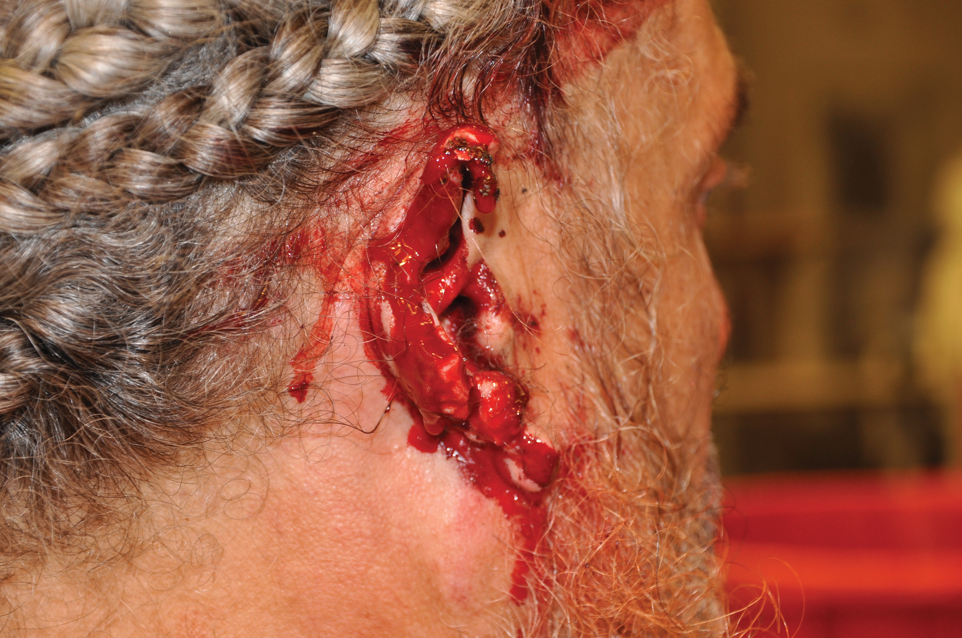
Injury to the Ear (2 of 2)
(© Edward T. Dickinson, M D)
Notes:
Clear or bloody fluid draining from the ear can indicate a skull fracture. Place a loose, clean dressing across the opening of the ear to absorb blood and fluids, but do not exert pressure to stop the bleeding.

Slide 80
Specific Injuries to the Eye, Face, and Neck (23 of 26)
Injuries to the Neck
  May be caused by blunt or penetrating trauma.
  Complications include bleeding, air embolism, airway compromise, and cervical spine injury.
Notes:
If the neck is lacerated, bleeding from a major artery or vein can occur. Air can enter a lacerated vein. Other common consequences of neck injuries are a fractured larynx and a collapsed trachea.
Discussion Questions
What is subcutaneous emphysema? How does it occur?
How can air embolism occur in the patient with an injury to a jugular vein?

Slide 81
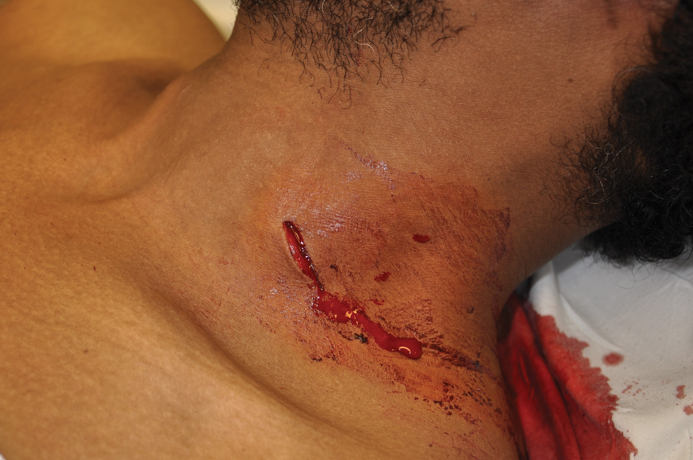
Injury to the Neck (1 of 2)
(© Edward T. Dickinson, M D)
Notes:
Common causes include hanging (accidental or intentional), impact with a steering wheel, knife wounds, gunshot wounds, or running or riding into a stretched wire or clothesline.

Slide 82
Injury to the Neck (2 of 2)
(© Edward T. Dickinson, M D)
Notes:
Other common consequences of neck injuries are a fractured larynx and a collapsed trachea.

Slide 83
Specific Injuries to the Eye, Face, and Neck (24 of 26)
Injuries to the Neck
  Signs and symptoms include:
    Swelling, bruising, hematoma formation
    Difficulty speaking
    Change in or loss of voice
    Subcutaneous emphysema
    Airway obstruction
    Crepitation while speaking
    Displacement of the trachea to one side
Notes:
Maintaining an airway is extremely important in neck injuries, because, in addition to swelling or presence of damaged airway structures or debris such as bone fragments, blood will clot when it is exposed to air and can threaten the airway. Maintain a high index of suspicion for possible cervical spinal injury.

Slide 84
Specific Injuries to the Eye, Face, and Neck (25 of 26)
  Injuries to the Neck
  Management
    Spinal stabilization.
    Establish a patent airway.
    Maintain adequate oxygenation.
    Positive pressure ventilation for inadequate breathing.
    Control severe bleeding.
    Treat for shock.
Notes:
To treat a neck injury, use proper Standard Precautions and take spinal motion restriction precautions. Establish a patent airway, maintain adequate oxygenation with supplemental oxygen, if necessary, or provide positive pressure ventilation with supplemental oxygen if breathing is inadequate. Control severe bleeding, treat for shock, and transport.

Slide 85
Specific Injuries to the Eye, Face, and Neck (26 of 26)
Jugular vein laceration
  Air may enter the injured vessel, resulting in air embolism.
  Quickly apply an occlusive dressing.
Notes:
A jugular vein laceration can permit development of an air embolism, because venous pressure drops below atmospheric pressure during deep inhalation if the patient is breathing spontaneously.

Slide 86
E M T Skills 33-8
Emergency Care—Severed Blood Vessel of the Neck

Slide 87
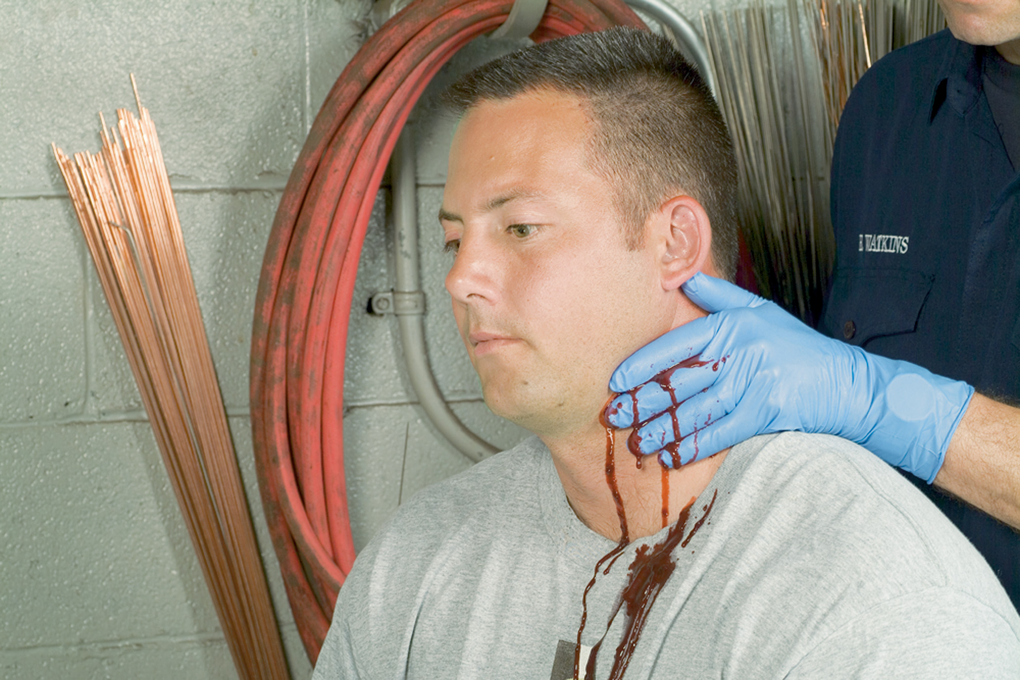
Place a Gloved Hand over the Wound to Control Bleeding
Apply pressure to the carotid artery only if necessary to control bleeding. Never apply pressure to both sides of the neck at the same time.
Notes:
Control any major bleeding from the neck by applying direct pressure.

Slide 88
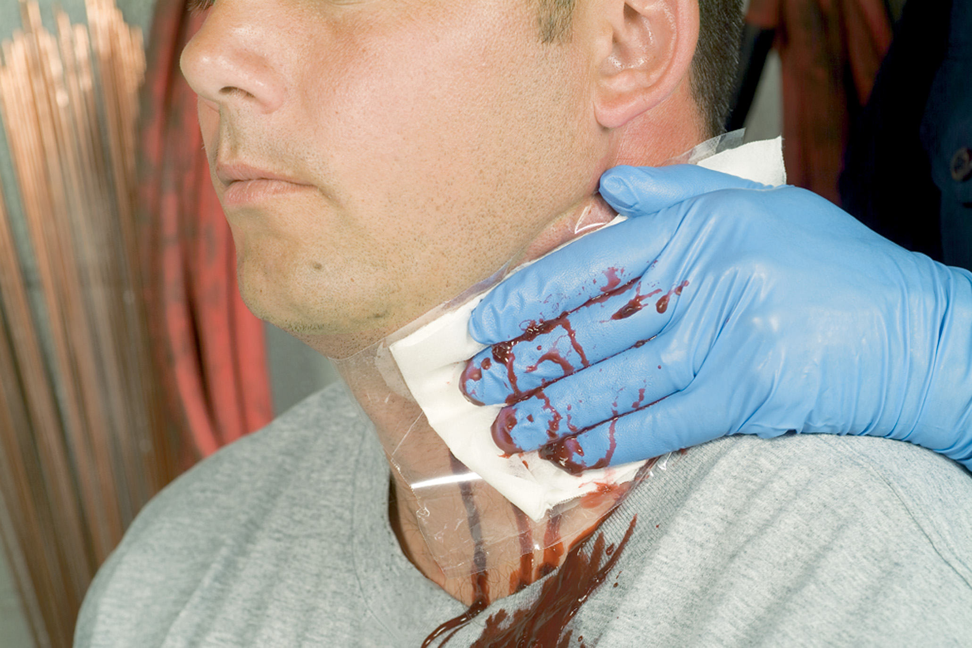
Apply an Occlusive Dressing, Which Should Extend Beyond all Edges of the Wound to Avoid Being Sucked into the Wound
Cover the occlusive dressing with a regular dressing. Apply only enough pressure to control the bleeding.
Notes:
If severe blood loss, head injury, or signs of hypoxia or respiratory distress are present, or the SpO₂ reading is less than 95percent, administer O to maintain the SpO₂ at 95 percent or greater. Apply a nonporous dressing, taped on four sides.

Slide 89
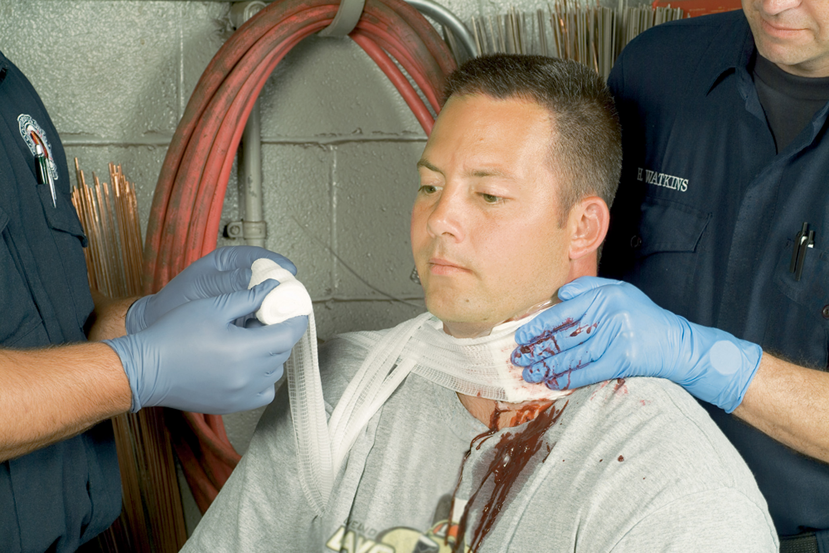
Once Bleeding is Controlled, Apply a Pressure Dressing
A figure-eight bandage is wrapped over the dressing, across one shoulder, across the back, under the opposite armpit, and anchored at the shoulder.
Notes:
Establish and maintain an open airway. Avoid using a nasopharyngeal airway if there is midface or nasal trauma.

Slide 90
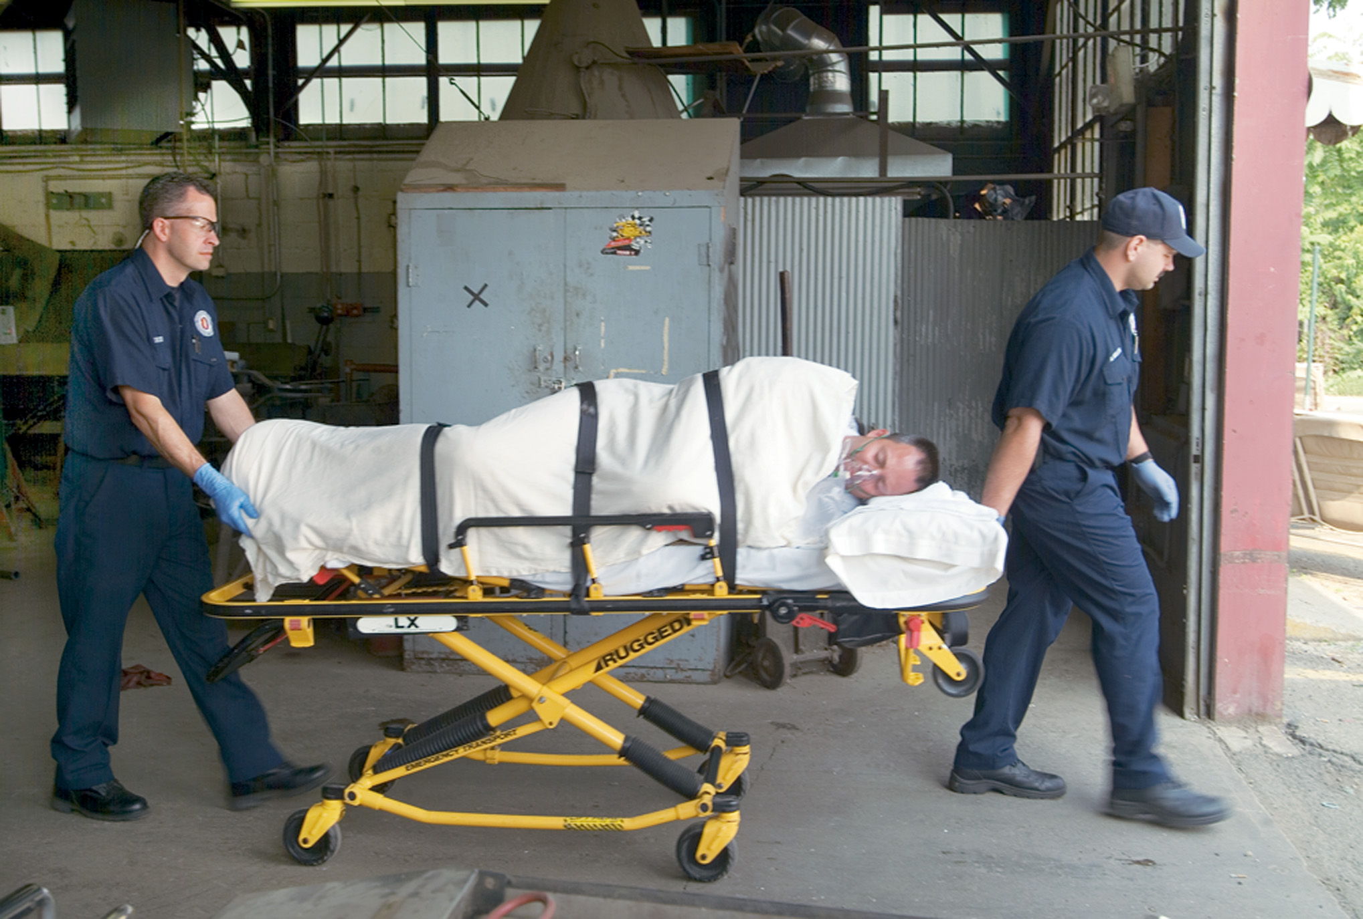
If Spinal Injury is not Suspected, Position the Patient on his Left Side, Head Tilted Downward
(If spinal injury is suspected and the patient is immobilized to a spine board, board and patient can be turned and tilted as a unit.) Continue administration of oxygen. Care for shock, and transport.
Notes:
Provide continued spinal motion restriction if you suspect spinal injury.

Slide 91
Case Study Conclusion (1 of 2)
Paul immediately provides in-line stabilization of the spine and a jaw-thrust maneuver, as Jeremy prepares suction. The patient is awake, but is uncooperative and confused. A nasopharyngeal airway is contraindicated because of massive mid-facial trauma.
Instability of the mandible makes manual positioning of the airway difficult. Jeremy immediately requests A L S backup for advanced airway management.
Notes:
Review Case Study Conclusion and emphasize the application of knowledge learned from this presentation.

Slide 92
Case Study Conclusion (2 of 2)
The patient’s breathing is adequate, and he has a strong, regular radial pulse.
The E M T s immobilize the patient to a long backboard while continuing basic airway management. A L S arrives; the paramedic sedates and intubates the patient, and the crew begins transport to a trauma center.
The patient is found to have complex facial fractures that require surgery, as well as a cerebral contusion.
Notes:
Review Case Study Conclusion and emphasize the application of knowledge learned from this presentation.

Slide 93
Lesson Summary (1 of 2)
Severe facial or neck injuries can be clinically challenging.
Patients can require emotional support as well as care of the injuries.
Notes:
Follow-Up
Answer student questions.
Follow-Up Assignments
Review Chapter 33 Summary.
Complete Chapter 33 In Review questions.
Complete Chapter 33 Critical Thinking questions.
Assessments
Handouts
Chapter 33 quiz

Slide 94
Lesson Summary (2 of 2)
Keep in mind the possibility of spinal and traumatic brain injuries in association with facial and neck injuries.
Airway management is critical and can be complicated in patients with facial and neck trauma.
Notes:
Class Activity
As an alternative to assigning the follow-up exercises in the lesson plan as homework, assign each question to a small group of students for in-class discussion.
Teaching Tips
Answers to In Review questions are in the appendix of the text. Advise students to review the questions again as they study the chapter.

Slide 95
Correct!
The best course of action in this case is to bandage both eyes to minimize movement of the injured eye and transport. Do not attempt to remove any object embedded in the eye.
Click here to return to the program.

Slide 96
Incorrect (1 of 3)
Never attempt to remove an embedded object from the eye.
Click here to return to the quiz.

Slide 97
Incorrect (2 of 3)
Never attempt to remove an embedded object from the eye. Many E M S system protocols do not allow irrigation except in the case of chemical exposure of the eye.
Click here to return to the quiz.

Slide 98
Incorrect (3 of 3)
When one eye is injured, both eyes should be bandaged to minimize movement, since the eyes move together.
Click here to return to the quiz.

Slide 99
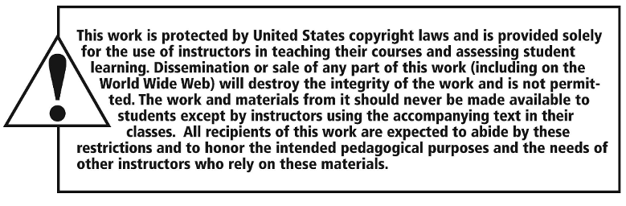
Copyright

