Slide 1

Prehospital: Emergency Care
Eleventh Edition
Chapter 30
Musculoskeletal Trauma
"Slides in this presentation contain hyperlinks. JAWS users should be able to get a list of links by using INSERT+F7"
Copyright © 2018, 2014, 2010 Pearson Education, Inc. All Rights Reserved
Notes:
If this PowerPoint presentation contains mathematical equations, you may need to check that your computer has the following installed:
1) MathType Plugin
2) Math Player (free versions available)
3) NVDA Reader (free versions available)
Advance Preparation
Student Readiness
Assign the associated section of MyBRADYLab and review student scores. Review the chapter material in the Instructor Resources, which includes Student Handouts, PowerPoint slides, and the MyTest Program.
Prepare
Make copies of course policies and procedures, the syllabus, handouts from the Instructor Resources, and other materials for distribution or post them in your learning management system.
Preview the media resources and Master Teaching Notes in this lesson.
Preview the Case Study presented in the PowerPoint slides.
The total teaching time recommended is only a guideline. Take into consideration factors such as the pace at which students learn, the size of the class, breaks, and classroom activities. The actual time devoted to teaching objectives is the instructor’s responsibility.

Slide 2
Learning Readiness
E M S Education Standards, text p. 896.
Chapter Objectives, text p. 896.
Key Terms, text p. 896.
Purpose of lecture presentation versus textbook reading assignments.
Notes:
Explain to students what the National EMS Education Standards are. The National EMS Education Standards communicate the expectations of entry-level EMS providers. As EMTs, students will be expected to be competent in these areas. Acknowledge that the standards are broad, general statements. Although this lesson addresses the listed competencies, the competencies are often complex and require completion of more than one lesson to accomplish. The student is also expected to review the chapter objectives to foreshadow what will be in the chapter. By mastering the key terms the EMT student will better understand the learning and be able to communicate more clearly.
Additionally, explain to the students that the purpose of using these slides is to help keep the instructor focused on highlighting important portions of the material, explain interrelationships of topics, and discuss how to apply this information. It’s not the intent of the presentation (or slides alone) to include every component in the chapter. This presentation still requires the student to thoroughly read the chapter.

Slide 3
Setting the Stage
Overview of Lesson Topics
  Musculoskeletal System Review
  Injuries to Bones and Joints
  Basics of Splinting
  Nontraumatic Fractures
Notes:
These bulleted points are the major headings from the chapter, in order. Their purpose is to provide a basic lecture navigation for the student.

Slide 4
Case Study Introduction
Forty-five-year-old Dominique Foster rushes out the door of her office building. “Running late, as usual,” she thinks. As she steps off the curb onto the parking lot, she slips on a patch of ice and pitches to the left. Her left arm shoots out reflexively to stop her fall. As she lands on her outstretched hand, Dominique simultaneously hears and feels a snap just above her left wrist.
Notes:
Case Study
Present the Case Study Introduction provided in the PowerPoint slide set.
Lead a discussion using the Case Study questions provided on the subsequent slide(s).
The Case Study with discussion questions continues throughout the PowerPoint presentation.
Case Study Discussion
Use the Case Study content and questions to foreshadow the upcoming lesson content.

Slide 5
Case Study (1 of 5)
What are some safety considerations for the E M T s and patient in this scenario?
What signs and symptoms should the E M T s look for in their assessment?
Notes:
Use the Case Study content and questions to foreshadow the upcoming lesson content. Gauge the student’s responses as a guide of how well versed they are on this topic.

Slide 6
Introduction
Injuries to muscles, bones, and joints are common.
Such injuries vary in severity from minor to life-threatening.
Proper emergency care can prevent additional damage.
Notes:
During this lesson, students will learn to assess and treat a painful, swollen, or deformed extremity.

Slide 7
Musculoskeletal System Review (1 of 5)
Functions of the musculoskeletal system are:
  Giving the body shape
  Protecting the internal organs
  Providing for movement
  Storing salts and other materials
  Producing red blood cells.
Notes:
Teaching Tips
Since this section is review material, rely more heavily on questioning students rather than providing information.
Knowledge Application
Students should be able to use the information in this section to assess and describe musculoskeletal injuries.
Discussion Question
What happens to the shape of the muscles when they contract?

Slide 8
Musculoskeletal System Review (2 of 5)
The Muscles
  Three Muscle Types
    Voluntary (skeletal)
      Major muscle mass of the body
      Allows movement
    Involuntary (smooth)
      Internal organs
    Cardiac
      Heart
Notes:
Muscles can be injured in many ways. Overexerting a muscle can break fibers, and muscles subjected to trauma can be bruised, crushed, cut, torn, or otherwise injured, even if the skin is not broken. Muscles injured in any way tend to become swollen, tender, painful, or weak.

Slide 9
Musculoskeletal System Review (3 of 5)
Tendons and Ligaments
  Tendons connect muscle to bone.
  Ligaments connect bone to bone.
Cartilage
  Cartilage, an extension of the bone end, is composed of connective tissue.
  Cartilage allows the bones to ride over each other during movement with relatively little friction.
Notes:
Just like muscles, tendons and ligaments can be bruised, crushed, cut, or torn. They are included in the category of musculoskeletal injuries.
Cartilage acts as a shock absorber between bone surfaces. Cartilage can be injured, leading to joint pain.
Discussion Question
What is the function of cartilage?

Slide 10
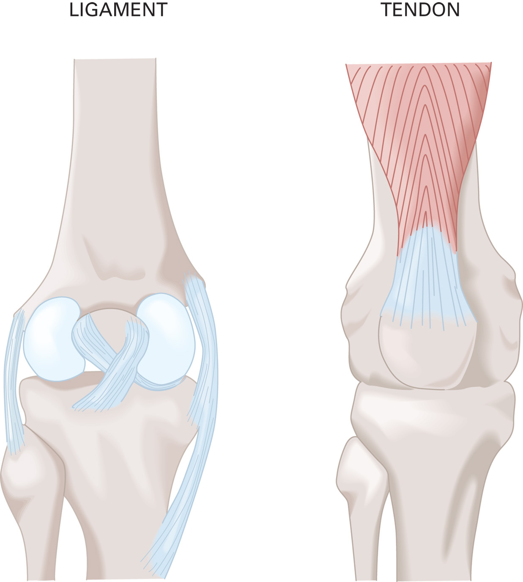
Ligaments Connect Bone to Bone. Tendons Attach Muscle to Bone
Notes:
Tendons and ligaments are, in a sense, the glue that holds the body together.

Slide 11
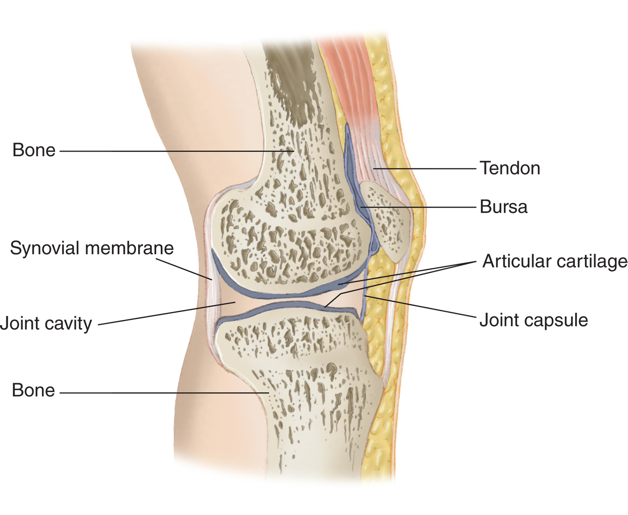
Structure of a Joint
Notes:
As the body’s structural framework, the skeleton must be strong enough to provide support and protection as well as jointed to permit motion.

Slide 12
Musculoskeletal System Review (4 of 5)
The Skeletal System
  The skeleton supports the body.
  The six types of motion are:
    Flexion
    Extension
    Adduction
    Abduction
    Rotation
    Circumduction.
Notes:
Flexion - This bending motion moves the extremity toward the body.
Extension - This bending motion moves the extremity away from the body.
Adduction - This is a movement of a body part toward the midline of the body.
Abduction - This is a movement of a body part away from the midline of the body.
Rotation - This movement turns the body along the axis of a bone or joint.
Circumduction - This is a movement through an arc of a circle or in a circular motion from a central point.
Discussion Questions
What are the components of the appendicular skeleton?
Where is the greater trochanter of the femur?
Class Activity
Assign groups of students to prepare presentations to review the musculoskeletal system. Divide the following topics among the groups: Skeletal Muscle, Axial Skeleton, Shoulder Girdle and Upper Extremities, Pelvis and Lower Extremities, and Types of Joint Movements. Give students 20 minutes to prepare before reporting back to the class.

Slide 13
Musculoskeletal System Review (5 of 5)
The Skeletal System
  Axial Skeleton
    Composed of the head, thorax, and vertebral column
  Appendicular Skeleton
    Made up of the bones in the extremities, including the shoulder girdle and the pelvis
Notes:
The skeletal system has six basic components: the skull, spinal column, thorax, pelvis, lower extremities, and upper extremities.

Slide 14
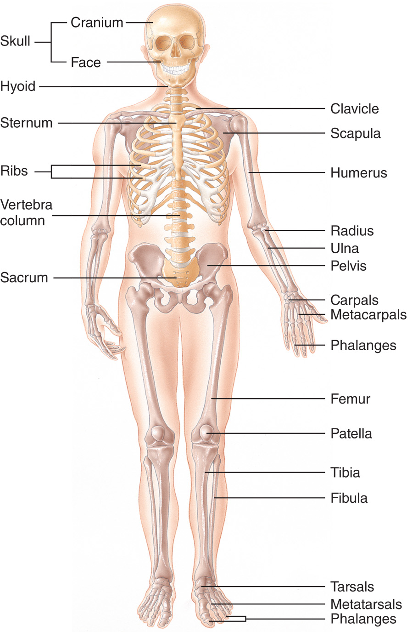
The Skeletal System
Notes:
The skeletal system supports the body, allowing it to stand erect.

Slide 15
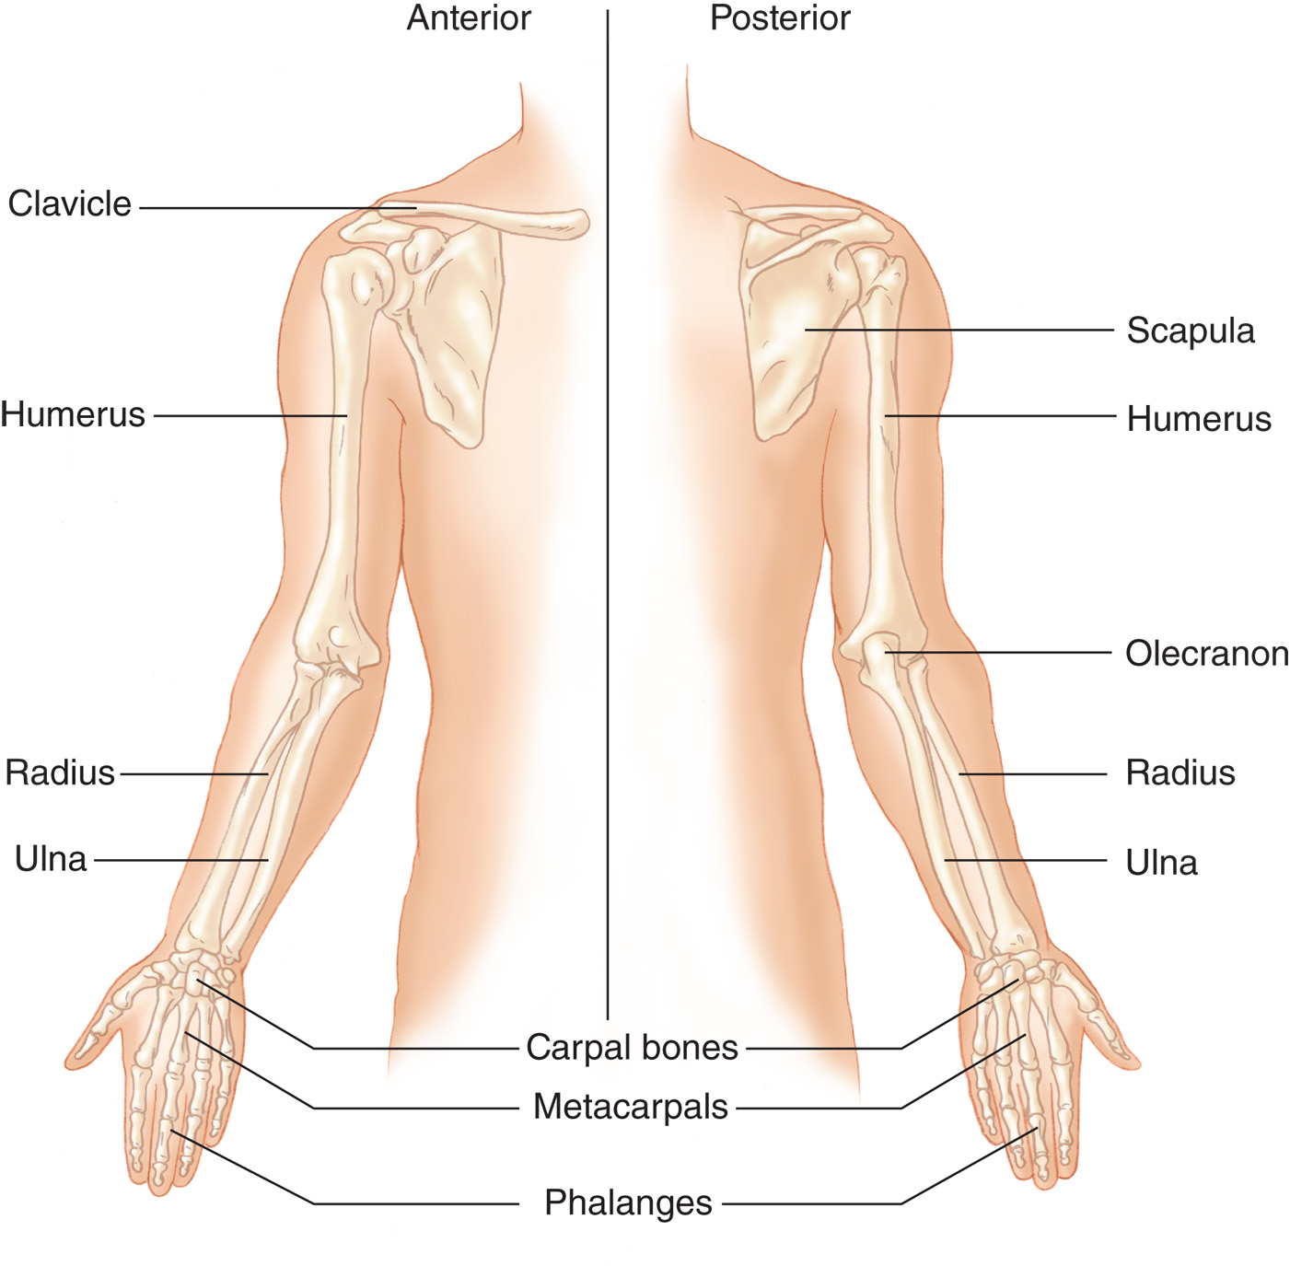
Bones of the Upper Extremity
Notes:
The upper extremity consists of the shoulder girdle, arm, forearm, and hand.
Bones of the upper extremity are:
• Clavicle (collarbone)
• Scapula (shoulder blade)
• Humerus
• Radius
• Ulna (including the olecranon)
• Carpal bones
• Metacarpals
• Phalanges

Slide 16
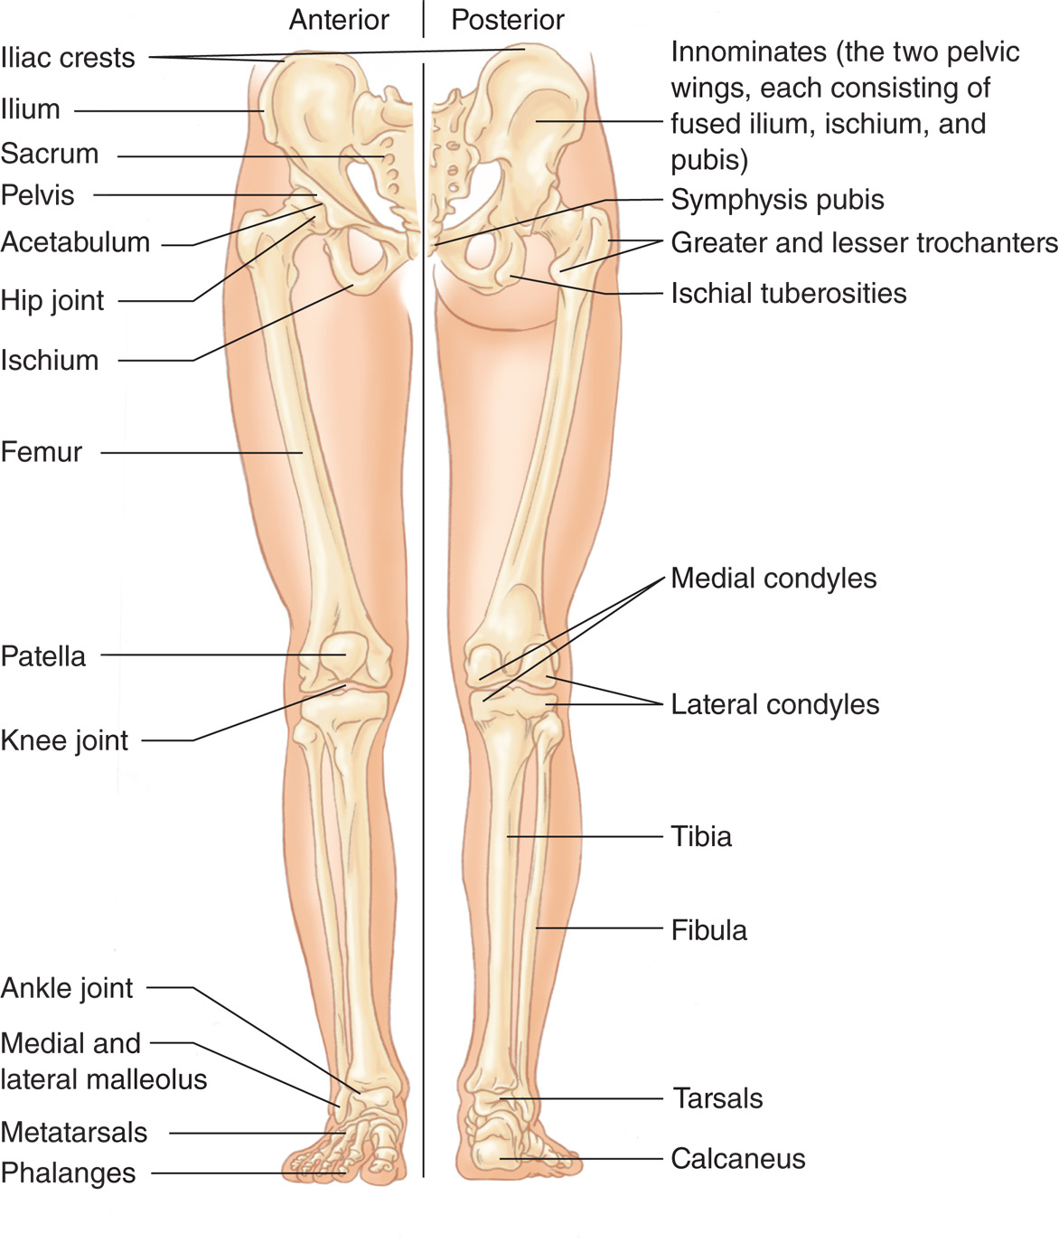
Bones of the Lower Extremity
Notes:
The lower extremity is made up of the pelvis, thigh, leg, and foot.
Bones of the lower extremity are:
• Pelvis (including the ilium, ischium, and pubis)
• Femur
• Patella (kneecap)
• Tibia
• Fibula
• Calcaneus (heel bone)
• Tarsals
• Metatarsals
• Phalanges.

Slide 17
Injuries to Bones and Joints (1 of 14)
Types of Injuries
  Fracture
    A fracture is a break in the continuity of a bone.
    A fracture may be open or closed.
    Displacement of bones can cause damage to surrounding tissues.
    Osteoporosis is a degenerative bone disorder.
Notes:
Osteoporosis is a degenerative bone disorder associated with an accelerated loss of minerals, primarily calcium, from the bone.
Teaching Tips
Obtain a variety of radiographs of orthopedic injuries and show them to the students.
Discussion Questions
Which joints are most commonly dislocated?
Why should you consider dislocations significant injuries?
Knowledge Application
Students should be able to recognize a painful, swollen, deformed extremity as well as other indications of musculoskeletal injury.

Slide 18
Injuries to Bones and Joints (2 of 14)
Types of Injuries
  Fracture — Signs and Symptoms
        Pain tenderness
        Deformity, discoloration
        Paresthesia or anesthesia
        Paresis or paralysis/inability to move the extremity
        Decreased pulse/perfusion
Notes:
Paresthesia distal to the fracture site, a tingling or abnormal sensation, can indicate nerve injury.
Anesthesia distal to the fracture site, a loss of feeling, can indicate nerve injury.
Paresis, or weakness, can indicate nerve injury.
Paralysis, a loss of muscle control, can indicate nerve injury.
Inability to move an extremity can indicate muscle or tendon damage.
Decreased pulse amplitude, increased capillary refill time, paresthesia, or pale, cool skin distal to the fracture site can indicate vessel injury.

Slide 19
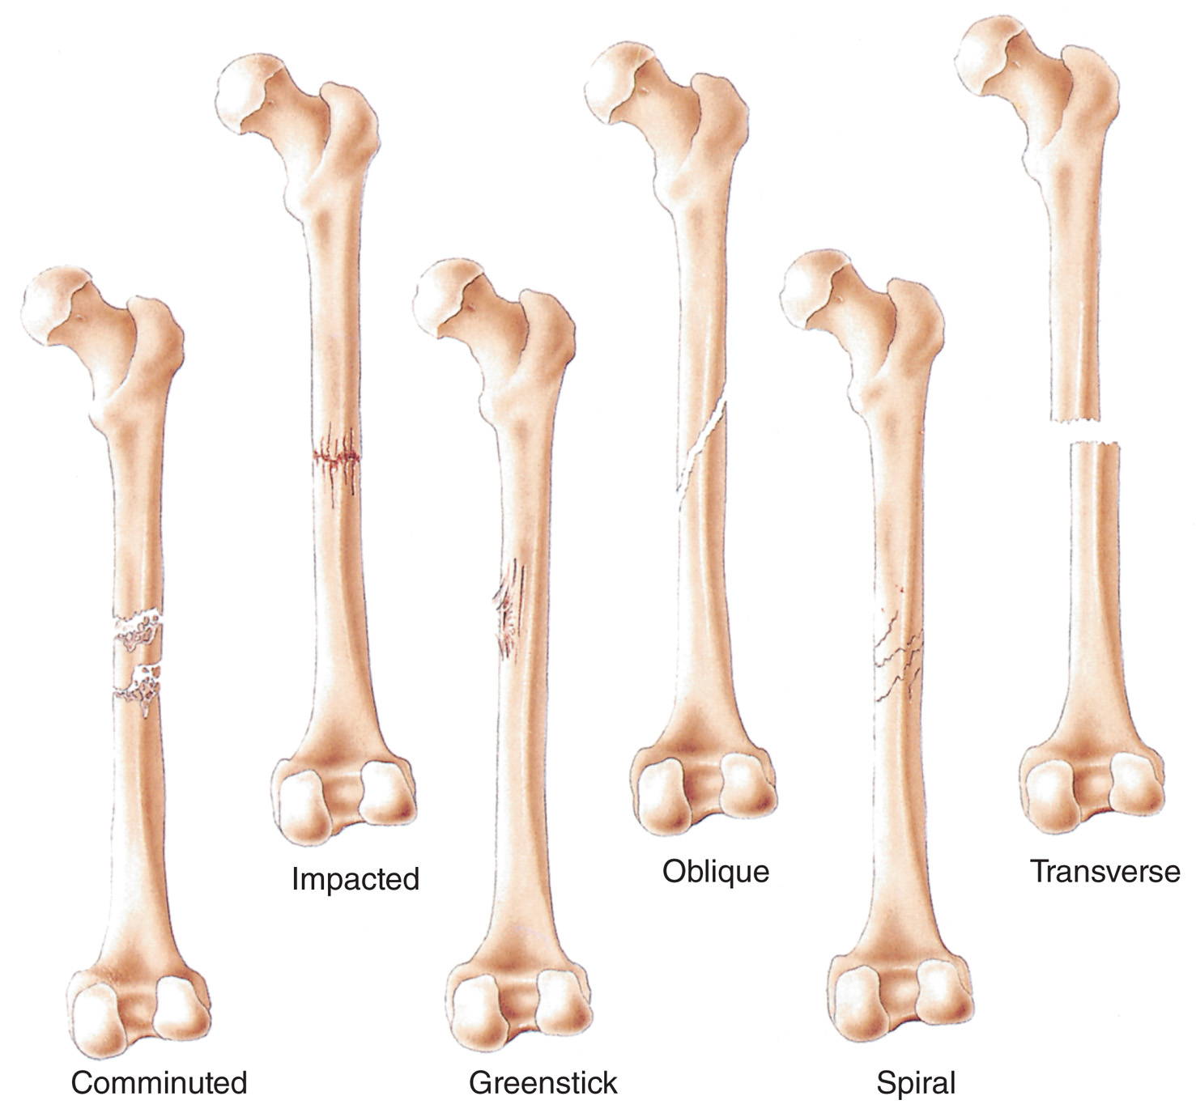
Types of Fractures
Notes:
Discuss the types of fractures and common mechanisms resulting in this kind of injury.

Slide 20
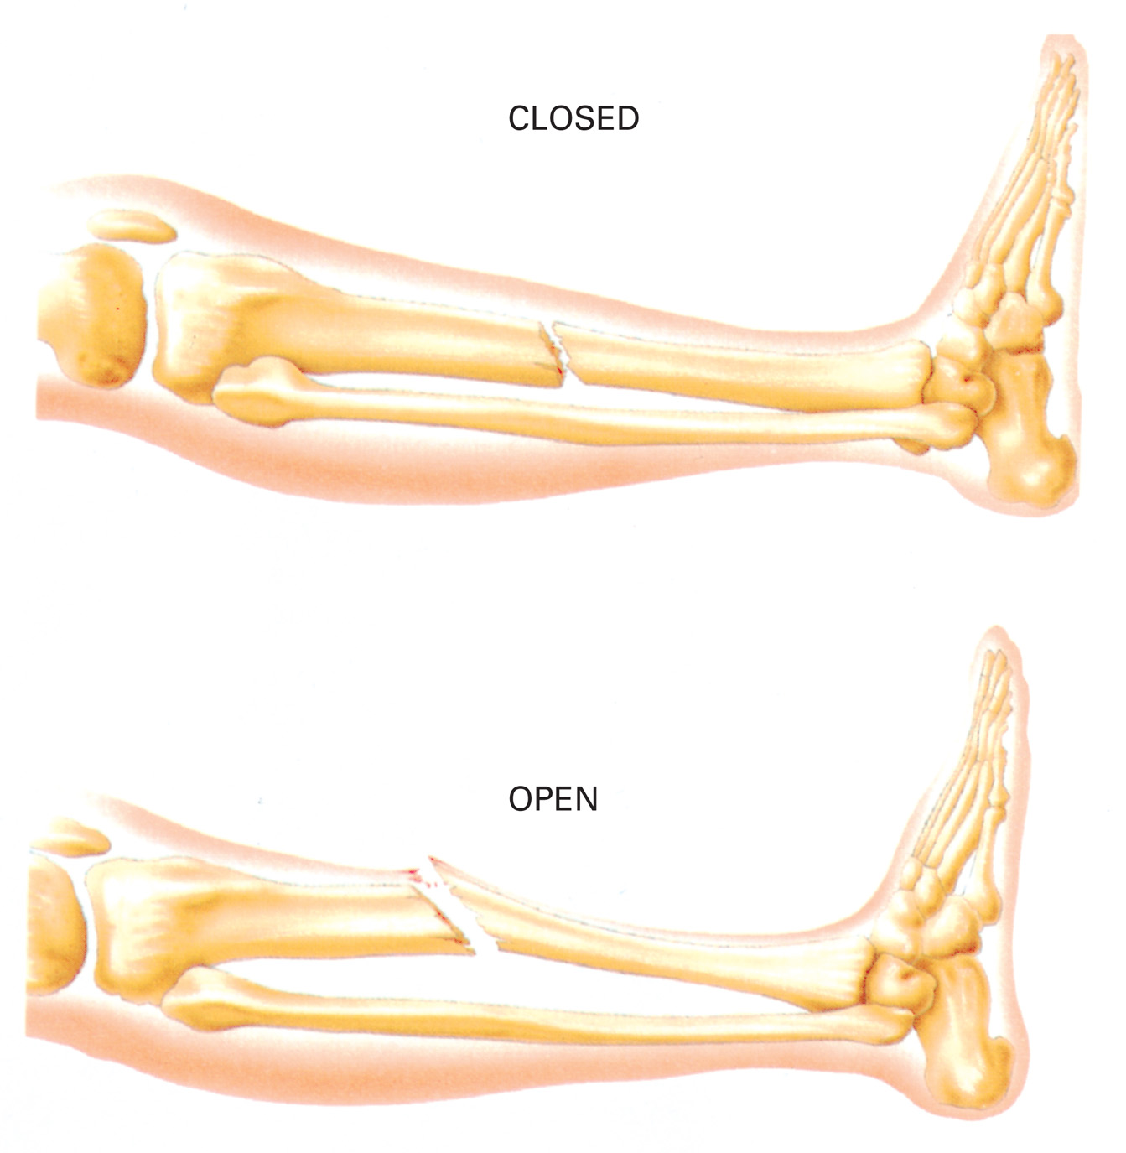
Closed and Open Injuries
Notes:
Discuss the types of fractures and common mechanisms resulting in this kind of injury.

Slide 21
A Closed Fracture Has no Associated Open Wound
(© Edward T. Dickinson, M D)
Notes:
Discuss this type of fracture and how to properly immobilize the injury and care for any soft tissue trauma present.

Slide 22
An Open Fracture Presents with an Open Wound, Often with a Bone end Protruding Through the Skin
(© Edward T. Dickinson, M D)
Notes:
Discuss this type of fracture and how to properly immobilize the injury and care for any soft tissue trauma present.

Slide 23
Deformity is a Sign of This Kind of Fracture
(© David Effron, M D)
Notes:
Discuss this type of fracture and how to properly immobilize the injury and care for any soft tissue trauma present.

Slide 24
Injuries to Bones and Joints (3 of 14)
Types of Injuries
  Fractures
    Complications of fractures include:
      Hemorrhage
      Tissue damage, including nerves and blood vessels
      Infection
      Interruption of the blood supply.
Notes:
Discuss how to identify if a complication exists from a fracture.

Slide 25
Injuries to Bones and Joints (4 of 14)
Types of Injuries
  Fractures
    A strain occurs when overexertion or overstretching causes muscle fibers to tear.
    Pain is usually localized with no edema or discoloration.

Slide 26
Injuries to Bones and Joints (5 of 14)
Types of Injuries
  Fractures
    A sprain is an injury to a joint capsule, with damage to the connective tissue, usually the ligaments.
    This injury causes immediate pain and tenderness, with delayed swelling and discoloration.

Slide 27
Injuries to Bones and Joints (6 of 14)
Types of Injuries
  Strain
    An injury to a muscle or a muscle and tendon, possibly caused by overextension, or overstretching
  Dislocation
    Displacement of bones in a joint
    May damage blood vessels and nerves
    Ligament or joint capsule damage likely
Notes:
The shoulder, knee, wrist, and ankle are the joints most vulnerable to sprains. The patient typically experiences immediate pain and tenderness in the joint upon injury.
The patient complains of pain and tenderness at the site of dislocation and typically is unable to move the extremity. A dislocation is dangerous because it can damage blood vessels and nerves by compression or tearing.

Slide 28
Dislocation of the Knee Joint
(© Edward T. Dickinson, M D)
Notes:
A dislocation usually occurs from the joint being forced well beyond its normal range of motion.

Slide 29
Click on the Injury That is Characterized by Overstretching and Tearing Muscle Fibers
A. Strain
B. Sprain
C. Dislocation
D. Fracture

Slide 30
Injuries to Bones and Joints (7 of 14)
Types of Injuries
  General Injury Considerations
    All musculoskeletal injuries can present with similar signs and symptoms.
    The force that causes the musculoskeletal injury, also cause other injuries.
    Always assess the mechanism of injury and the signs and symptoms.
Notes:
The force applied to the body can cause injuries to the surrounding soft tissues (e.g., nerves and arteries), even to body areas that are distant from the injury site.

Slide 31
Injuries to Bones and Joints (8 of 14)
Mechanism of Injury
  Direct Force
    The injury occurs at the point of impact.
  Indirect Force
    The injury impacts one end of a limb, causing injury some distance away.
  Twisting Force
    Part of the extremity remains stationary while the rest twists.
Notes:
Discussion Questions
What is an example of direct force applied to a bone?
What is an example of indirect force applied to a bone?

Slide 32
Injuries to Bones and Joints (9 of 14)
Critical Fractures — The Femur and the Pelvis
  The Femur and Pelvis
    There is the potential for significant bleeding; can be life-threatening.
      A patient can easily lose approximately 1,500 milliLiter of blood around each femur.
      The large amount of blood that can be lost via the unstable and expanded pelvic compartment can easily lead to death.
Notes:
However, two specific fractures are associated with a high incidence of serious bleeding and the potential for the patient to develop shock. A fracture of the femur or pelvis is considered a critical injury and must be managed, not only to immobilize the bones, but also to reduce the associated bleeding. The bones of both the femur and the pelvis contain a large blood supply. When fractured, these bones tend to bleed heavily. Also, the bones are near other large vessels that might be lacerated by the bone ends, leading to serious bleeding.
A traction splint is applied to accomplish two goals:
The bone ends are realigned, which helps prevent further injury and reduces pain, and
the size (diameter) of the thigh is decreased, which allows less blood to accumulate and also indirectly puts pressure on the bleeding bone ends.

Slide 33
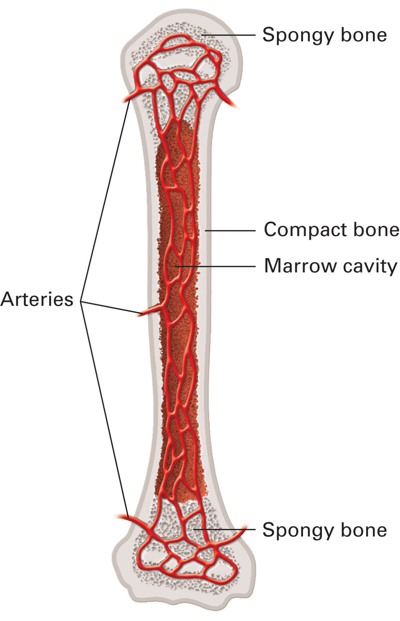
The Bones are Highly Vascular and Can Bleed Profusely if Injured, as Illustrated in the Long Bone Shown
The bones of both the femur and the pelvis contain a large blood supply with a tendency to bleed heavily when fractured
Notes:
When the femur fractures, the bone bleeds heavily.

Slide 34
Injuries to Bones and Joints (10 of 14)
Assessment-Based Approach — Bone or Joint Injuries
  Secondary Assessment
  Inspect and palpate the injured extremity.
  Though a fracture may be suspected in the field by signs, it can only be definitively diagnosed in X-rays taken at the hospital.
Notes:
If the patient is unresponsive, there are multiple injuries, or the MOI is significant, conduct a rapid secondary assessment.
Check for deformity, contusions, tenderness, swelling, discoloration, and open wounds at the injury site. Assess the skin temperature, color, and condition; assess the pulse amplitude and check the capillary refill time distal to the site of injury.

Slide 35
Injuries to Bones and Joints (11 of 14)
Assessment-Based Approach — Bone or Joint Injuries
  Secondary Assessment
  Check for deformity, contusions, tenderness, swelling, and discoloration.
  Check the skin color, temperature, and condition as well as the circulation distal to the injury site.
Notes:
The severe pain associated with a fracture to an extremity can distract the patient from complaining of other more significant pain, such as abdominal or spinal pain. For this reason, fractures are referred to as distracting injuries.

Slide 36
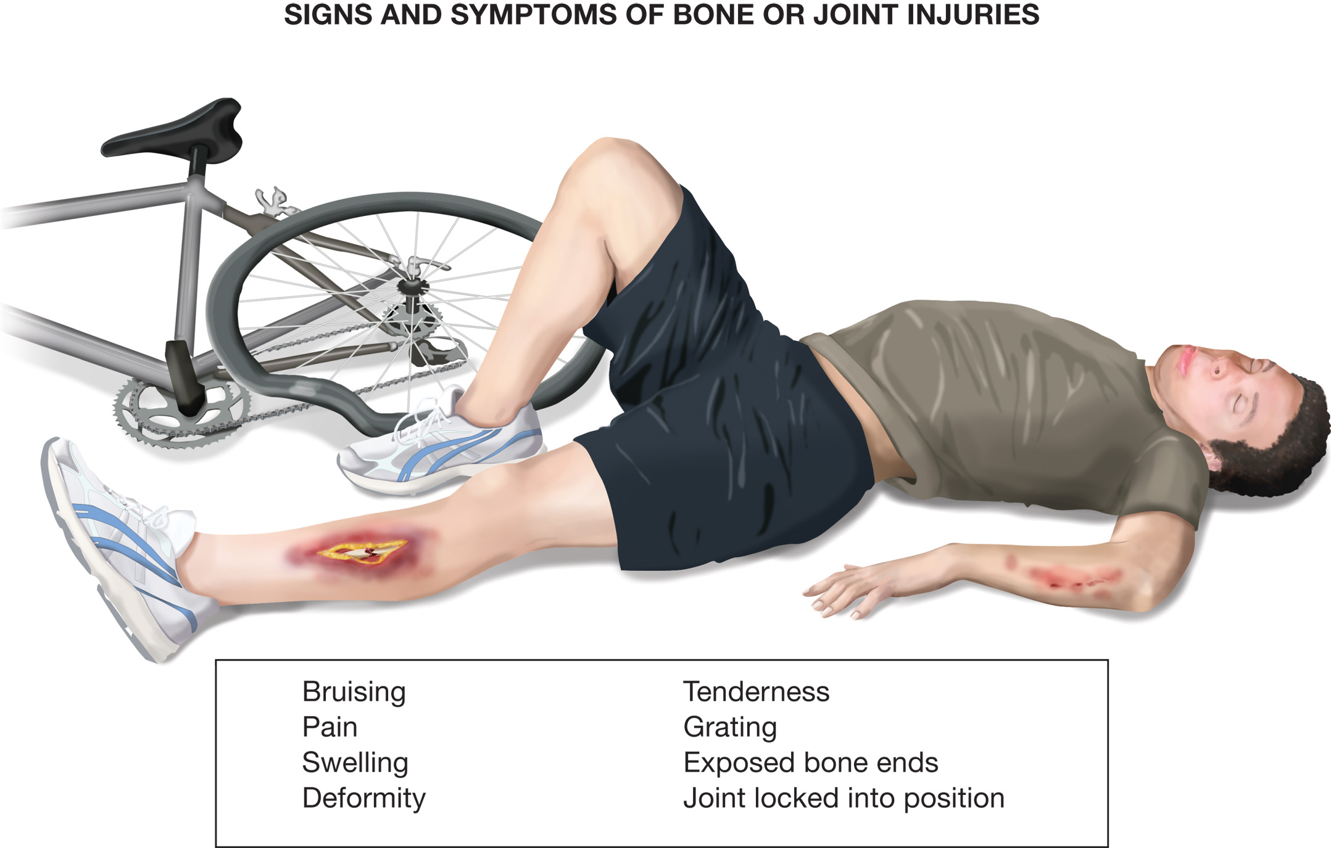
Signs and Symptoms of Bone or Joint Injuries
Notes:
With open injuries, an open wound is associated with the fracture; the bone might protrude through the wound.

Slide 37
Injuries to Bones and Joints (12 of 14)
Assessment-Based Approach — Bone or Joint Injuries
  Secondary Assessment
    Assess for the Six “Ps”
      Pain
      Pallor
      Paralysis
      Paresthesia
      Pressure
      Pulses
Notes:
Pain. Pain might be on palpation (tenderness) with movement, or without movement.
Pallor. The skin distal to the injury site might be pale and capillary refill delayed if an artery is compressed or torn. If a vein is blocked by the fracture, the distal extremity can appear warm, red (flushed), and swollen.
Paralysis. The patient is unable to move the extremity. This might be from nerve, muscle, tendon, or ligament damage.
Paresthesia. The patient might complain of numbness or a tingling sensation. This can indicate nerve damage.
Pressure. The patient might complain of a pressure sensation within the extremity. This can be associated with swelling from damaged tissue or blood loss within the muscle and surrounding structures.
Pulses. The pulse distal to the injury may be absent or show a decrease in amplitude. This can indicate damage to an artery.

Slide 38
Injuries to Bones and Joints (13 of 14)
Assessment-Based Approach — Bone or Joint Injuries
  Emergency Medical Care
    Use Standard Precautions.
    Maintain in-line spinal stabilization, if indicated.
    Administer oxygen, if needed.
    Splint bone and joint injuries.
    Apply cold packs and elevate extremity.
Notes:
If the patient has a life-threatening condition caused by or directly related to the extremity injury, such as a femur or pelvic fracture with hypotension or an open fracture with severe bleeding, immobilize the injured extremity during your primary or secondary assessment if the appropriate resources are available and it does not cause a delay in transport of the patient. Transport the patient immediately.

Slide 39
Injuries to Bones and Joints (14 of 14)
Assessment-Based Approach — Bone or Joint Injuries
  Reassessment
    Repeat vital signs.
    Check interventions.
    Recheck distal pulses, motor function, and sensation.
Notes:
Make sure that the patient’s distal pulses, motor function, and sensation have improved or have not deteriorated because of immobilization.

Slide 40
Case Study (2 of 5)
E M T s Kyle Velez and Ellen Peterson have arrived on the scene, glad to see that the first-in engine has spread some sand on the surface of the ice to minimize chances of further injury.
Notes:
Discuss the continuation of the Case Study with the class.

Slide 41
Case Study (3 of 5)
The E M T s quickly complete a primary assessment and determine that the patient does not have a serious mechanism of injury or a likelihood of spinal injuries. Their next concern is getting her out of the cold. The patient is doing a good job of self-splinting the injury for the moment, so they place her on the stretcher and load her into the ambulance before completing a modified secondary assessment.
Notes:
Discuss the continuation of the Case Study with the class.

Slide 42
Case Study (4 of 5)
Kyle carefully examines Dominique’s left upper extremity. She has a deformity and swelling above her wrist. Her radial pulse is present and strong, and distal motor and sensory function are intact. She also has a laceration on her left palm.
Notes:
Discuss the continuation of the Case Study with the class.

Slide 43
Case Study (5 of 5)
What would be some choices of splints that would be effective in this case?
What principles of splinting should the E M T s follow as they immobilize the injury?
Notes:
Use the Case Study content and questions to foreshadow the upcoming lesson content. Gauge the students’ responses as a guide of how well versed they are on this topic.

Slide 44
Basics of Splinting (1 of 13)
Splints are used to:
  Prevent movement of dislocated joints or bone fragments or ends, to reduce further injury
  Reduce pain and chances of complications.
Notes:
Discussion Question
What are the general rules of splinting?
Knowledge Application
Given a series of scenarios, students should be able to assess musculoskeletal injuries, assign injuries proper priority in the overall management of the patient, and demonstrate proper splinting techniques.

Slide 45
Basics of Splinting (2 of 13)
Complications include:
  Muscles, nerve, or blood vessel damage
  Conversion of a closed fracture to an open one
  Restriction of blood flow
  Excessive bleeding
  Increased pain
  Paralysis of extremities (spinal injury).
Notes:
A splint is any device used to immobilize a body part. A splint can be soft or rigid. It can be commercially manufactured or improvised from virtually any object that can provide stability.

Slide 46
Basics of Splinting (3 of 13)
General Rules of Splinting
  Assess the pulse, motor, and sensation.
  Immobilize joints both above and below.
  Cover all wounds.
  Align the injured limb, if needed.
  Pad each splint.
  Hold traction until the splint is applied.
  When in doubt, splint.
  Treat for shock, if necessary.
Notes:
If the patient shows signs of shock, align the patient in the normal anatomical position. Treat the patient for shock and transport immediately without taking the time to apply a splint. If a fracture of the femur or pelvis is suspected, splinting should be considered as a bleeding-control measure. Splint the femur or pelvis at the scene only if enough resources are present so that a delay in transport does not occur.

Slide 47
E M T Skills 30-1
General Splinting Rules

Slide 48
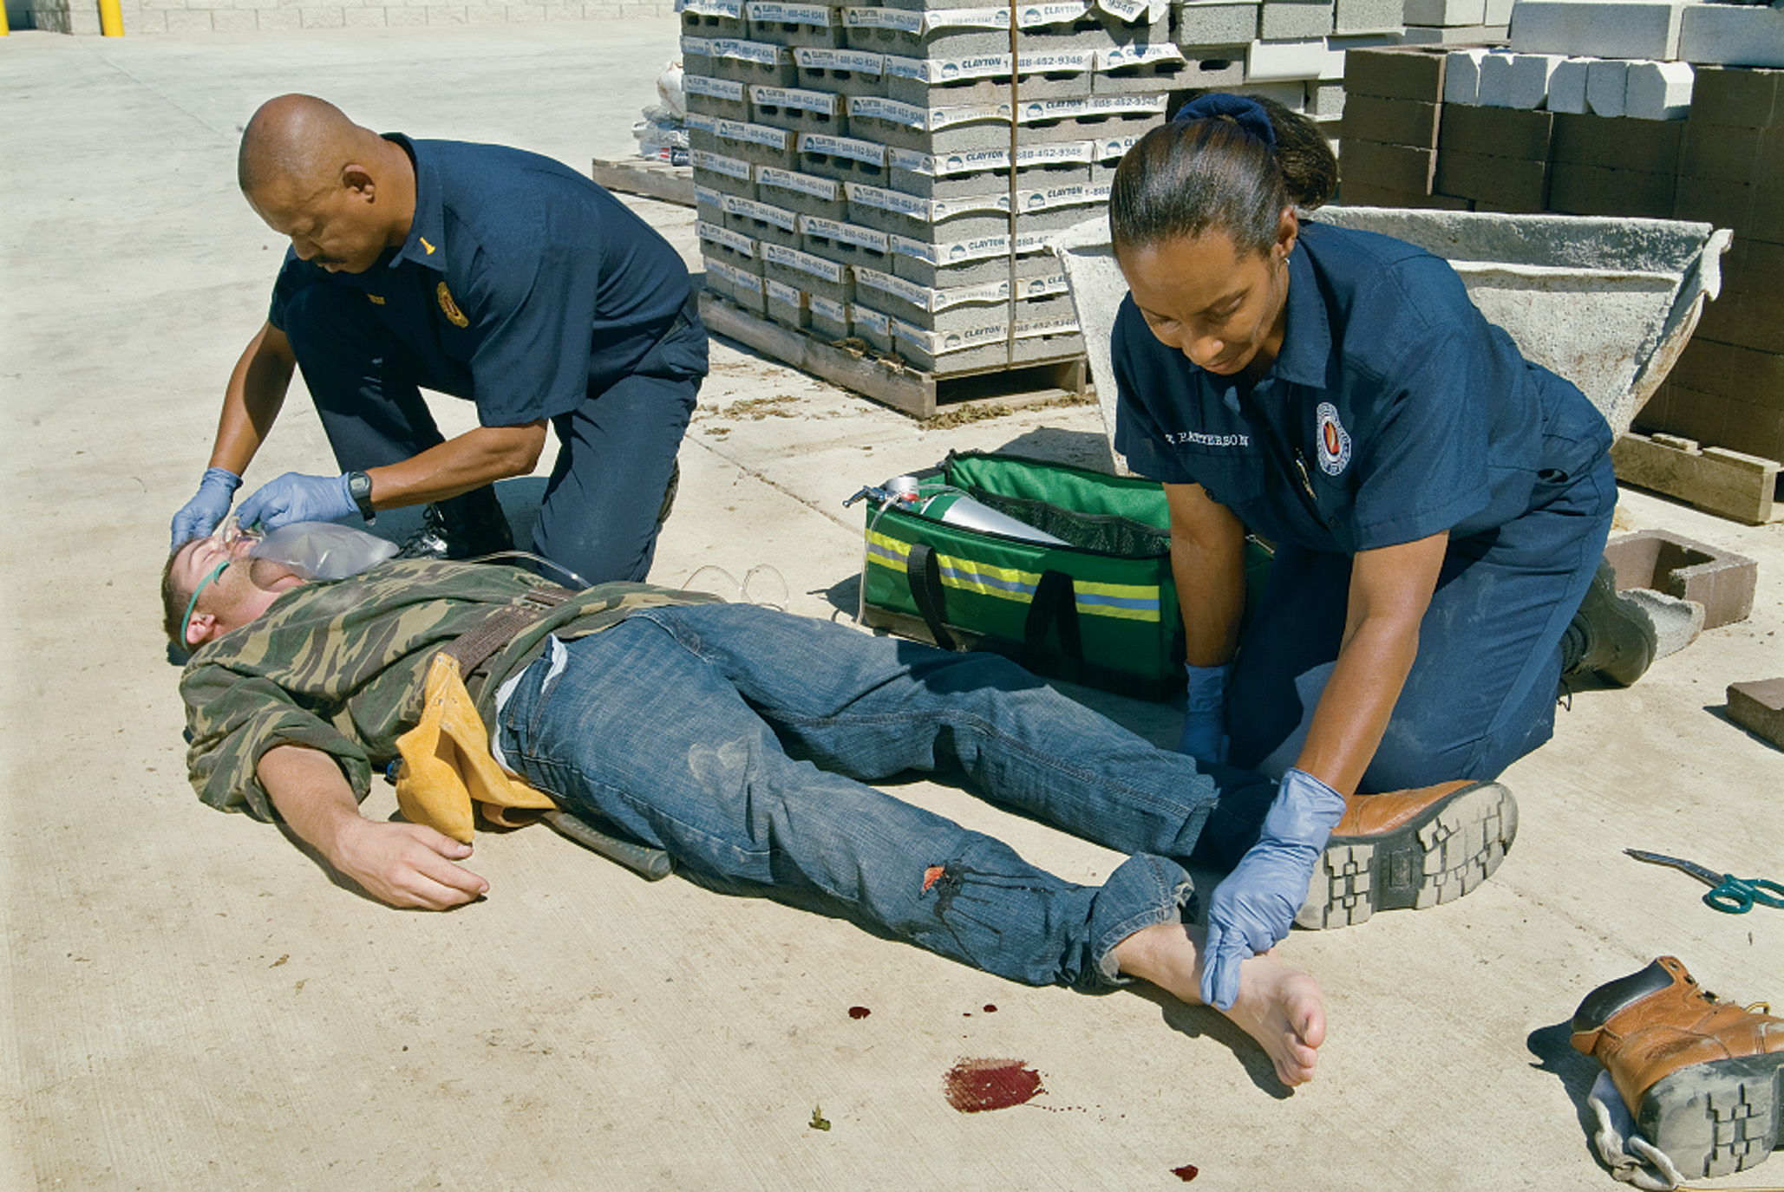
Assess the Distal Pulse and Motor and Sensory Function (1 of 2)
Notes:
Before and after you apply the splint, assess the pulse, motor function, and sensation distal to the injury. You should evaluate these signs every 15 minutes after applying the splint to make sure the it is not impairing circulation to the extremity.

Slide 49
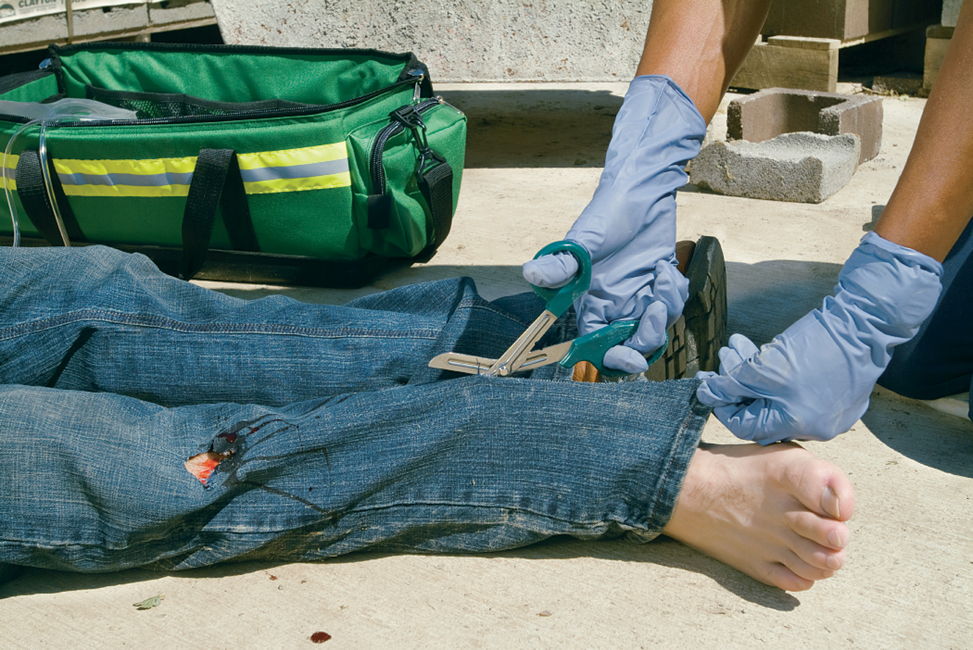
Cut Away Clothing to Expose the Injury Site
Notes:
Remove or cut away all clothing around the injury site with a pair of bandage scissors so you won’t accidentally move the fractured bone ends and complicate the injury.

Slide 50
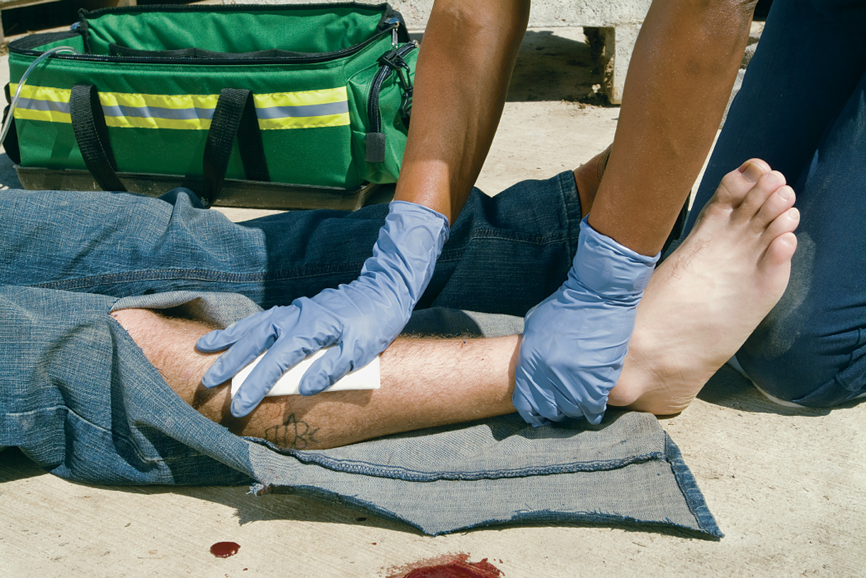
Place a Sterile Dressing Over the Open Wound
Notes:
Cover all wounds, including open fractures, with sterile dressings before applying a splint, and then gently bandage. Avoid applying excessive pressure to the wounds.

Slide 51
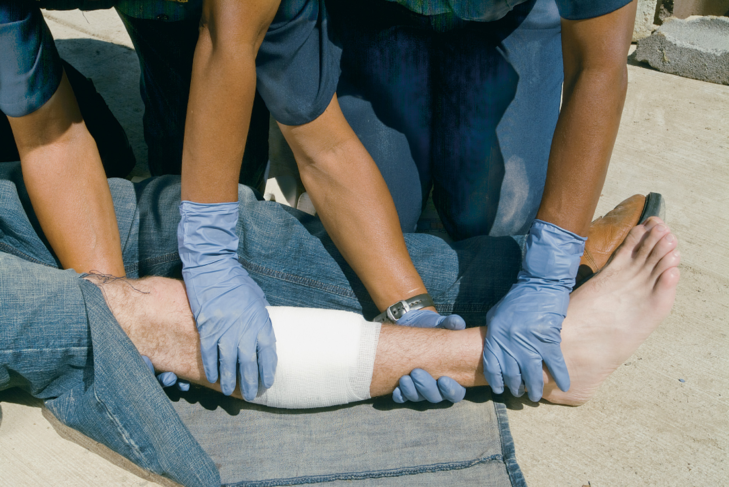
Align the Extremity with Gentle Traction if There is Severe Deformity, Absence of Distal Pulses, or Cyanosis
Notes:
If there is a severe deformity or the distal extremity is cyanotic (bluish) or lacks a pulse, align the injured limb with gentle manual traction (pulling) before splinting. As a general rule, make one attempt to align the extremity. If pain, resistance, or crepitus increase, stop. Generally, you should not try to align a wrist or an elbow.
Never intentionally replace protruding bones or push them back below the skin.

Slide 52
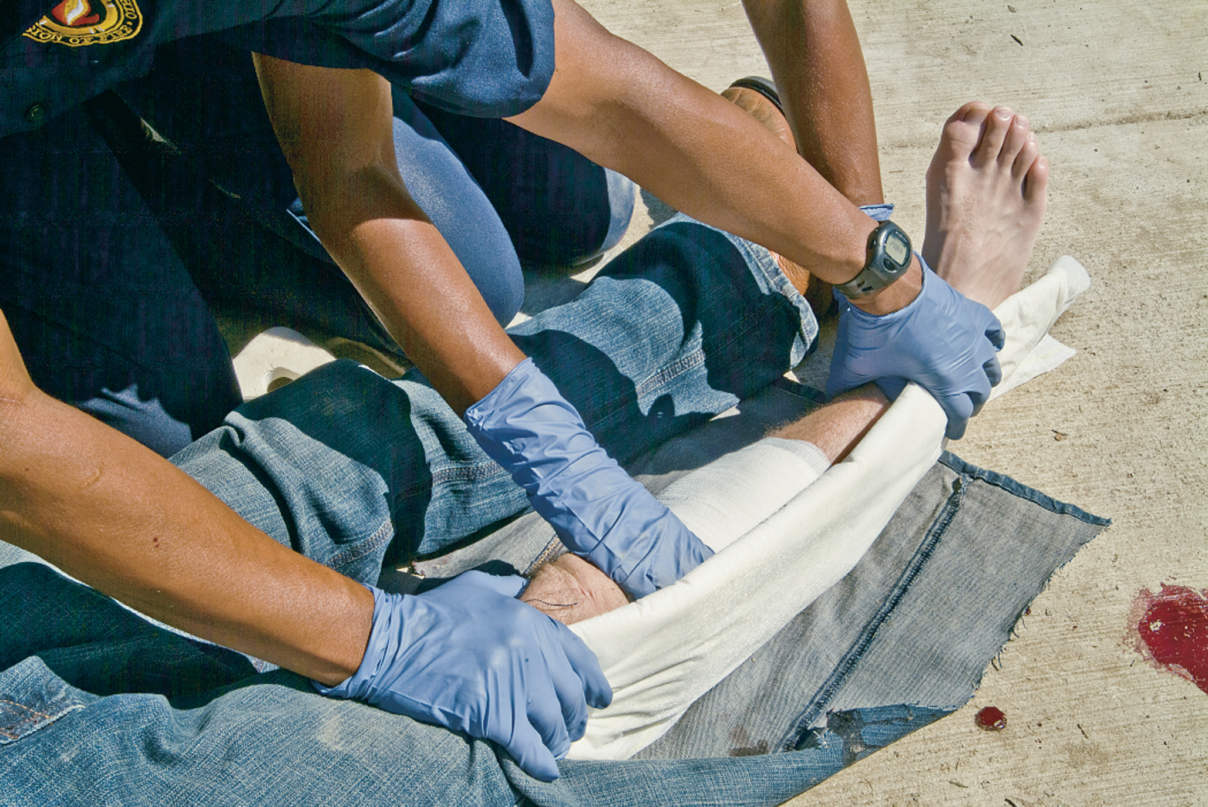
Pad the Splint to Prevent Discomfort and Unnecessary Pressure
The correct splint size will immobilize the joint above and below the site of a bone injury.
Notes:
Pad each splint to prevent pressure and patient discomfort.

Slide 53
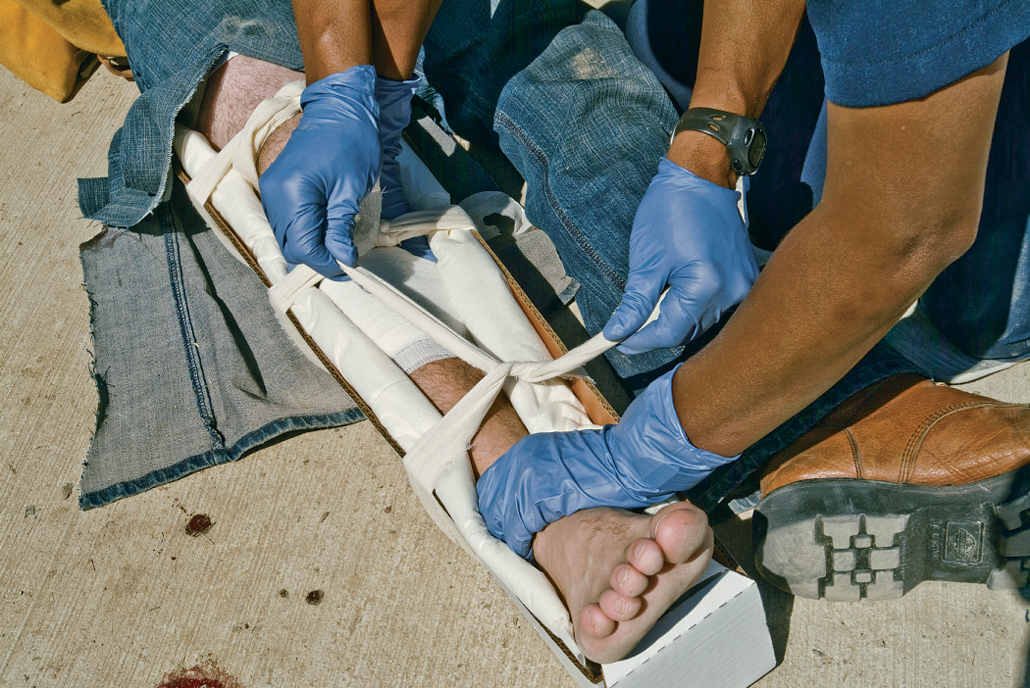
Maintain Manual Traction. Do not Release until the Splint has Been Applied
Assess distal pulse and motor and sensory function after the splint has been applied.
Notes:
Apply the splint before trying to move the patient. Do not release manual traction until after the splint has been applied.

Slide 54
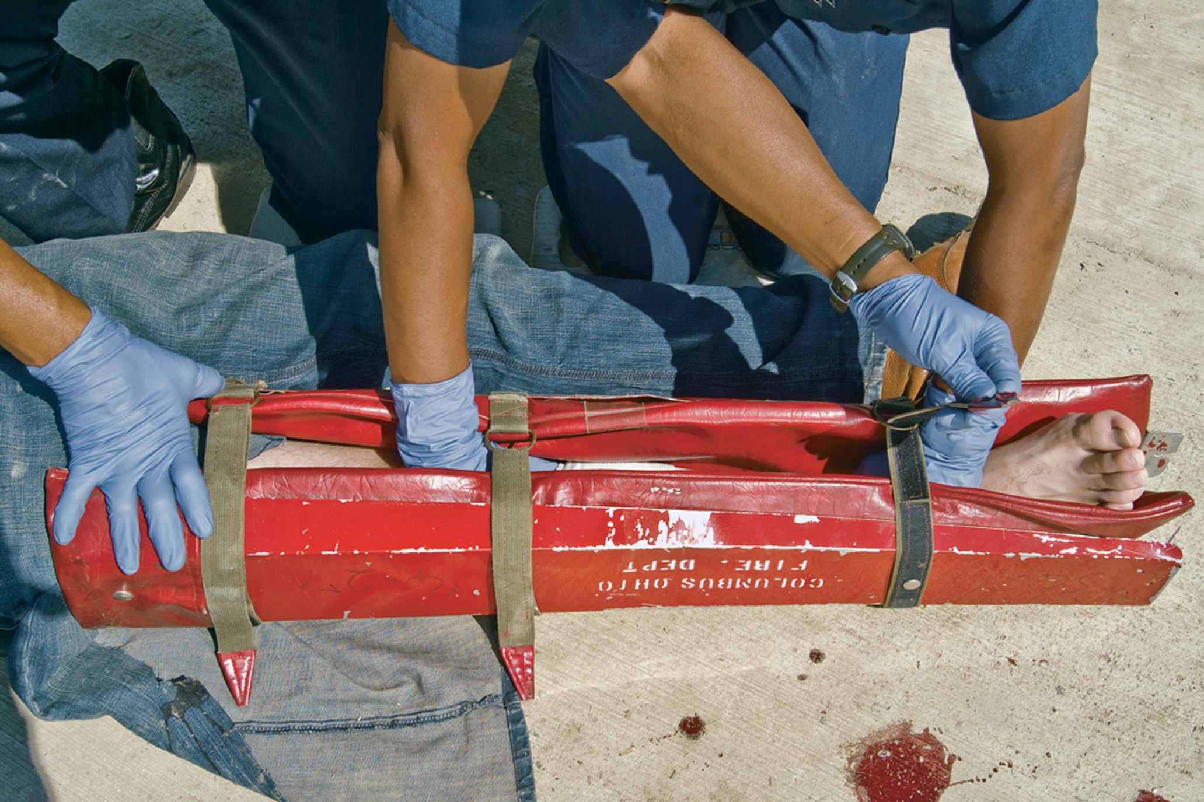
If Your Service Uses Commercially Prepared, Prepadded Splints, Skip the Padding Step, But Maintain Manual Traction, in Any Case
Notes:
If the patient shows signs of shock, align the patient in the normal anatomical position. Treat for shock and transport immediately without taking the time to apply a splint. If a fracture of the femur or pelvis is suspected, splinting should be considered as a bleeding-control measure.

Slide 55
Basics of Splinting (4 of 13)
Splinting Equipment
  Rigid Splints
  Pressure (Air or Pneumatic) Splints
  Traction Splints
  Formable Splints
  Vacuum Splints
  Sling and Swathe Splints
  Spine Board/Full-Body Vacuum Mattresses
  Vest-Type Immobilization Devices
Notes:
Rigid splints are commercially manufactured and made of wood, plastic, cardboard, or compressed wood fibers. Some are designed in specific shapes for arms and legs and are equipped with Velcro closures; others are pliable enough to be molded to fit any appendage.
Air splints are soft and pliable before being inflated, but they are rigid after they are applied and filled with air. Air splints cannot be sized and can impair circulation, interfere with the ability to assess pulses, and lose or gain pressure with temperature and altitude changes.
Traction splints provide a counterpull, alleviating pain, reducing blood loss, and minimizing further injury. Traction splints are not intended to reduce (correct) the fracture.
Formable splints are a type of rigid splint that is malleable enough to conform to a deformed or angulated extremity. The splint is shaped to the deformed extremity instead of making the extremity fit the splint. Once shaped to the injured extremity, it is fixed in place with cravats or Velcro straps. Formable splints are typically made of wire, thin aluminum, or another metal that can bend.
Vacuum splints are soft, pliable splints that are easily formed to deformed extremities. The air is then sucked out of the splint, causing it to become rigid in its position of placement.
A long spine board or a full-body vacuum mattress is a full-body splint. In the case of a critical injury, when extremity fractures cannot be splinted at the scene, placing the patient on a long spine board or in a full-body vacuum mattress will provide some stabilization through the limitation of movement. This is not an ideal method of splinting; however, uncomplicated fractures are not a priority in critically injured or unstable patients.
A vest-type immobilization device is sometimes turned upside down and used to splint a suspected pelvic injury.
You might be forced to improvise at the scene. Improvised splints can be made from a cardboard box, cane, ironing board, rolled-up magazine, umbrella, broom handle, catcher’s shin guard, or any similar object. An ordinary bed pillow or blanket roll can be an effective improvised splint when wrapped around the area and secured with several cravats.
Teaching Tips
Show examples of each type of splint as you talk about it.
Provide students with adequate time to practice splinting under supervision.
Discussion Question
What are some advantages and disadvantages of rigid splints?
Class Activity
Have a contest to see which group of students can come up with the best improvised splint.

Slide 56
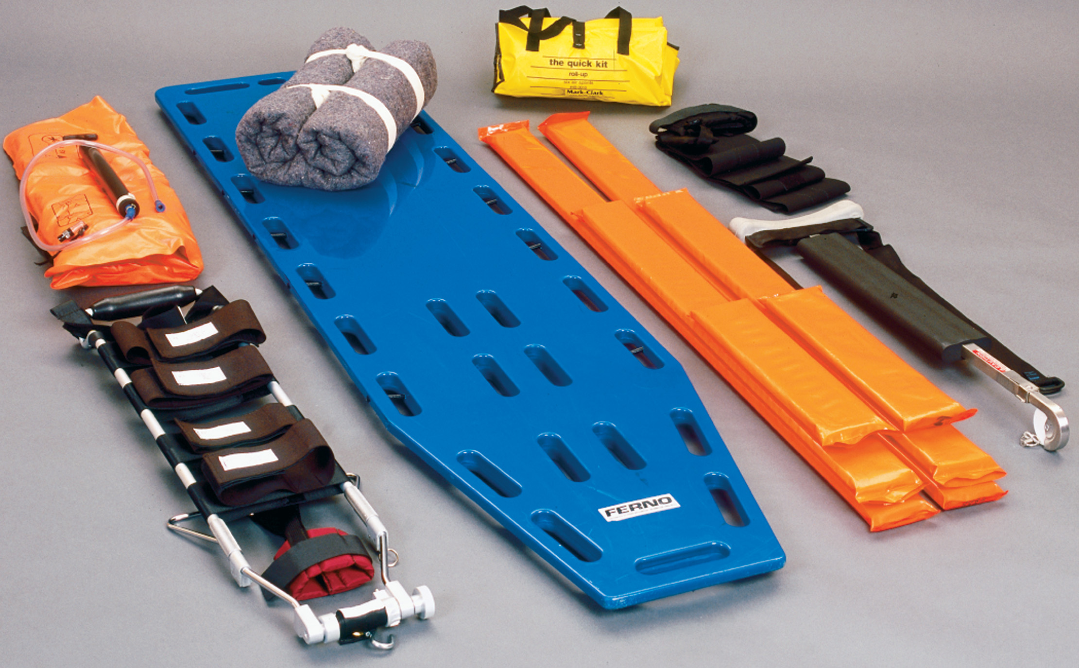
Examples of Splints
Notes:
Some splints are more suitable to certain types of injuries than others, but many are interchangeable. Follow your local protocol in such cases. The general types of splints are rigid, pressure, traction, formable, vacuum, sling and swathe, and improvised.

Slide 57
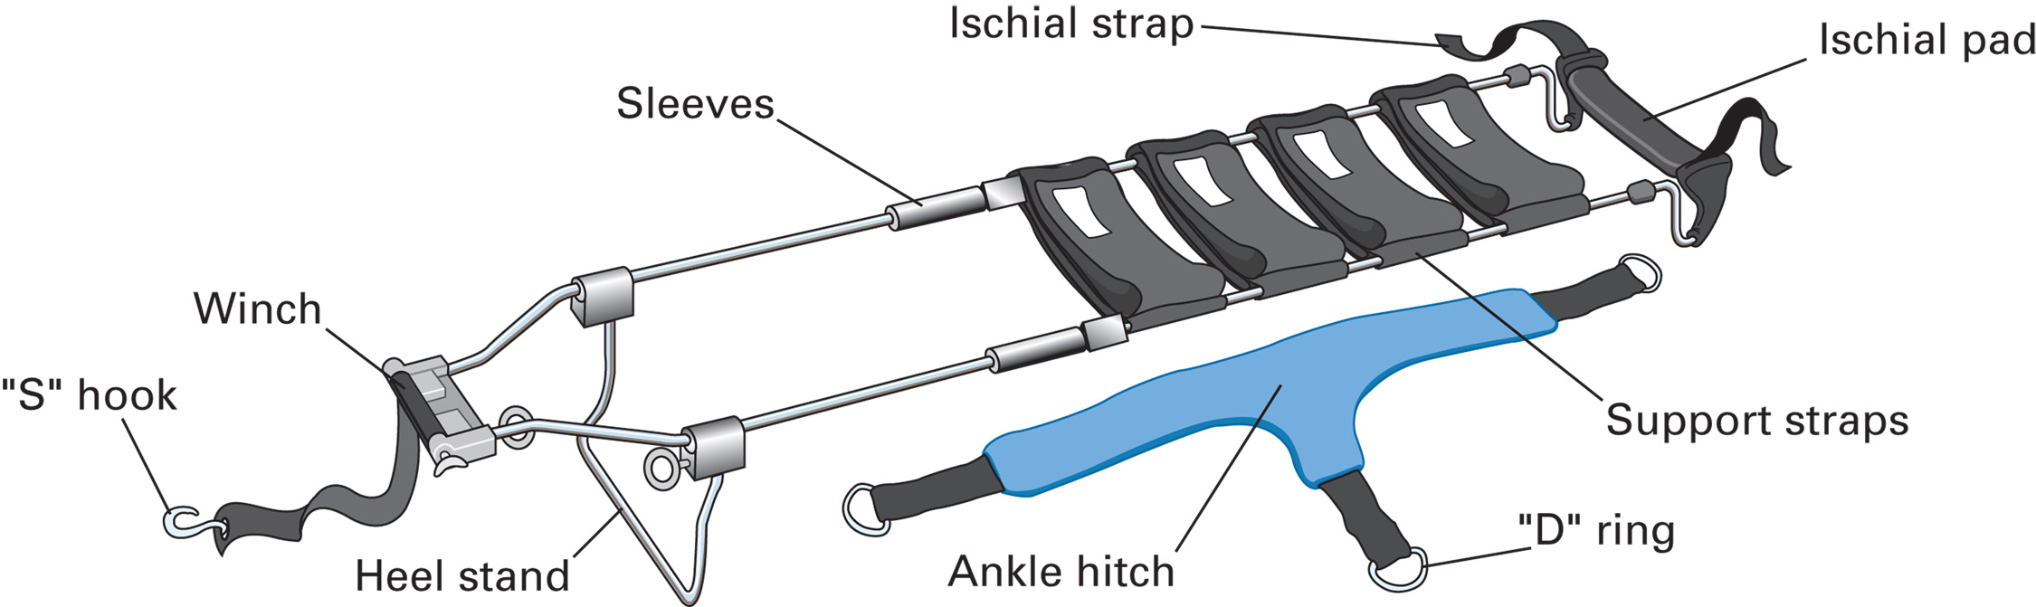
A Bipolar Traction Splint
Notes:
Several types of traction splints are available, and procedures vary according to the manufacturer.

Slide 58
E M T Skills 30-2
Applying a Vacuum Splint

Slide 59
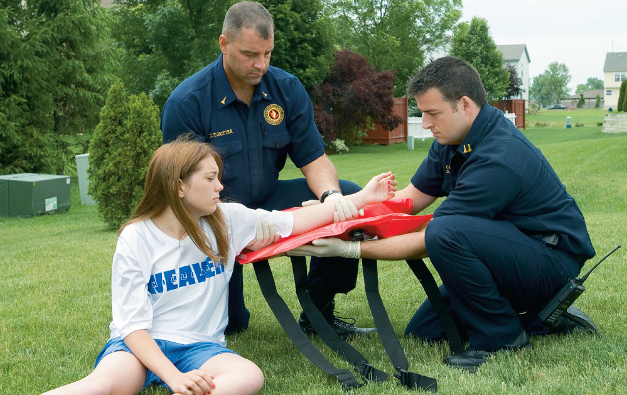
Manually Stabilize the Suspected Fracture and Assess Pulse and Motor and Sensory Functions
Notes:
Vacuum splints are soft, pliable splints that are easily formed.

Slide 60
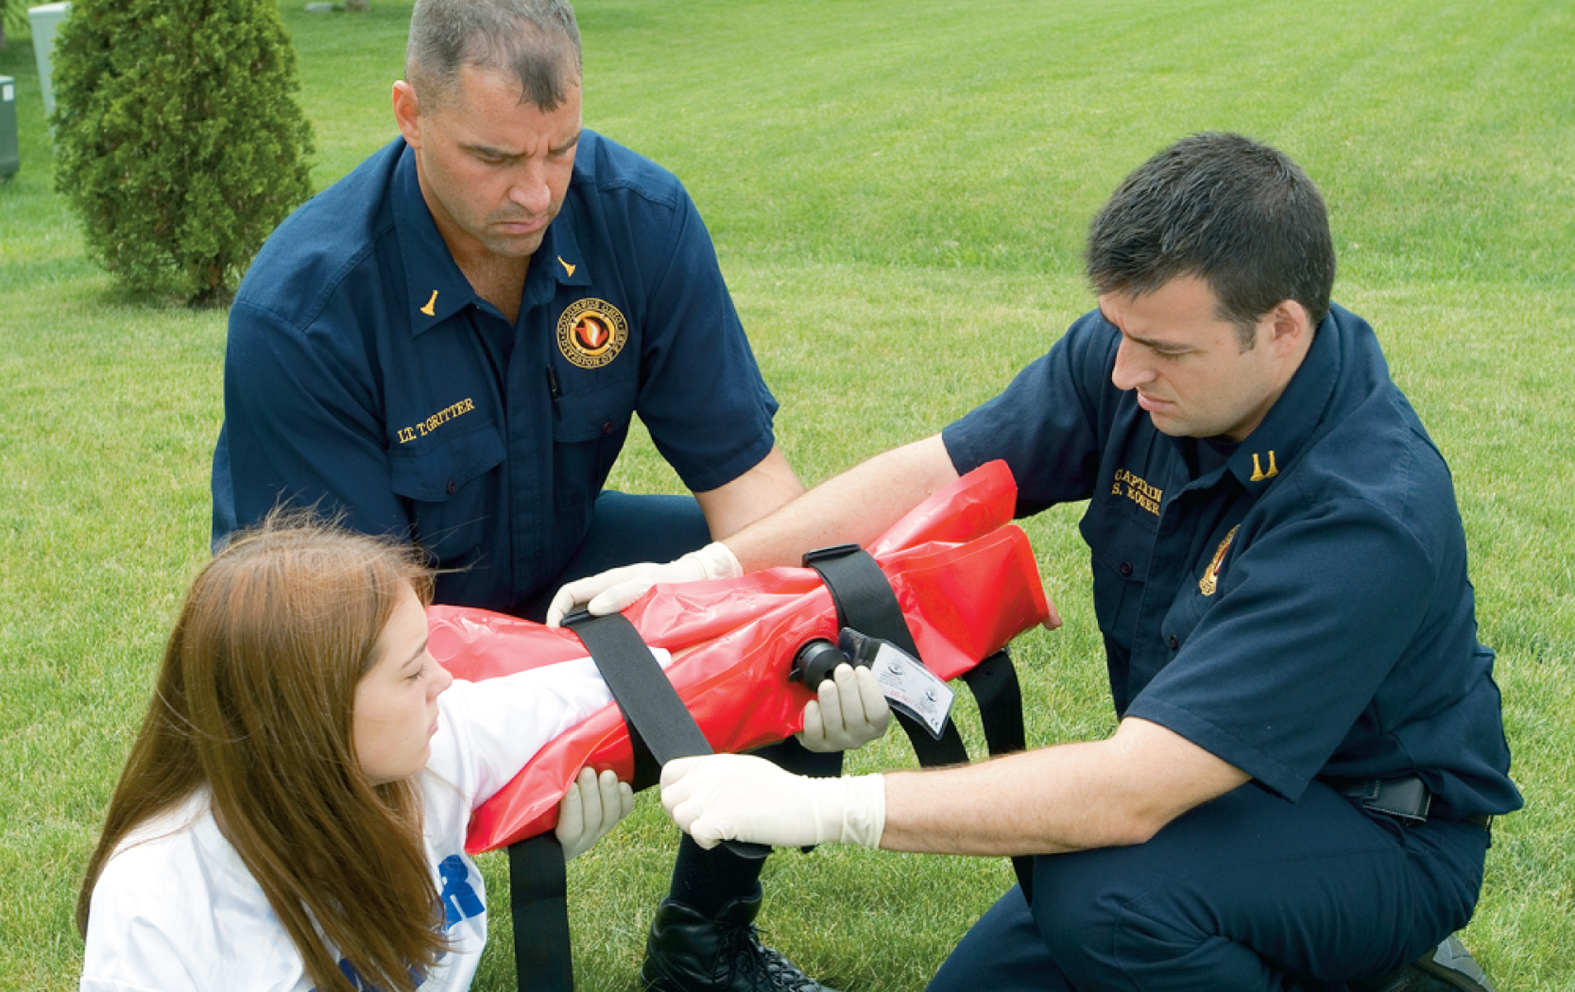
Apply the Splint and Secure it to the Extremity
Notes:
Vacuum splints are considered to be a type of formable splint.

Slide 61
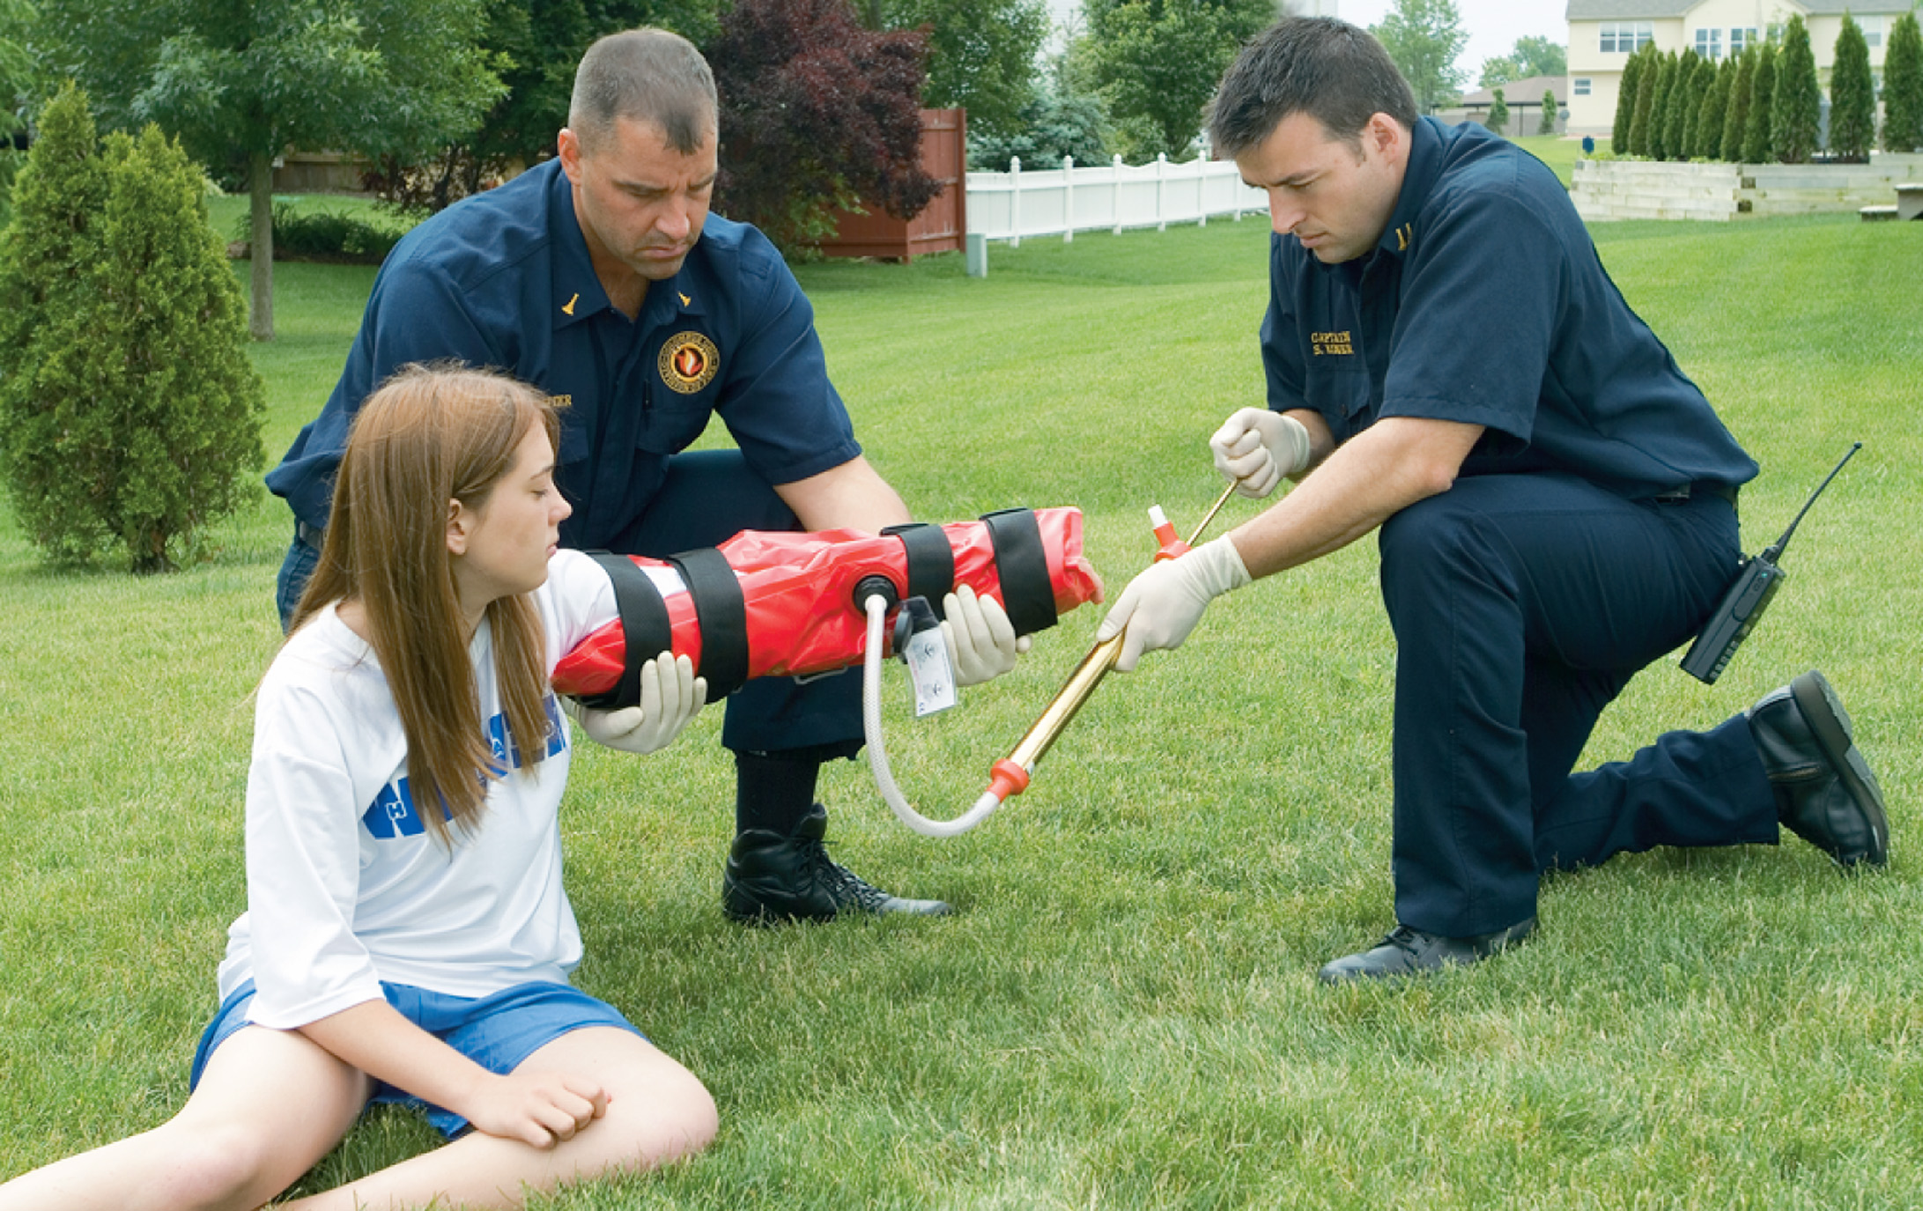
Suction the Air out of the Splint until it is Rigid. Reassess Pulse and Motor and Sensory Functions
Notes:
The air is sucked out of the splint, causing it to become rigid in its position of placement.

Slide 62
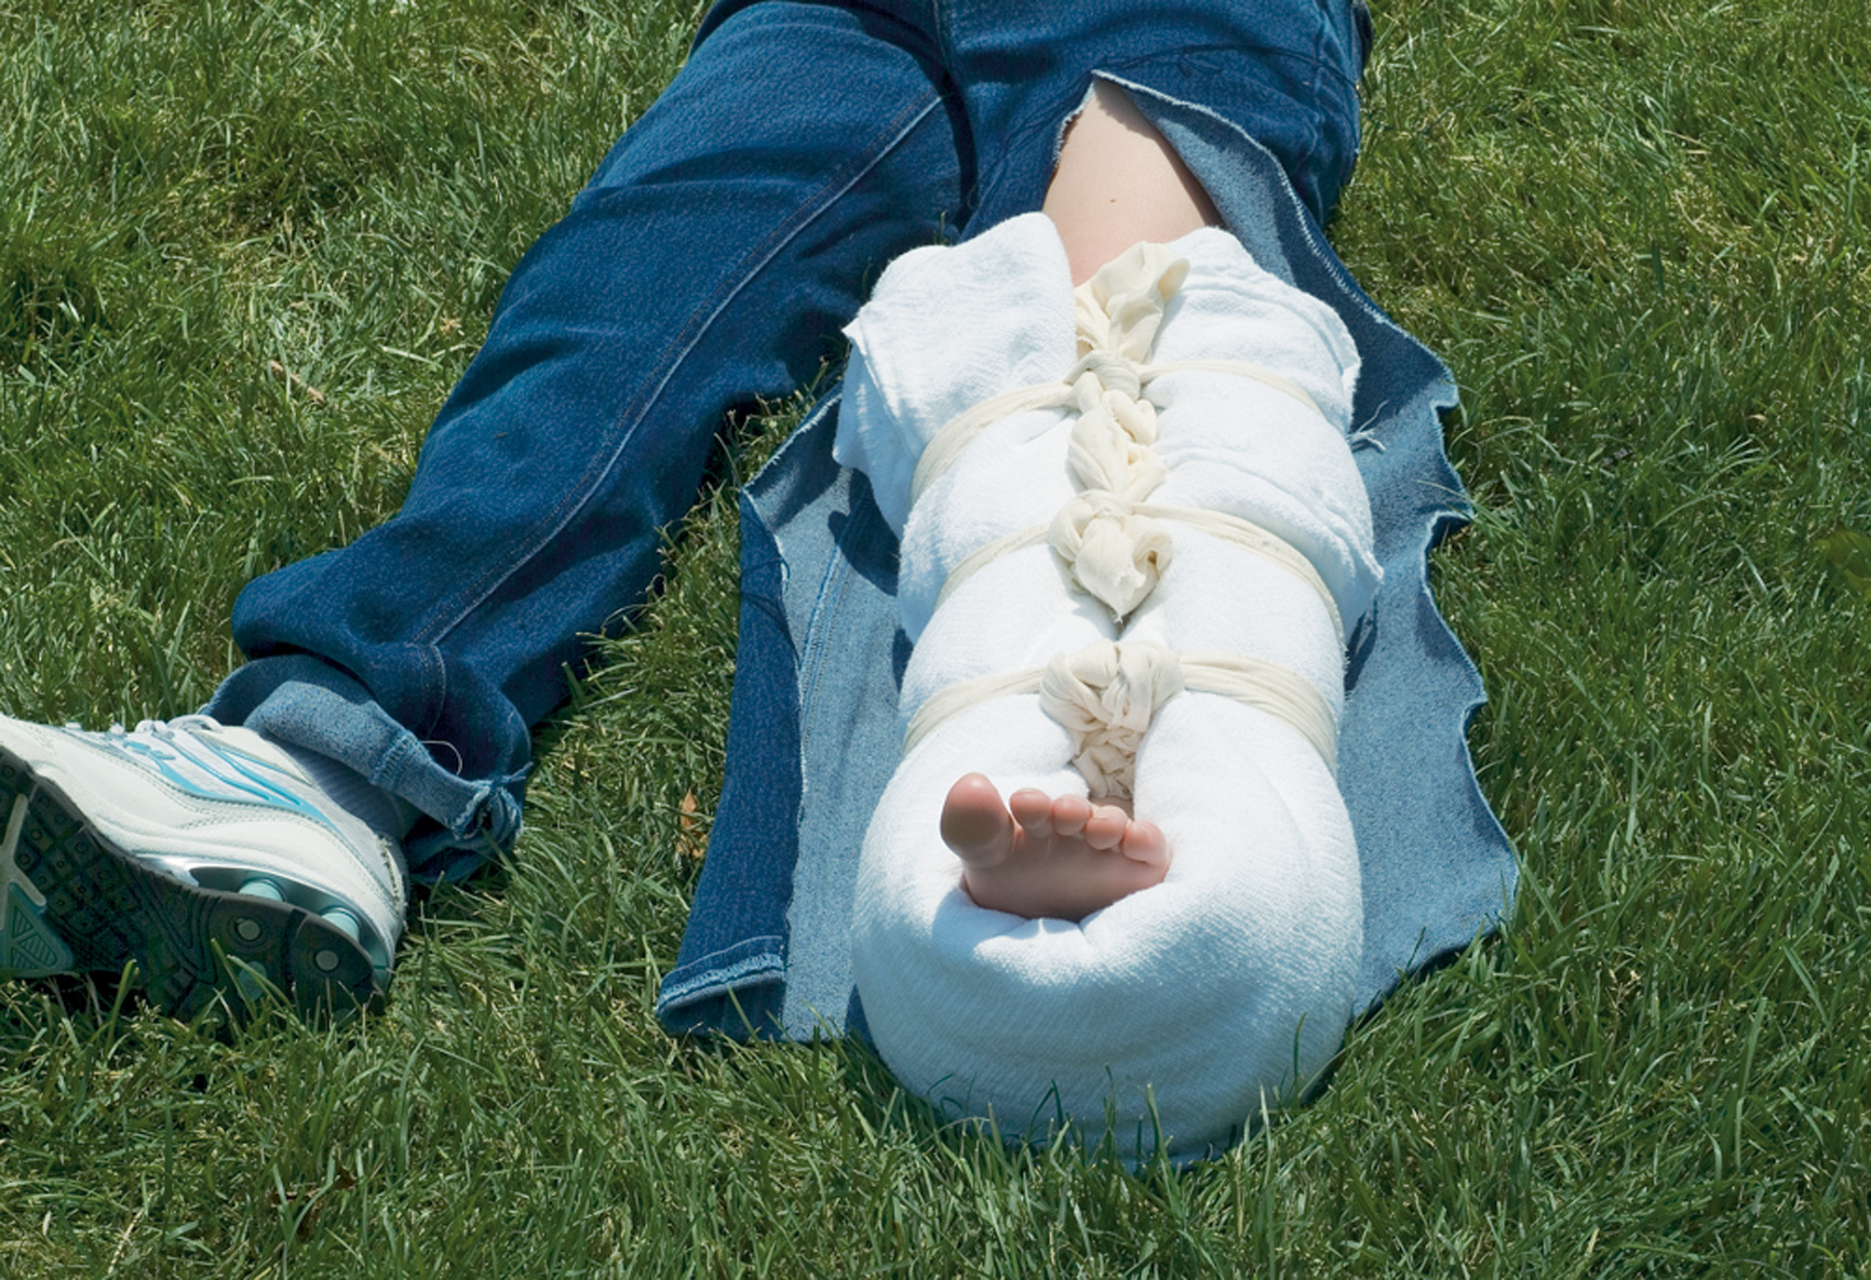
An Injured Foot or Ankle May be Splinted by Wrapping the Area in an Ordinary Bed Pillow
Notes:
An ordinary bed pillow or blanket roll can be an effective improvised splint.

Slide 63
Basics of Splinting (5 of 13)
Hazards of Improper Splinting
  Compression of nerves, tissues, blood vessels
  Delayed transport
  Reduced distal circulation
  Aggravation of the injury
  Excessive movement
  Skin damage from improper padding
Notes:
For all their obvious benefits to the patient with a bone or joint injury, splints can also cause complications if they are applied in the wrong manner.

Slide 64
Basics of Splinting (6 of 13)
Splinting Long Bone Injuries
  Test pulse and motor and sensory function tests.
  Align, if necessary.
  Do not release traction until splinted.
  Splint in functional position.
  Reassess pulses, motor and sensory functions after splinting and during reassessment.
Notes:
Signs and symptoms of long bone injury:
Exposed bone ends
Joints locked in position
Paresthesia, a pricking or tingling feeling that indicates some loss of sensation
Paralysis
Pallor of the injury site
Loss of distal pulse.

Slide 65
E M T Skills 30-3
Splinting a Long Bone

Slide 66
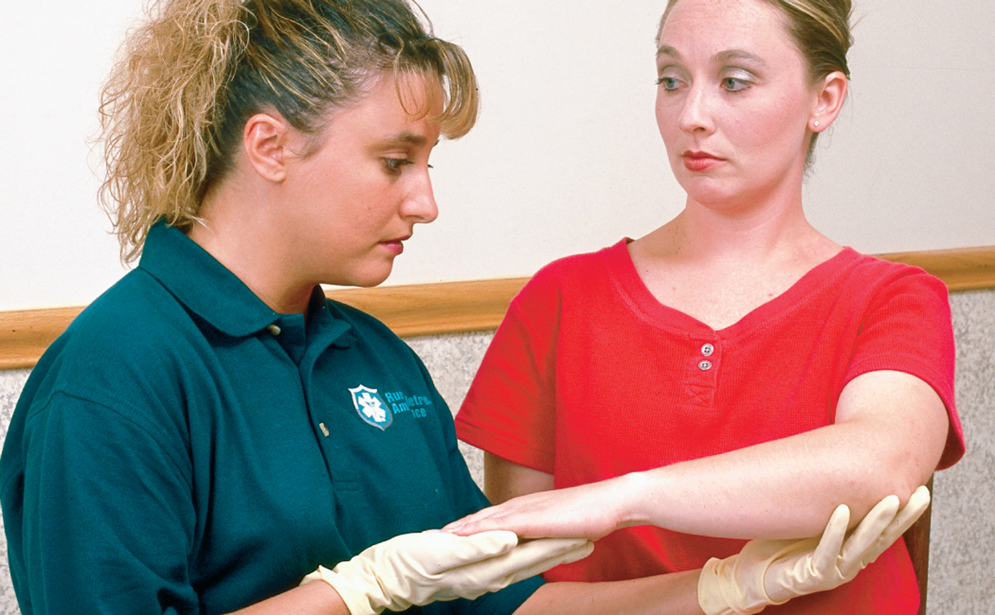
Apply Manual Stabilization to the Injured Extremity
Notes:
Special considerations must be taken into account when splinting long bones or joints.

Slide 67
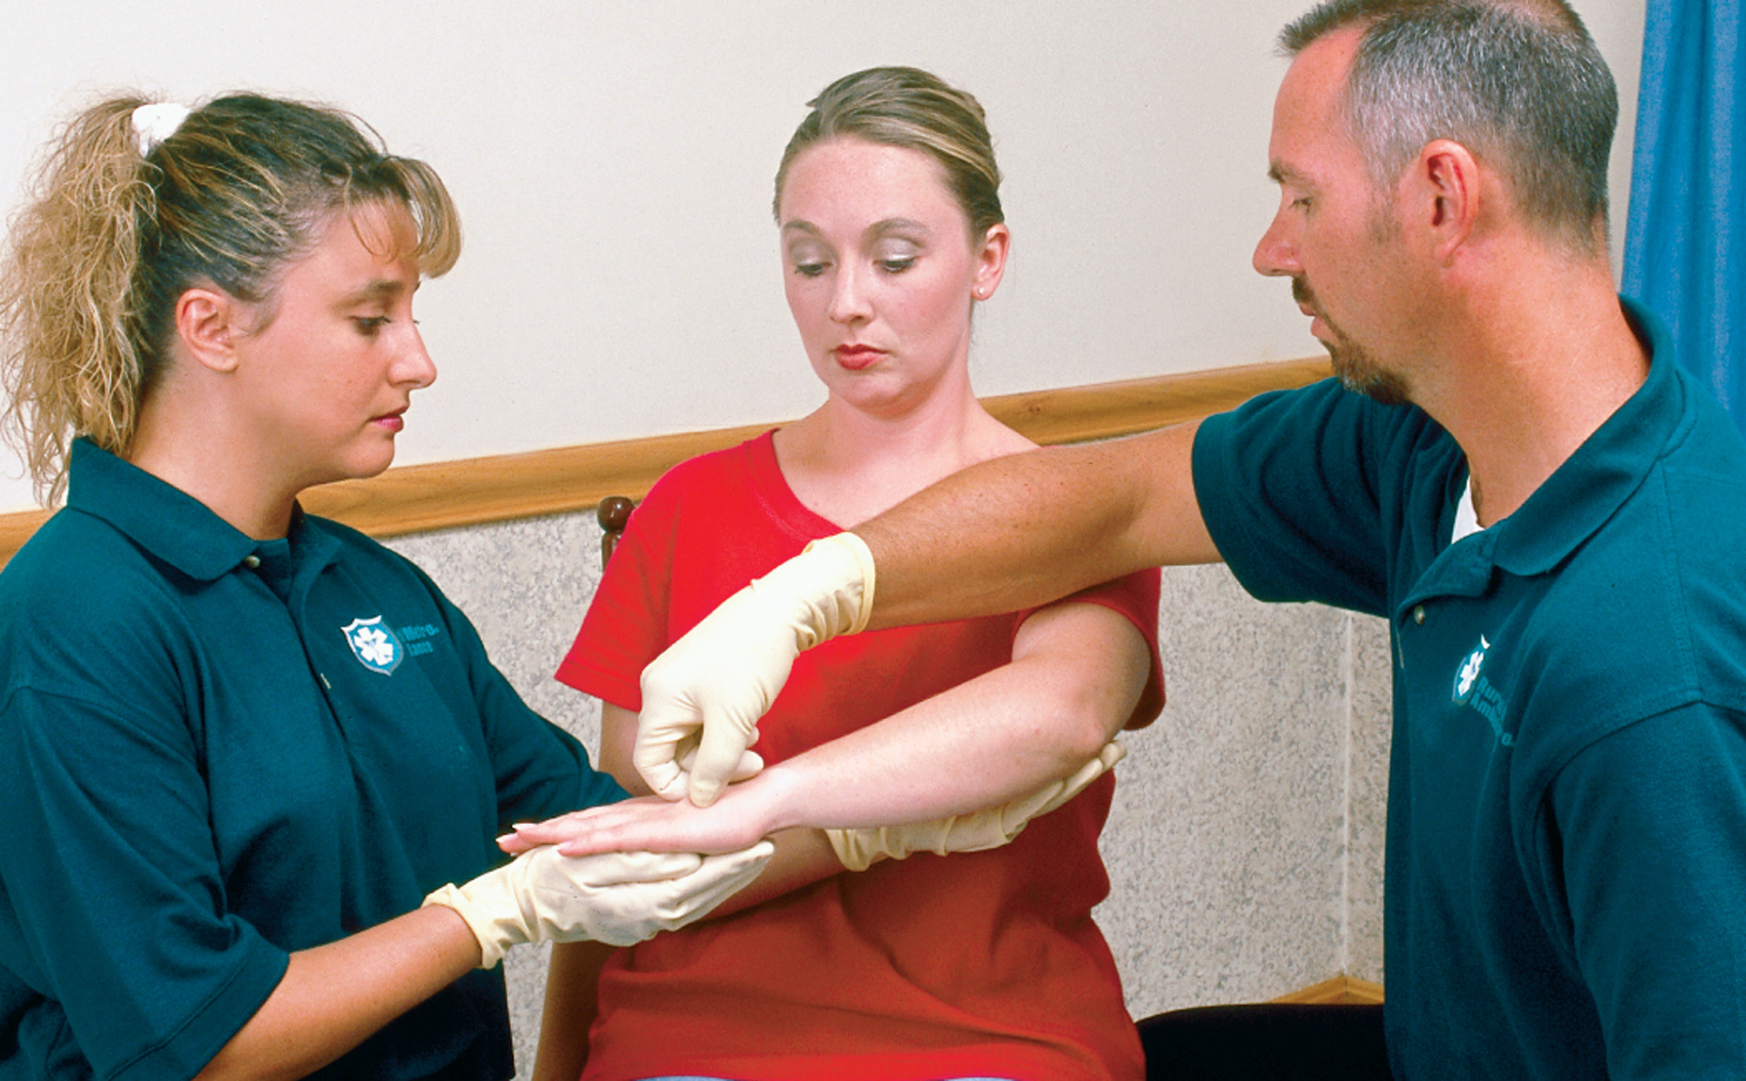
Assess the Distal Pulse and Motor and Sensory Function (2 of 2)
Notes:
Assess the pulse and motor and sensory function below the injury site. Assess the radial pulse for an upper extremity, the dorsal pedal or posterior tibial pulse for a lower extremity.

Slide 68
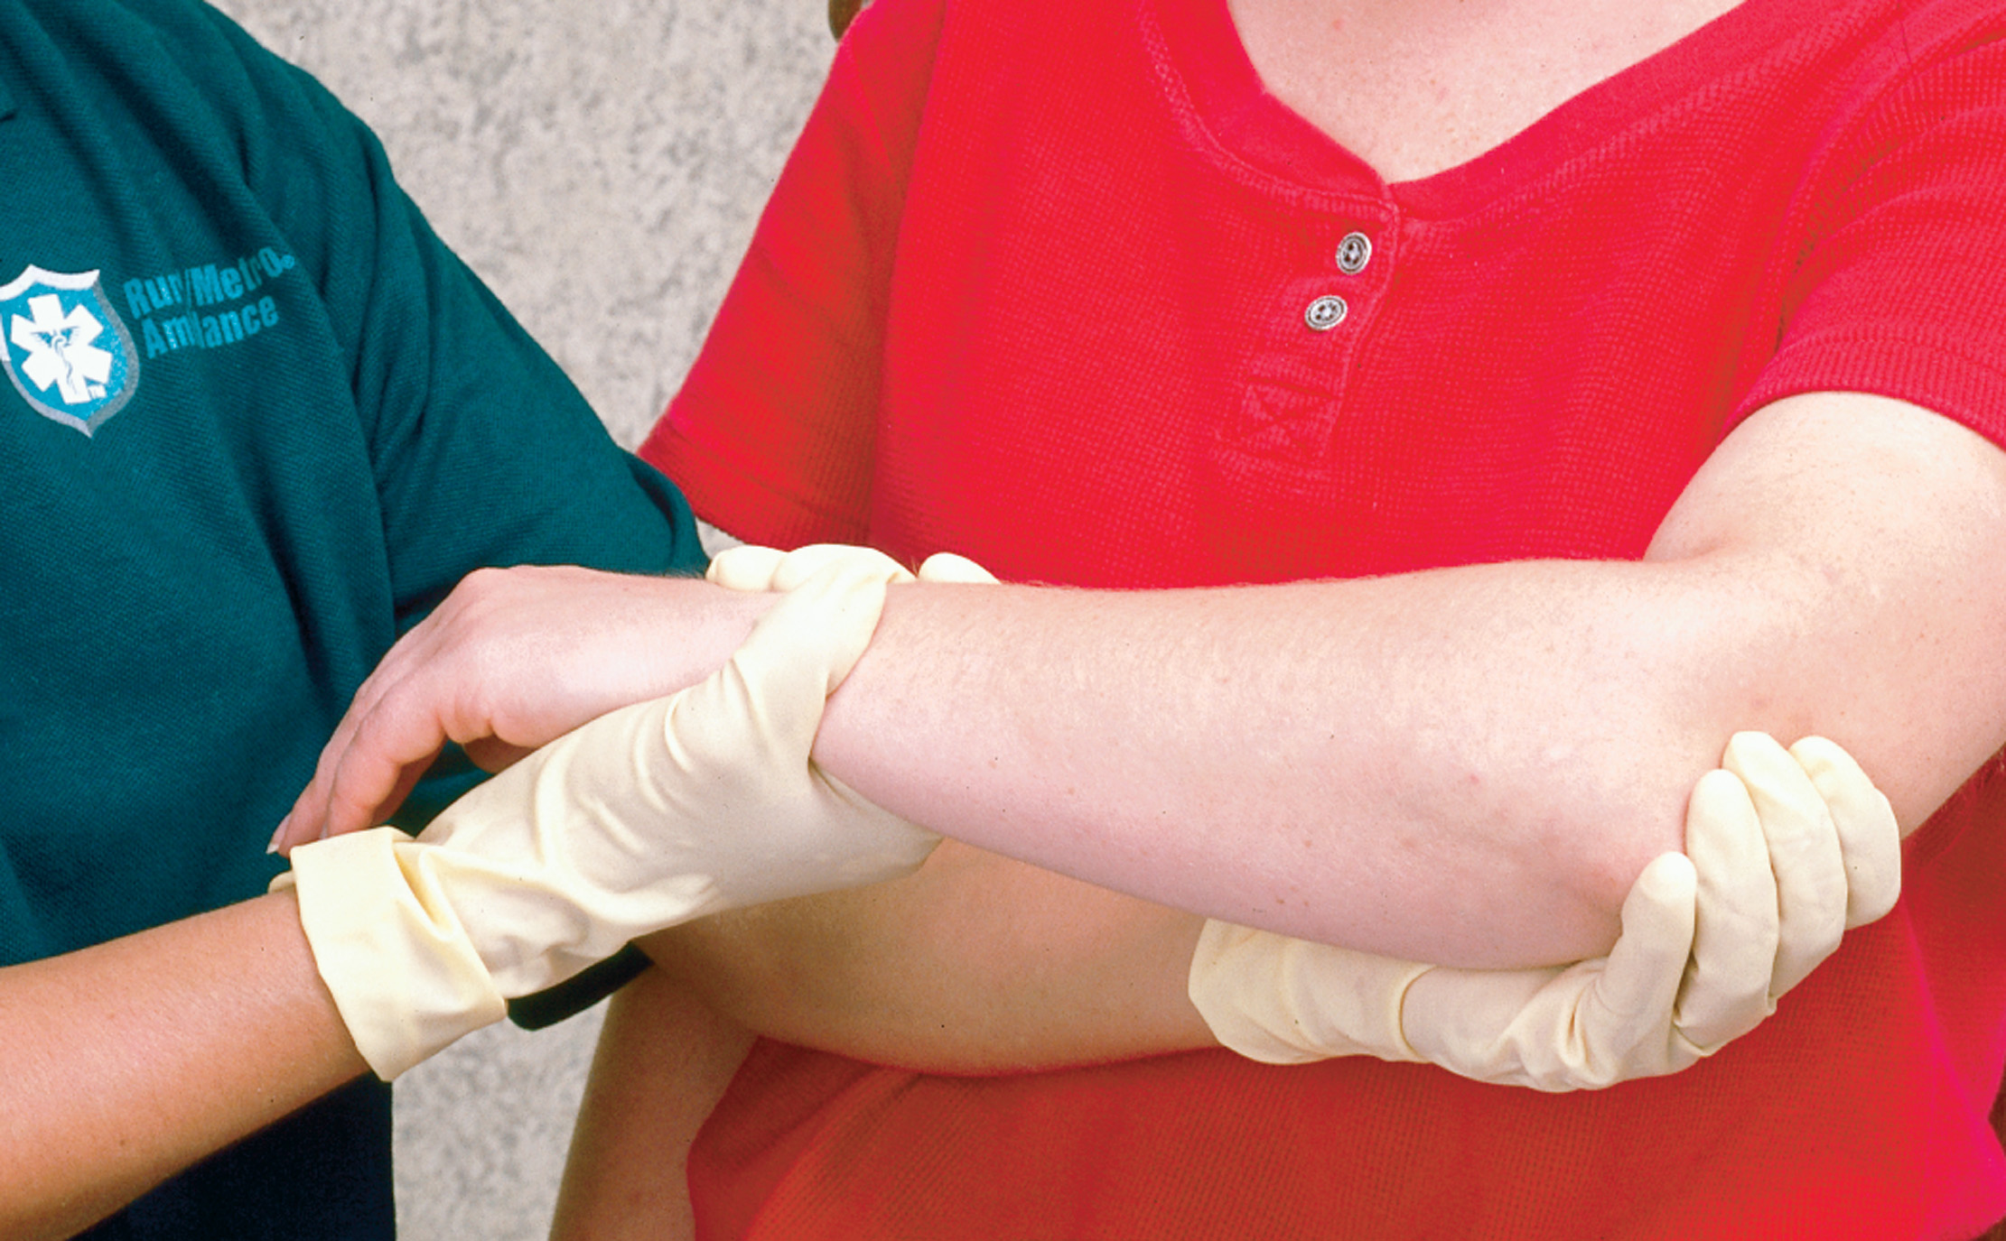
If the Deformity is Severe, Distal Pulses are Absent, or the Distal Extremity is Cyanotic, Align with Gentle Manual Traction
Notes:
If the limb is severely deformed, is cyanotic, or lacks distal pulses, align it with gentle traction.
Provide steady, gentle pressure along with traction. If pain or crepitus increases, stop.

Slide 69
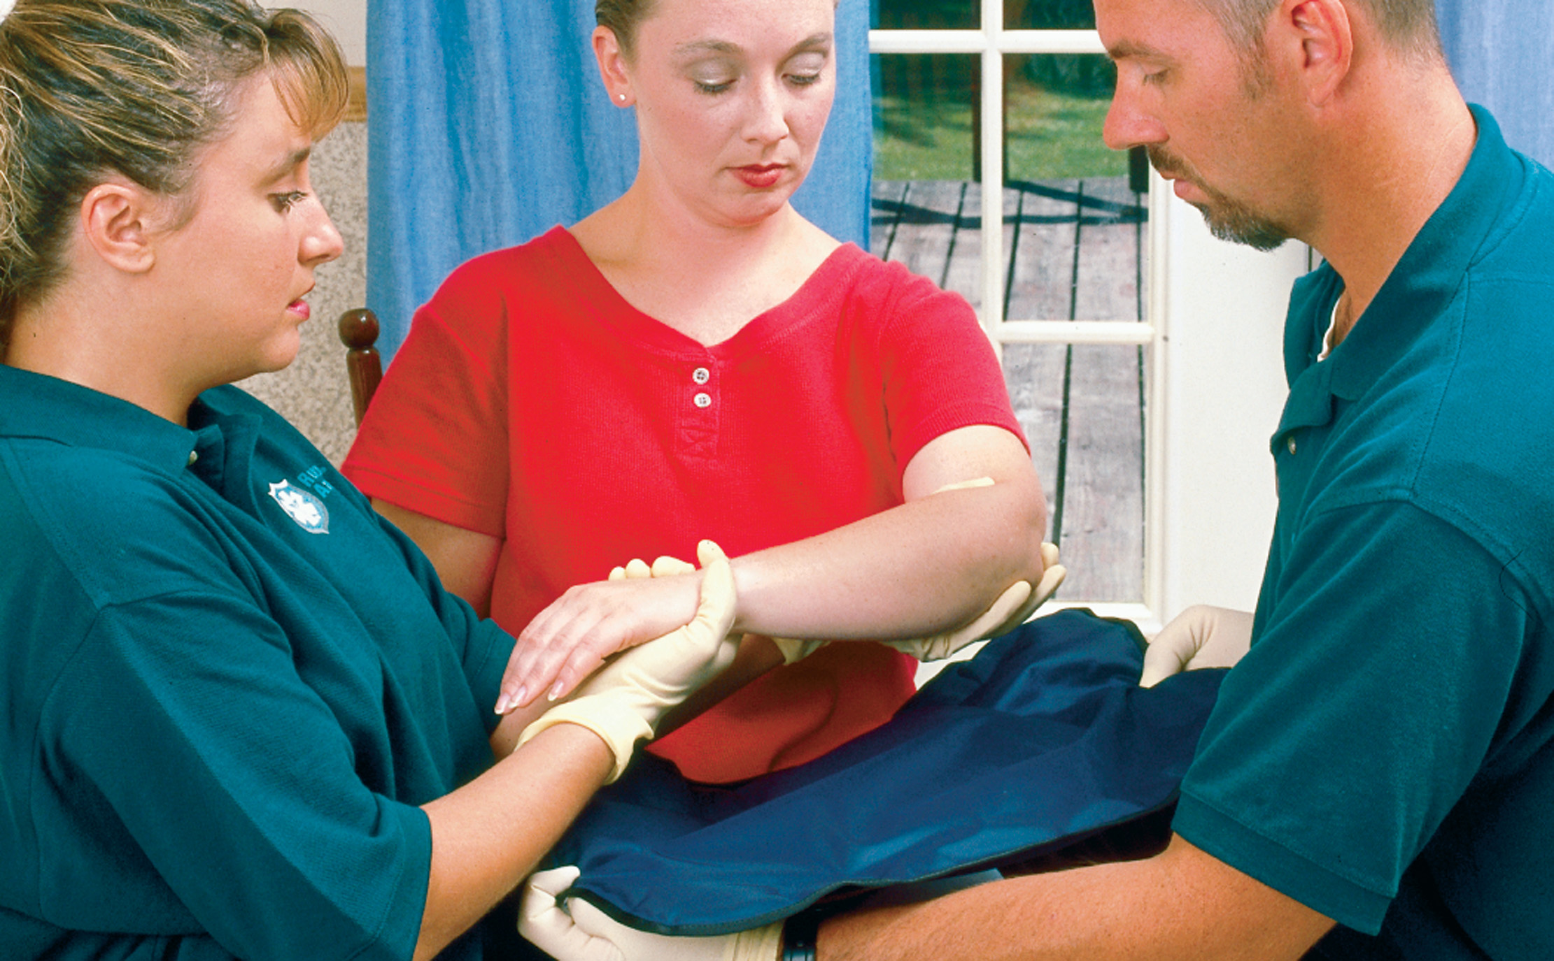
Measure the Splint for Proper Length
Notes:
As you assess for evidence of trauma, look for signs and symptoms of long bone injury.

Slide 70
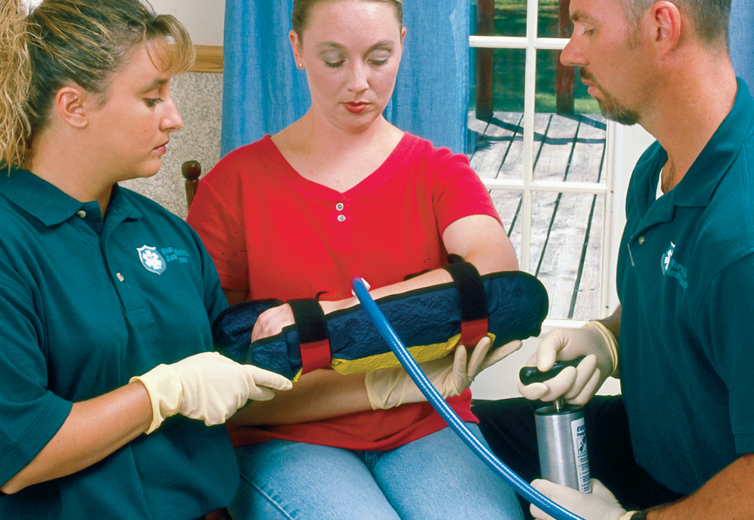
Secure the Entire Injured Extremity. The Hand (or Foot) Must be Immobilized in the Position of Function
Notes:
The hand must be immobilized in the position of function. The position of function for a hand is with the fingers curled as if holding a ball.

Slide 71
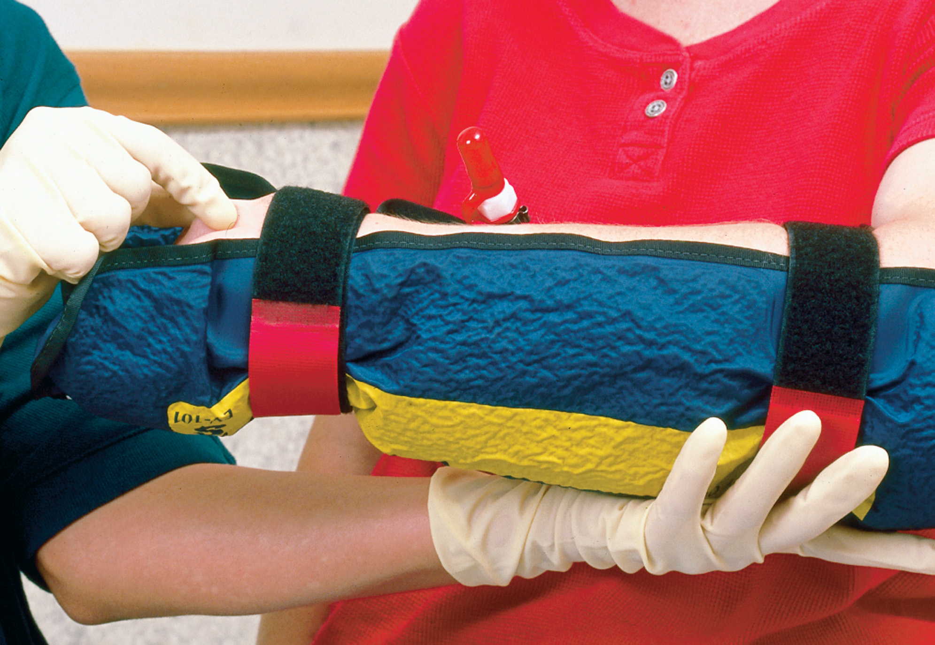
Reassess the Pulse and Motor and Sensory Functions
Notes:
Reassess the pulse, motor and sensory function after completing immobilization.

Slide 72
Basics of Splinting (7 of 13)
Splinting Joint Injuries
  Ligaments holding the bones in proper position are often stretched and torn loose.
  Signs and symptoms of joint injury are pain, swelling, deformity, possible immobility and loss of function.
  Assess the pulse and motor and sensory functions below the injury.
Notes:
If the distal extremity is cyanotic or lacks pulses, align the joint with gentle traction. If pain or crepitus increases, stop. Do not spend time trying to differentiate a joint injury from a bone injury because it might be difficult to distinguish between the two; for both, you need to splint and transport.

Slide 73
E M T Skills 30-4
Splinting a Joint

Slide 74
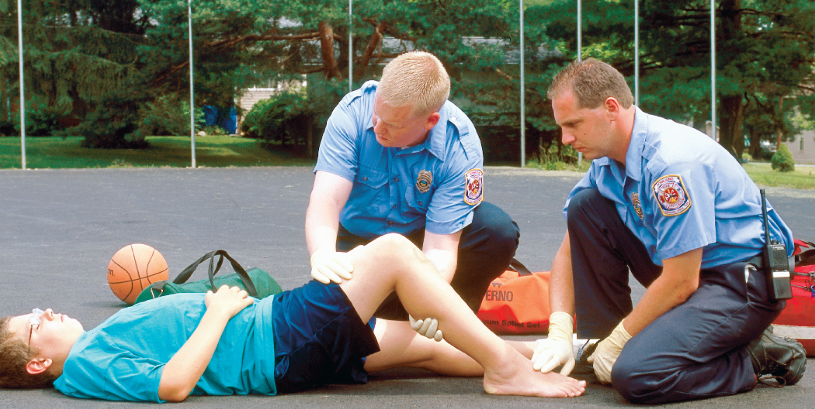
Manually Stabilize the Joint in the Position Found. Then Assess Distal Pulse and Motor and Sensory Function
Notes:
The principal signs and symptoms of any type of joint injury are pain, swelling, deformity, and possible immobility and loss of function.

Slide 75
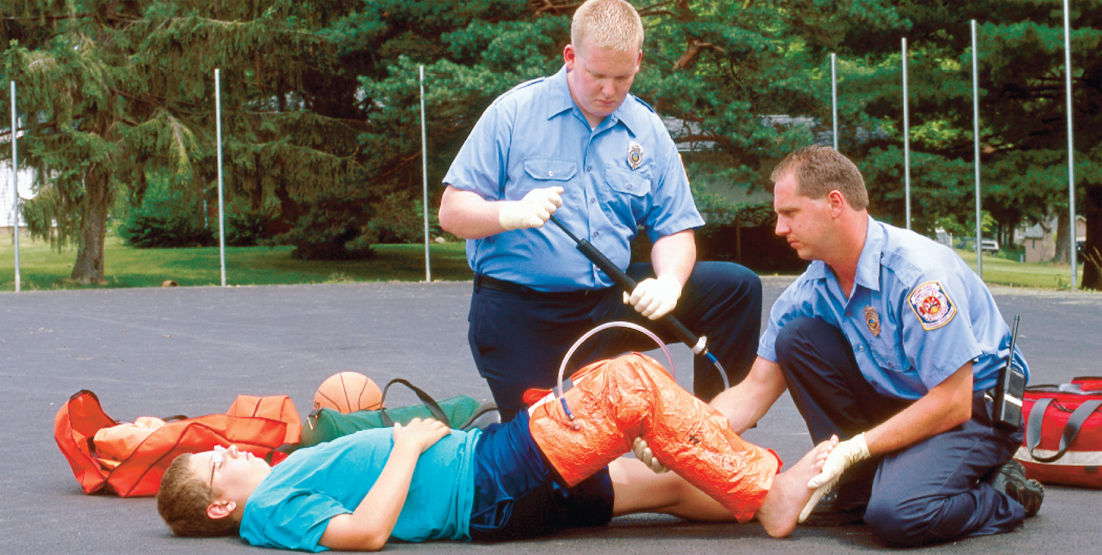
Apply the Splint to Immobilize the Bone above and Below the Joint
Notes:
Do not try to differentiate a joint injury from a bone injury because it might be difficult to distinguish between them.

Slide 76
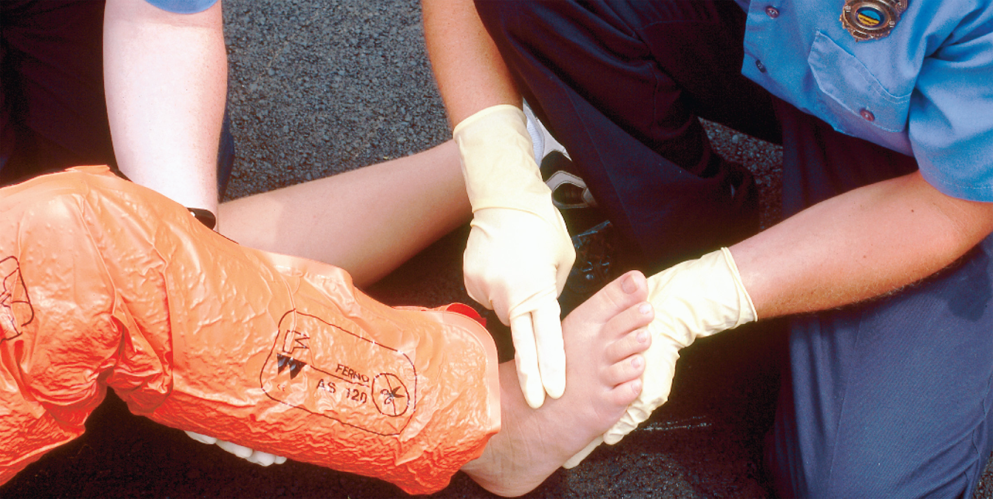
Reassess Sensory Function, Pulses, and Motor Function after the Splint is Applied
Notes:
After splinting, reassess the pulse and motor and sensory function below the injury site.

Slide 77
Basics of Splinting (8 of 13)
Traction Splinting
  Femur fractures can be accompanied by bleeding, pain, and muscle spasms.
  Using traction to align the femur can reduce complications.
  Treat for a fracture if the thigh is painful, swollen, or deformed.
  Traction splints may be unipolar or bipolar.
Notes:
Traction splinting reduces the diameter of the thigh, decreases the space in which bleeding can occur, and realigns the fractured femur. This helps to tamponade the bleeding, relieve pain, and reduce the incidence of internal injuries that would occur if the patient were transported without immobilization of the injured extremity.
Discussion Question
What is the mechanism by which traction splinting works?

Slide 78
Basics of Splinting (9 of 13)
Traction Splinting
  Do not use a traction splint if:
    The injury is within 1 to 2 inches of the knee or ankle.
    The knee has been injured.
    The hip has been injured.
    The pelvis has been injured.
    There is partial amputation or avulsion.
Notes:
Remember that you don’t have to be certain the femur has been fractured. If the thigh is painful, swollen, or deformed, you should treat the femur as if it is fractured.

Slide 79
Basics of Splinting (10 of 13)
Splinting Specific Injuries
  Special techniques can be applied to the splinting of suspected bone and joint injuries to specific sites.
Notes:
Familiarize yourself with proper splinting techniques for the upper arm, elbow, forearm, wrist, hand, fingers, pelvis, hip, thigh, knee, lower leg, ankle, and foot.

Slide 80
Basics of Splinting (11 of 13)
Pelvic Fracture
  Associated with pain and significant bleeding
  Splinting methods include:
    Commercial binder splints
    Improvised splints
    P A S G.
Notes:
Use a commercially available pelvic binder or splint or an improvised pelvic wrap to splint and stabilize the fracture and tamponade the bleeding.

Slide 81

A Pelvic Fracture Can be Effectively Splinted with a Commercial Pelvic Splint. A Pelvic Splint May also be Improvised from a Sheet
Notes:
To apply an improvised pelvic wrap, follow these steps:
Fold a sheet lengthwise to an approximate 8-inch width.
Slide it under the small of the patient’s back and then down under the pelvis until it is centered and the ends of the sheet are of equal length on both sides of the patient.
Cross the tail ends over the patient and twist the ends until the sheet is tightly secured around the pelvis. Take care to avoid any folds coming in contact with the skin and creating pressure points. These can cause skin breakdown if left in place for any length of time.
Tuck the sheet ends under the patient or tie the ends into a square knot.
Place the patient on a backboard or rigid device.

Slide 82
Basics of Splinting (12 of 13)
Compartment Syndrome
  Pressure develops within the injured area.
  The pressure exceeds the capillary pressure needed to perfuse the tissues.
  The tissue becomes hypoxic, which results in further damage and swelling.
Notes:
Compartment syndrome develops over time and is not often seen in the field.
Discussion Question
What is compartment syndrome?
Critical Thinking Discussion
What causes the pain and paresthesia associated with compartment syndrome?

Slide 83
Basics of Splinting (13 of 13)
Compartment Syndrome
  Compartment Syndrome Signs and Symptoms
    Severe pain or burning sensation
    Decreased strength in extremity
    Paralysis of the extremity
    Pain with movement
    Extremity feels hard to palpation
    Distal pulses and motor and sensory functions may be normal
Notes:
Emergency care focuses on treating any life-threatening injuries first. Immobilize and splint the affected extremity then elevate it and apply a cold pack or ice. It is important to transport the patient because they can lose the limb if compartment syndrome is not treated quickly and effectively.

Slide 84
Nontraumatic Fractures
Pathologic Fracture
  This fracture involves a diseased bone; less force is required to fracture the bone.
  Patients with a past medical history of cancer, osteoporosis, and other benign bone conditions such as congenital cysts often suffer pathologic fractures.
Notes:
The signs and symptoms associated with nontraumatic fractures are similar to fractures caused by trauma; however, nontraumatic fractures do not present with obvious evidence of trauma to the area of fracture such as contusions, abrasions, lacerations, and hematomas.
The emergency care for the nontraumatic fracture is the same as for a fracture caused by trauma. During the assessment, ensure the underlying medical condition is not producing any life threats that must be managed.

Slide 85
Case Study Conclusion
Kyle selects a padded, rigid splint that extends from the patient’s fingertips to just below the elbow. He carefully applies and secures the splint, then applies a sling to immobilize the elbow. He reassesses the distal pulse and motor and sensory functions.
At the hospital, Dominique is diagnosed with a fractured radius and ulna, and is told she will be wearing a cast for the next six weeks.
Notes:
Review Case Conclusion and emphasize the application of knowledge learned from this presentation.

Slide 86
Lesson Summary (1 of 2)
Musculoskeletal injuries include fractures, sprains, strains, and dislocations.
Some fractures can result in life-threatening hemorrhaging.
E M T management of musculoskeletal injuries can prevent complications.
Notes:
Follow-Up
Answer student questions.
Follow-Up Assignments
Review Chapter 30 Summary.
Complete Chapter 30 In Review questions.
Complete Chapter 30 Critical Thinking questions.
Assessments
Handouts
Chapter 30 quiz

Slide 87
Lesson Summary (2 of 2)
A variety of types of splints are available to E M T s.
Always assess pulse motor and sensory functions before and after splinting.
Notes:
Class Activity
As an alternative to assigning the follow-up exercises in the lesson plan as homework, assign each question to a small group of students for in-class discussion.
Teaching Tips
Answers to In Review questions are in the appendix of the text. Advise students to review the questions again as they study the chapter.

Slide 88
Correct!
When muscle fibers are overstretched and torn, the injury is known as a strain.
Click here to return to the program.

Slide 89
Incorrect (1 of 3)
A sprain is an injury to the joint capsule and ligaments.
Click here to return to the quiz.

Slide 90
Incorrect (2 of 3)
A dislocation occurs when bone ends are displaced from their normal position in the joint.
Click here to return to the quiz.

Slide 91
Incorrect (3 of 3)
A fracture is a break in the continuity of a bone.
Click here to return to the quiz.

Slide 92

Copyright

