Slide 1
Hazardous Materials Recognition & Safety

Slide 2
Importance of Recognition
Any responder can encounter hazmats
Any responder can get hurt
Percent of responder injured at hazmat incidents.
C-2

Slide 3
Importance of Recognition
Recognition leads to safety
Safety leads to lives preserved
C-2

Slide 4
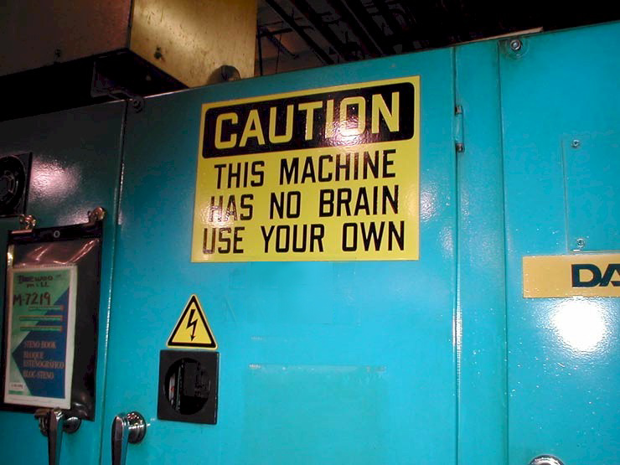

Slide 5
Not Always Reported as Hazmats
Many reported as:
  Traffic accident
  Medical aid
  Fire, person down, etc.
Initial report may not indicate presence of hazardous materials!
C-2
Notes:
Haz Mat Incidents Not Always Reported as Haz Mat Incidents.

Slide 6
Hazmat Recognition Clues
Occupancy/Location
  Who’s there?
  What are they making/selling/storing?
Container Shapes
Markings & Colors
Placards & Labels
Shipping Papers and SDS
Senses
C-4
Notes:
4
Occupancy/Location (Plating shop or highway).
Container Shapes (55-Gallon drum or ribbed tanker).
Markings & Colors (Package/label markings or colors).
Placards & Labels (Orange placard = Explosive).
Shipping Papers and SDS (Consist for railroad incident).
Senses (Sight, hearing and smell - last resort).
Other Clues (Responsible party, witness, business plan).
(As per NFPA 472.)

Slide 7
Other Recognition Clues?
Responsible Party
Witnesses
Business plan
C-4

Slide 8
“Clues” are “Clues”!
They are a,
  Warning
  Note of caution
  Indication of things to come
  But not always all the answers!
C-4

Slide 9
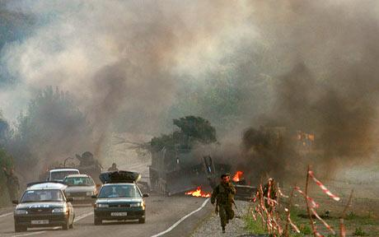
Outward Warning Signs
People running from, or collapsed in the area
C-6
Notes:
5

Slide 10
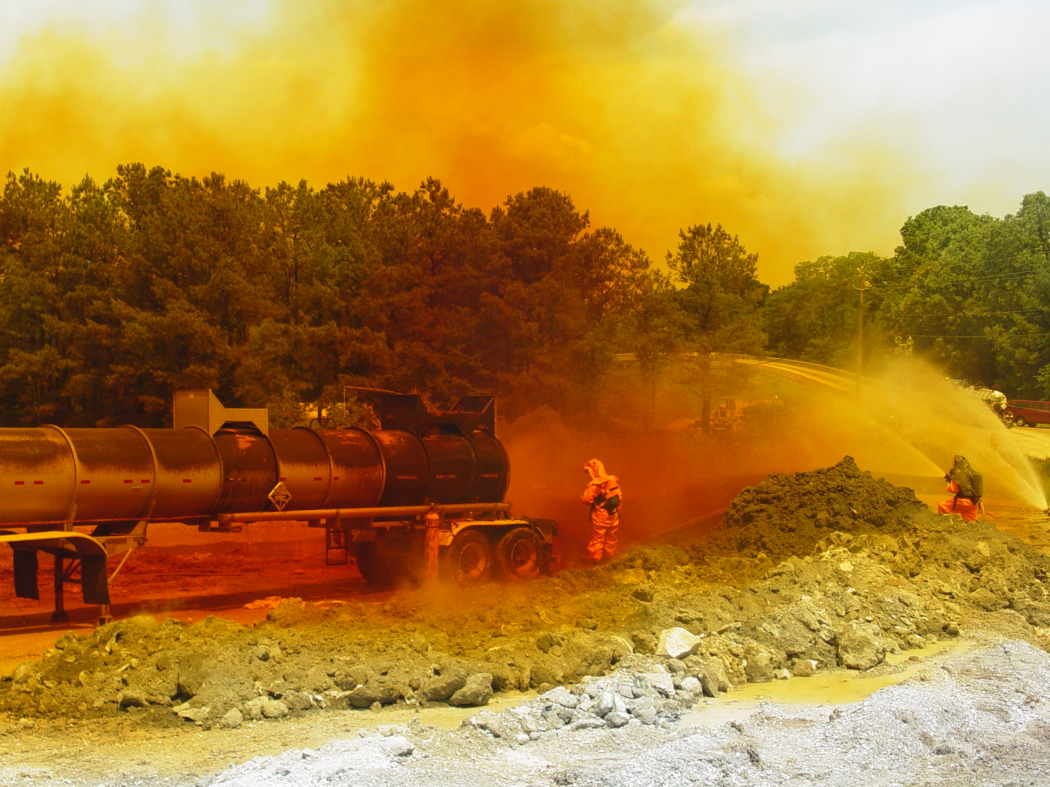
Outward Warning Signs
Evidence of leak, fire, smoke, visible vapors, unusual colors/odors, sheen on the water
C-6

Slide 11
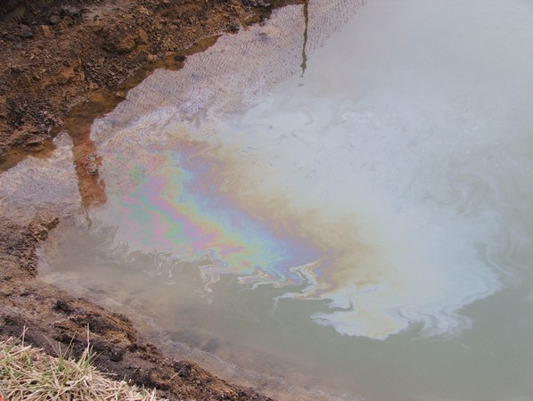
Outward Warning Signs
Evidence of leak, fire, smoke, visible vapors, unusual colors/odors, sheen on the water
C-6

Slide 12
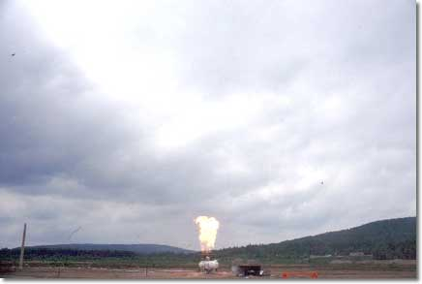
Outward Warning Signs
Sound of an operating relief valve
C-6

Slide 13

Outward Warning Signs
Evidence of fumigation
C-6

Slide 14
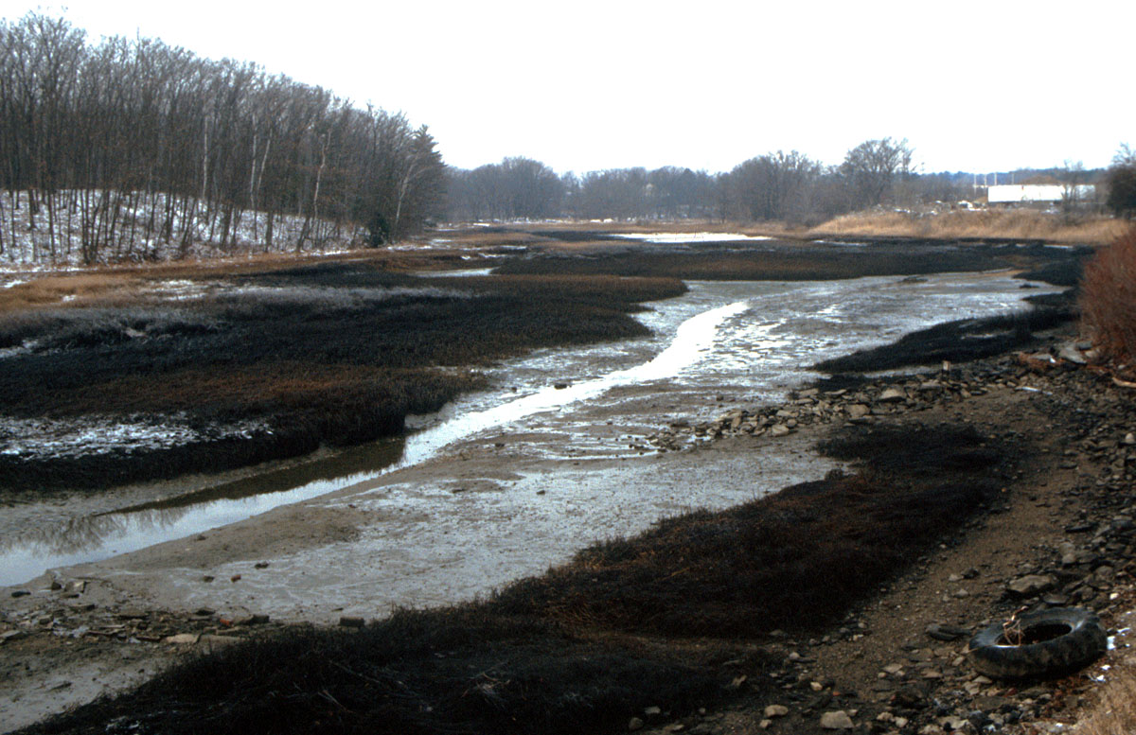
Outward Warning Signs
Dead animals
Dead insects
Discolored vegetation
C-6

Slide 15

Outward Warning Signs
People w/symptoms of exposure
C-6

Slide 16
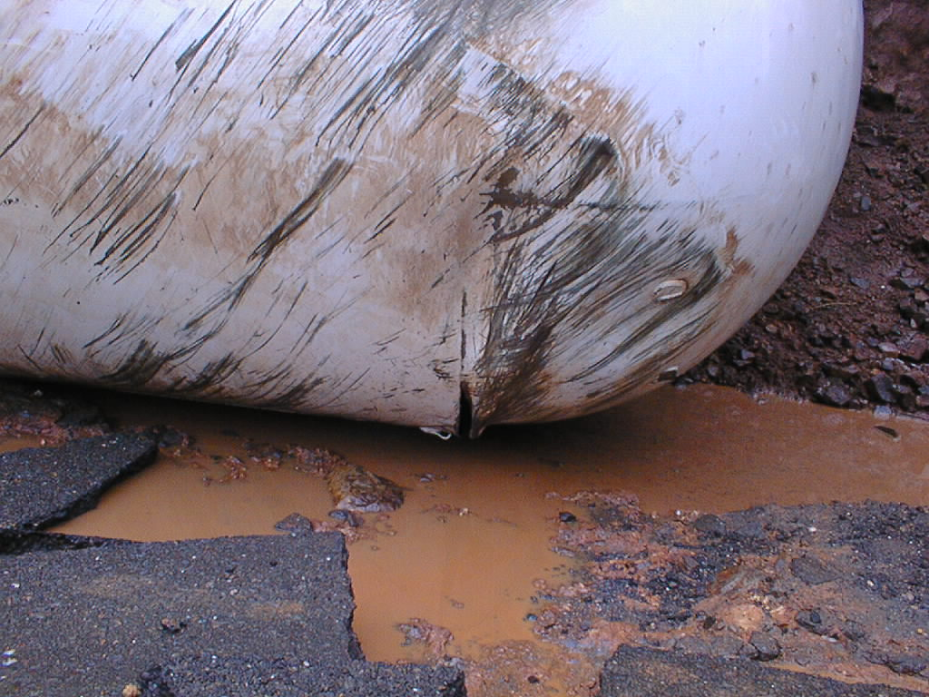
Outward Warning Signs
Damaged/deteriorated container(s)
C-6

Slide 17
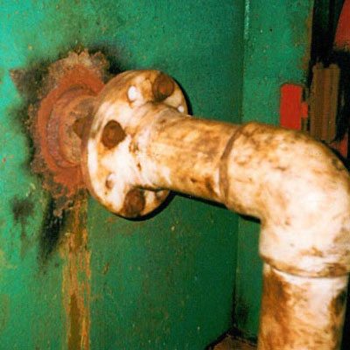
Outward Warning Signs
Discoloration
  Containers, pipes, valves, containment, etc.
C-6

Slide 18
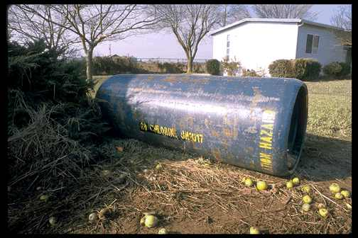
Outward Warning Signs
Something just doesn’t look right…
C-6

Slide 19
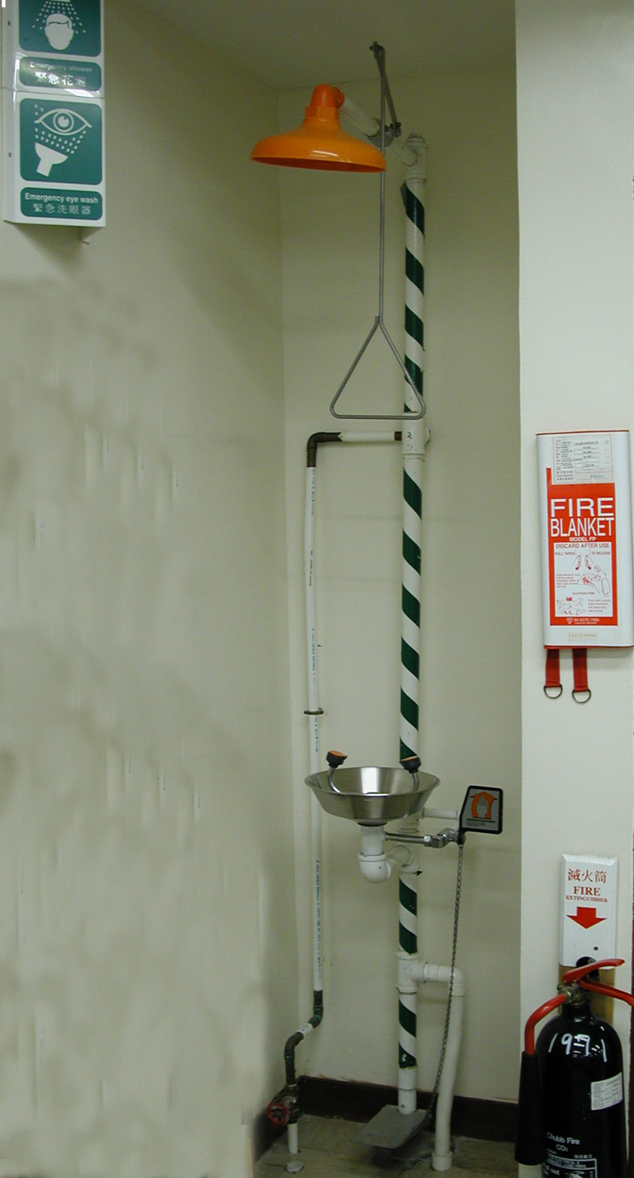
Industrial Facilities
Alarms
  Monitoring systems
  Emergency decon showers
Visible warnings
  Signs, Paint
C-6

Slide 20
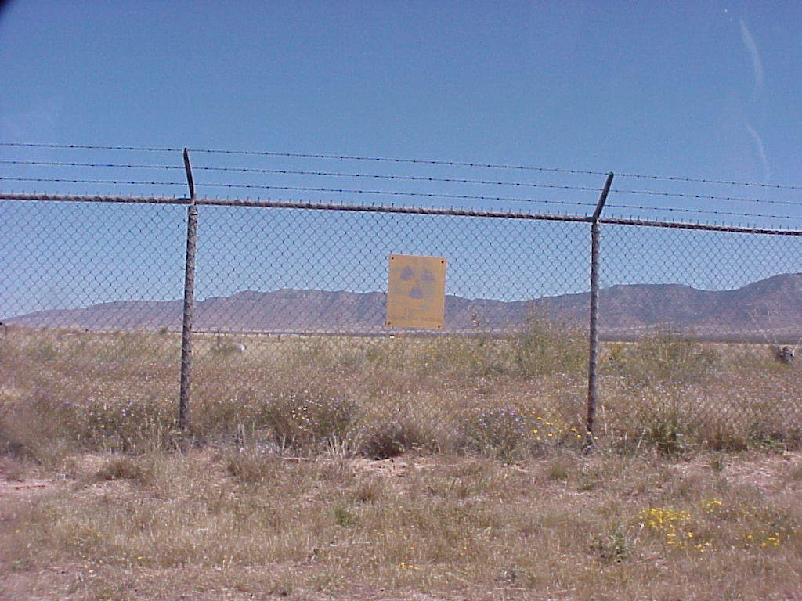
Signs – Unspecified Hazards
C-6

Slide 21

C-6

Slide 22
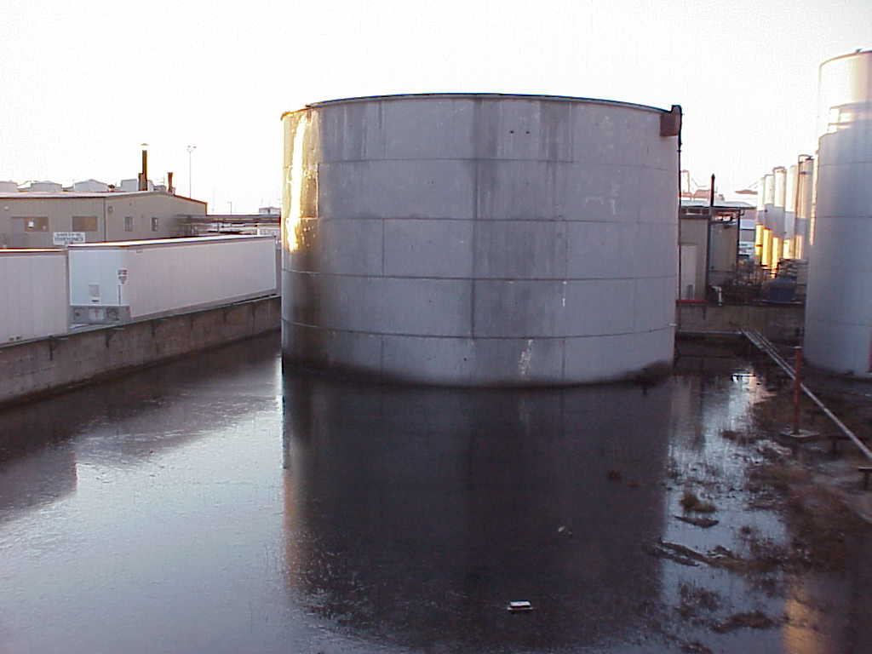
Industrial Facilities
Unknown material in containment
C-6

Slide 23
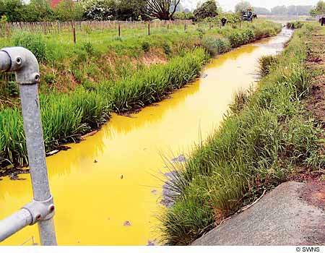
Outward Warning Signs
Something just doesn’t look right…
C-6

Slide 24
Outward Warning Signs
Remember: Assume Haz Mat & look for clues or warning signs until you confirm the absence of hazardous materials!
C-6

Slide 25
Occupancy & Location
Fiori Foundry
C-8

Slide 26
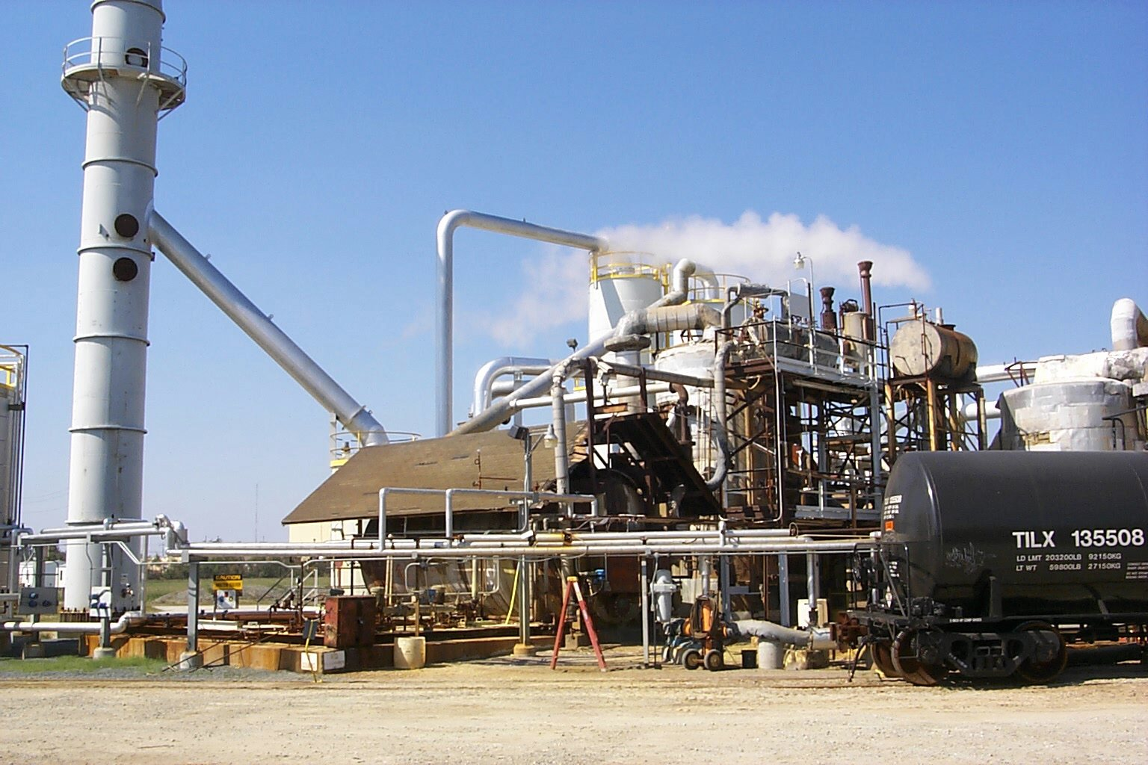
Occupancy & Location
Obvious locations
C-8

Slide 27
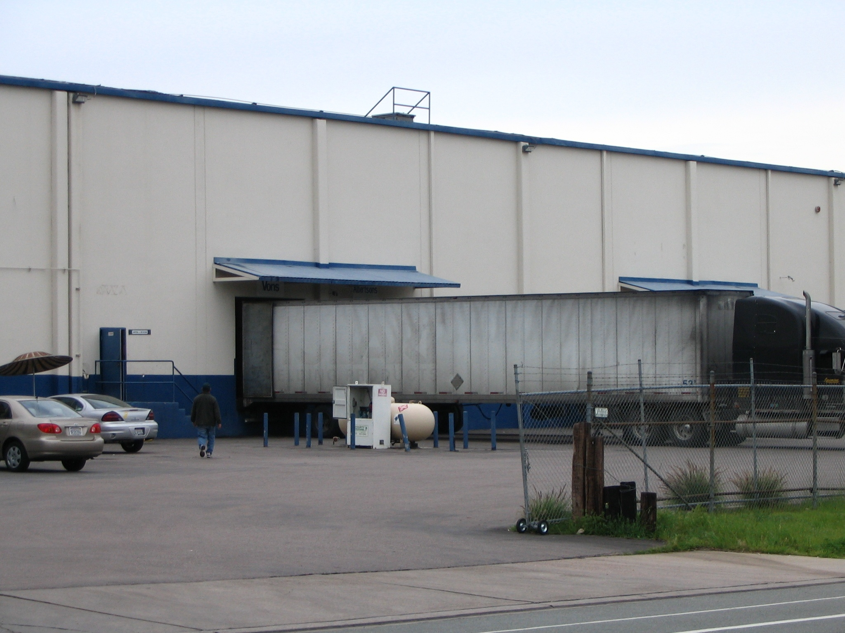
Occupancy & Location
Not so obvious
C-8

Slide 28
Container Shapes
Bejar & Sons Gases
C-8

Slide 29
Containers and Packages
Physical properties determine shape
They are shaped that way for a reason!
C-8

Slide 30
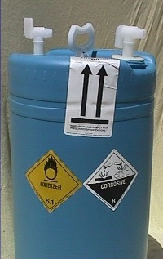
Container Materials
They are made that way for a reason
Shape and material are important clues
C-8

Slide 31
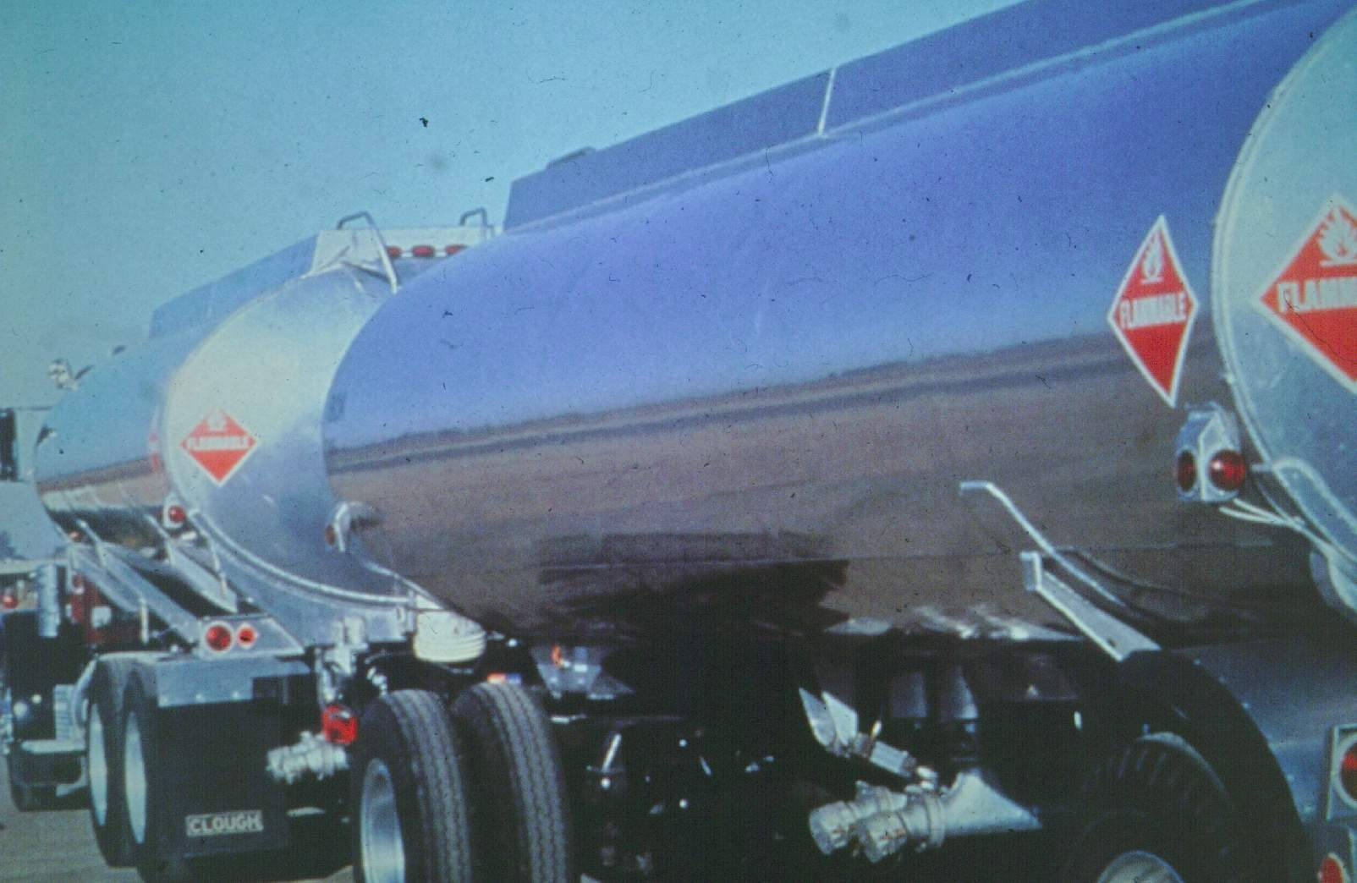
DOT Spec Vehicles
DOT 406/MC 306
C-8

Slide 32
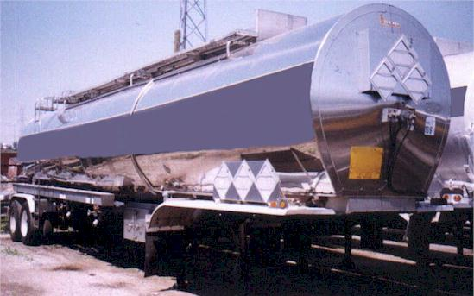
DOT Spec Vehicles
DOT 407/MC 307
C-8

Slide 33
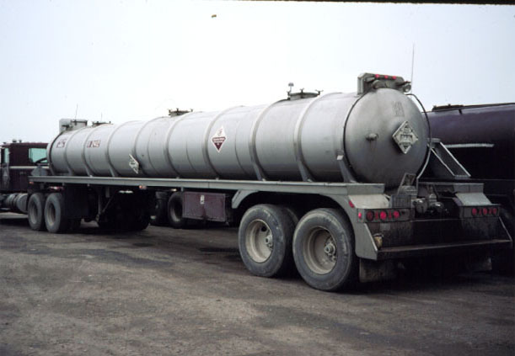
DOT Spec Vehicles
DOT 412/MC 312
C-8

Slide 34
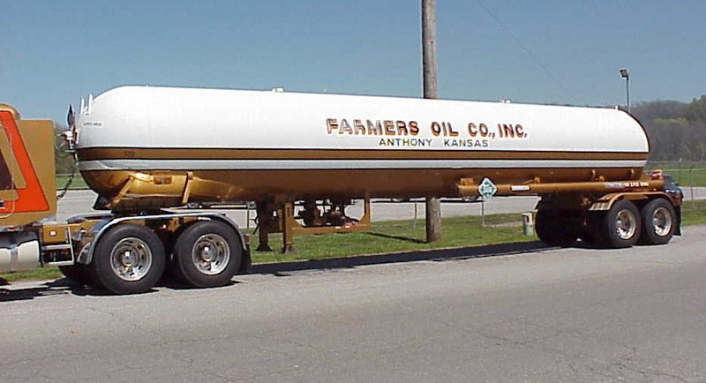
DOT Spec Vehicles
MC 331
C-8

Slide 35
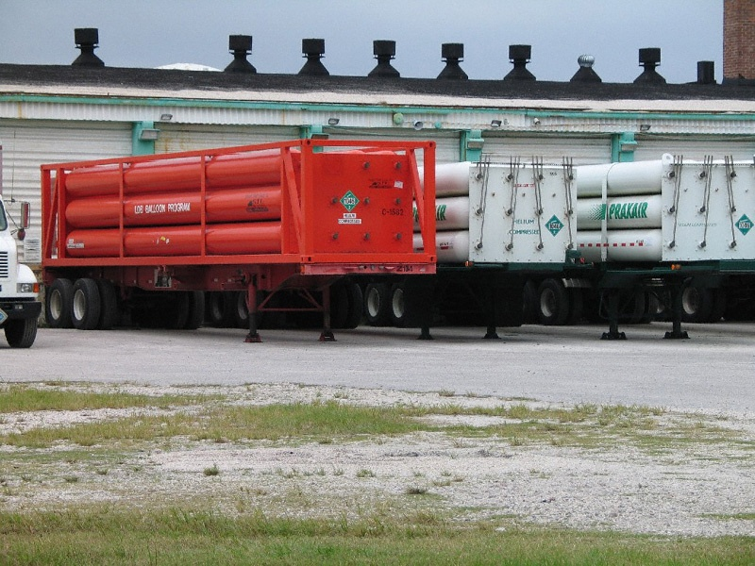
DOT Spec Vehicles
MC 331 – Tube Trailer
C-8

Slide 36
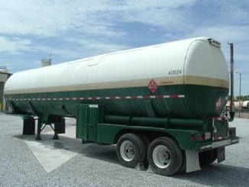
DOT Spec Vehicles
MC 338
C-8

Slide 37
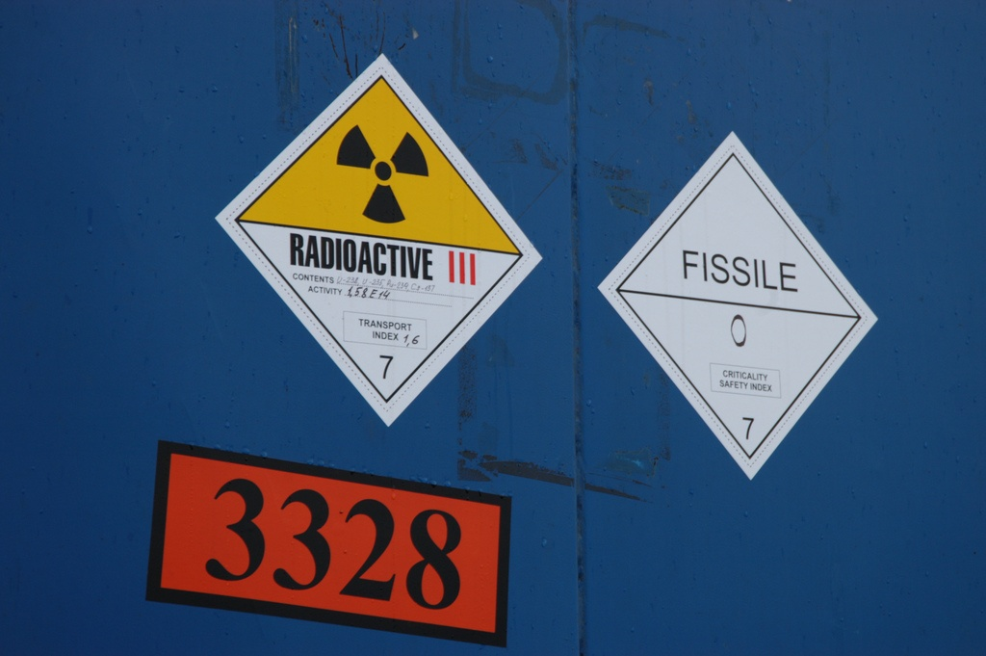
Radiological Containers
C-10

Slide 38

Radiological Containers
Excepted
C-10

Slide 39
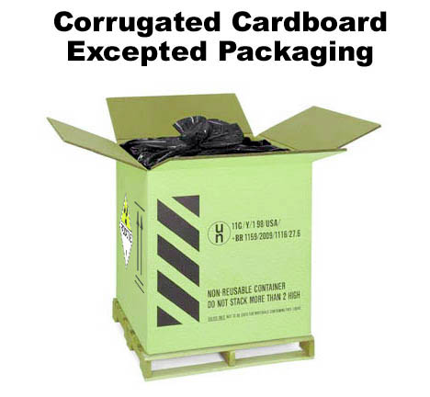
C-10

Slide 40
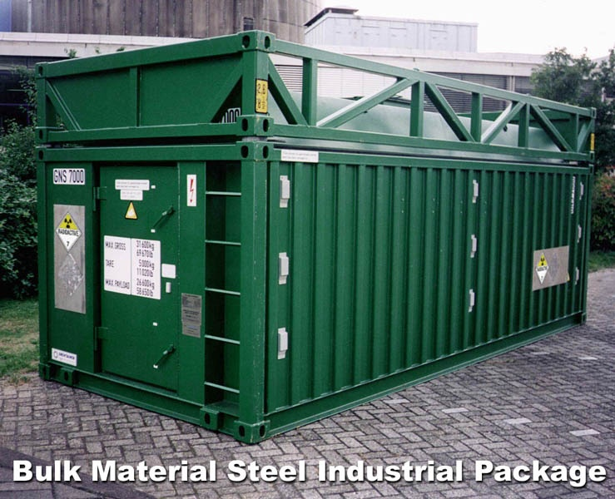
Radiological Containers
Industrial
C-10

Slide 41
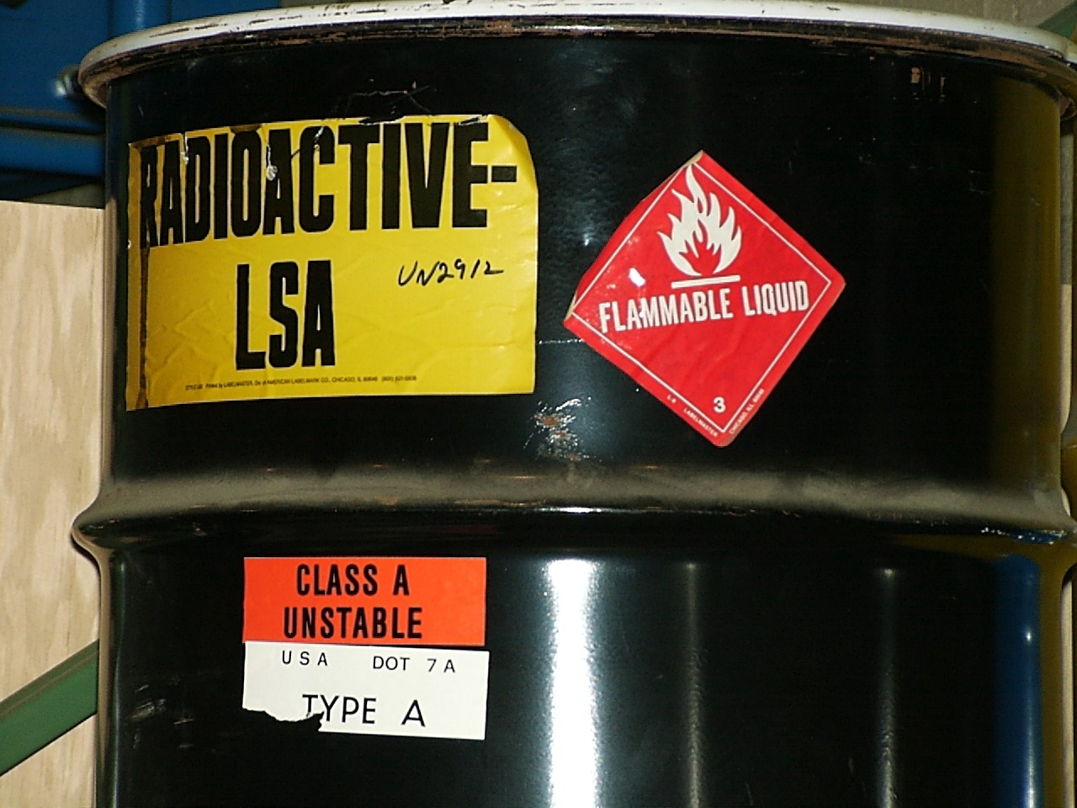
Radiological Containers
Type A
C-10

Slide 42
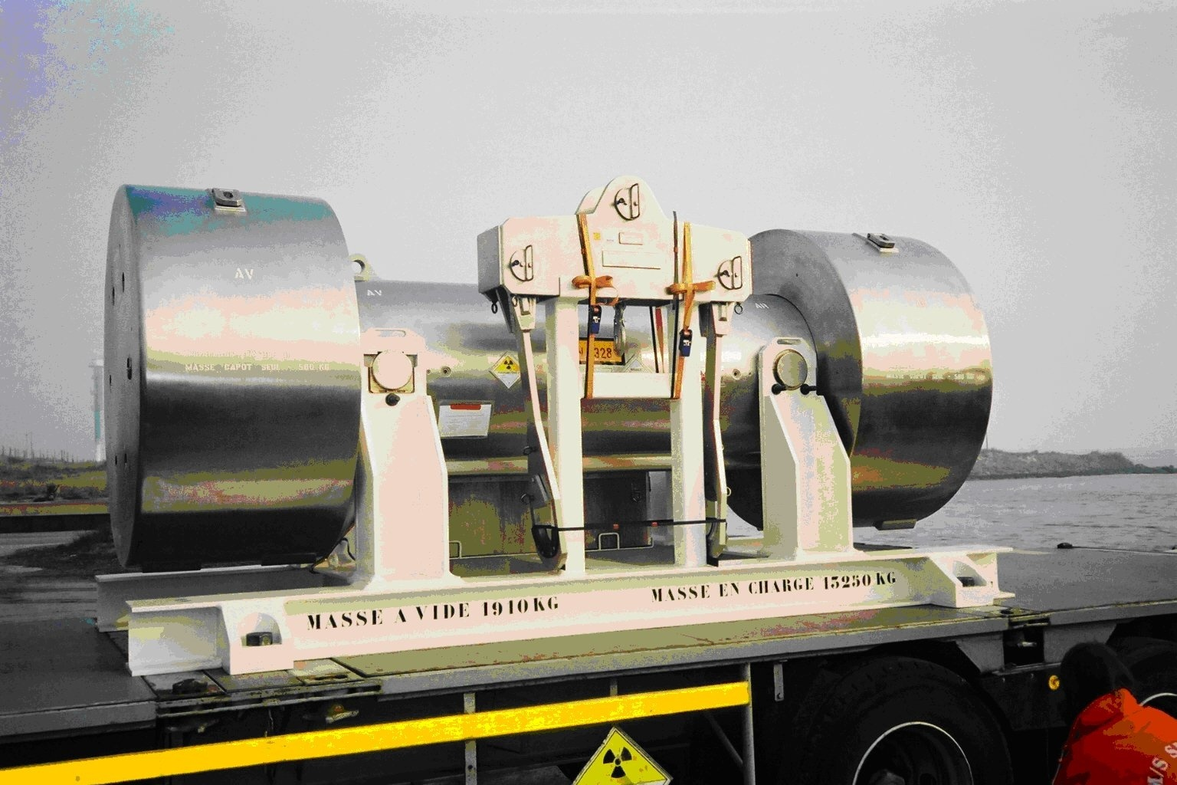
Radiological Containers
Type B
C-10

Slide 43
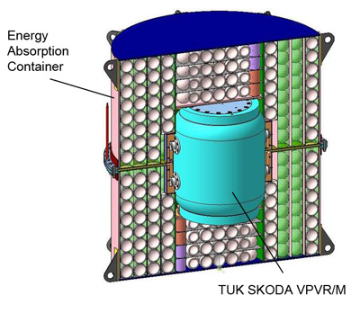
Radiological Containers
Type C
C-10

Slide 44
Other Types of Containers

Slide 45
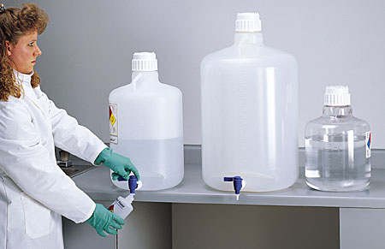
Carboys
C-10

Slide 46
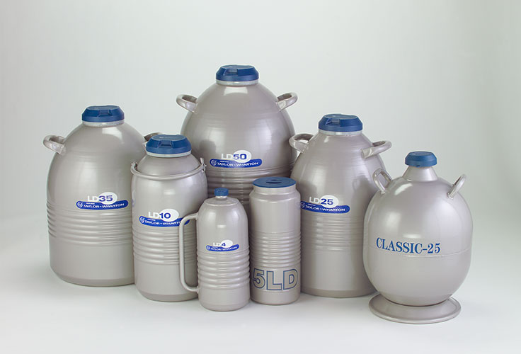
Dewar Flasks
C-10

Slide 47
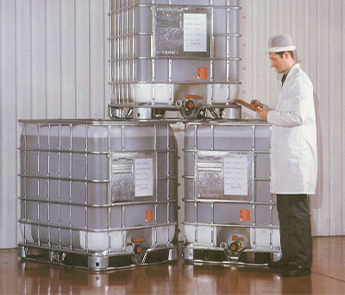
Intermediate Bulk Containers
C-10

Slide 48
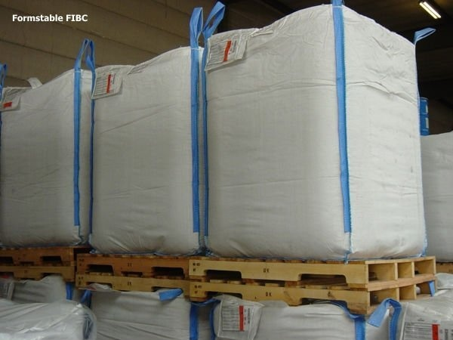
Flexible IBCs
C-10

Slide 49
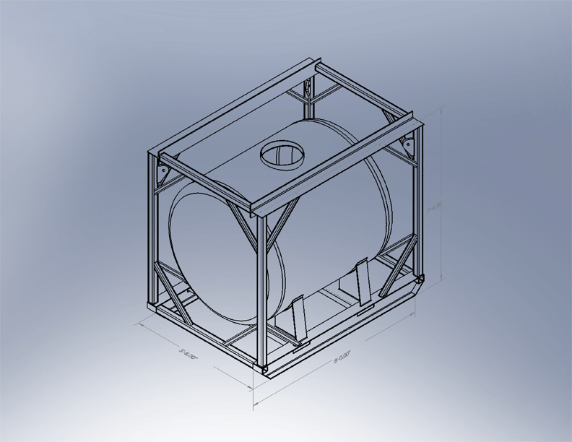
Marine Portable Tank
C-10

Slide 50
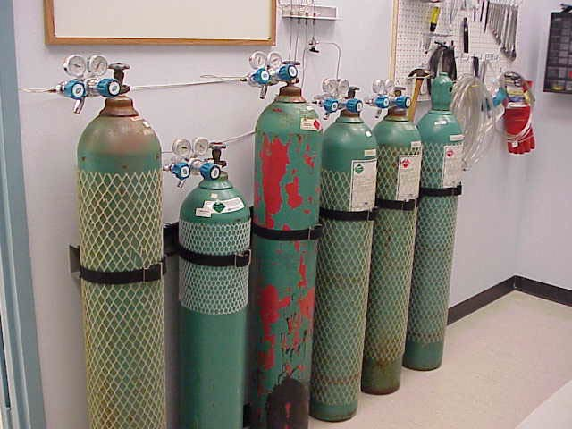
Compressed Gas Cylinders
C-10

Slide 51

Above-Ground Tanks
C-12

Slide 52
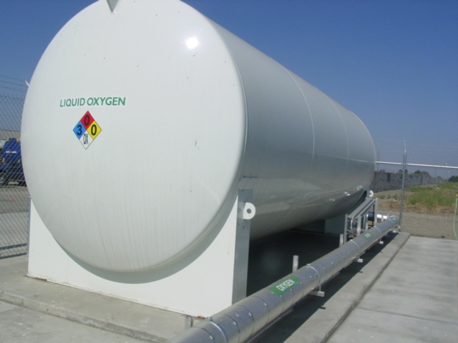
Cryogenic Liquid Tanks
C-12

Slide 53
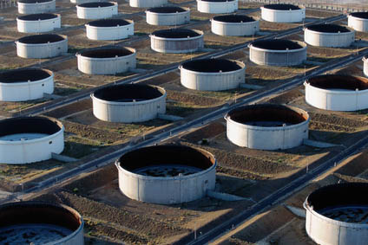
Non-Pressure Tanks
C-12

Slide 54
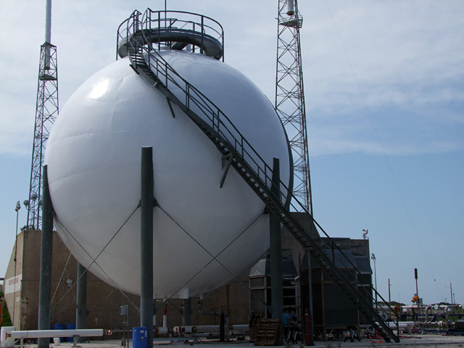
Pressure Tank (High)
C-12

Slide 55
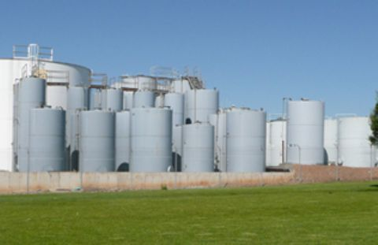
Pressure Tank (Low)
C-12

Slide 56
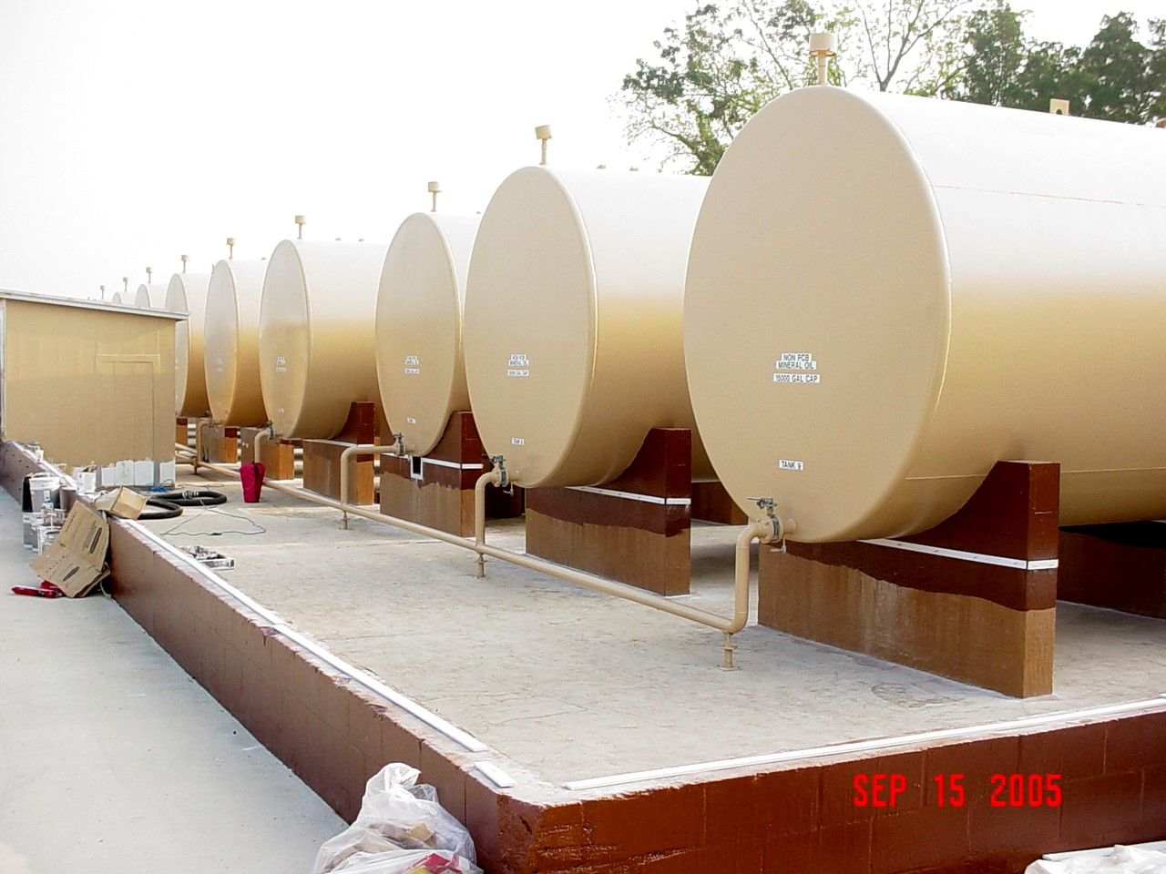
Secondary Containment
C-12
Most above-ground tanks will have secondary containment

Slide 57
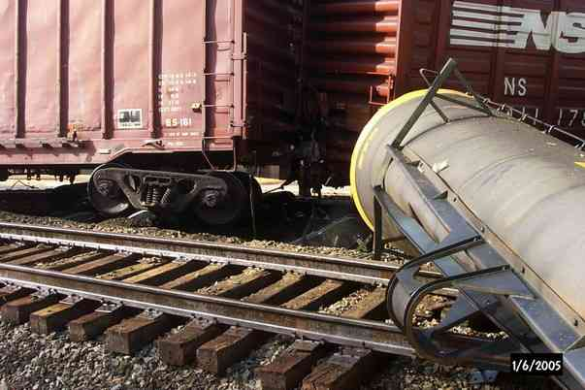
Railcars
C-14

Slide 58
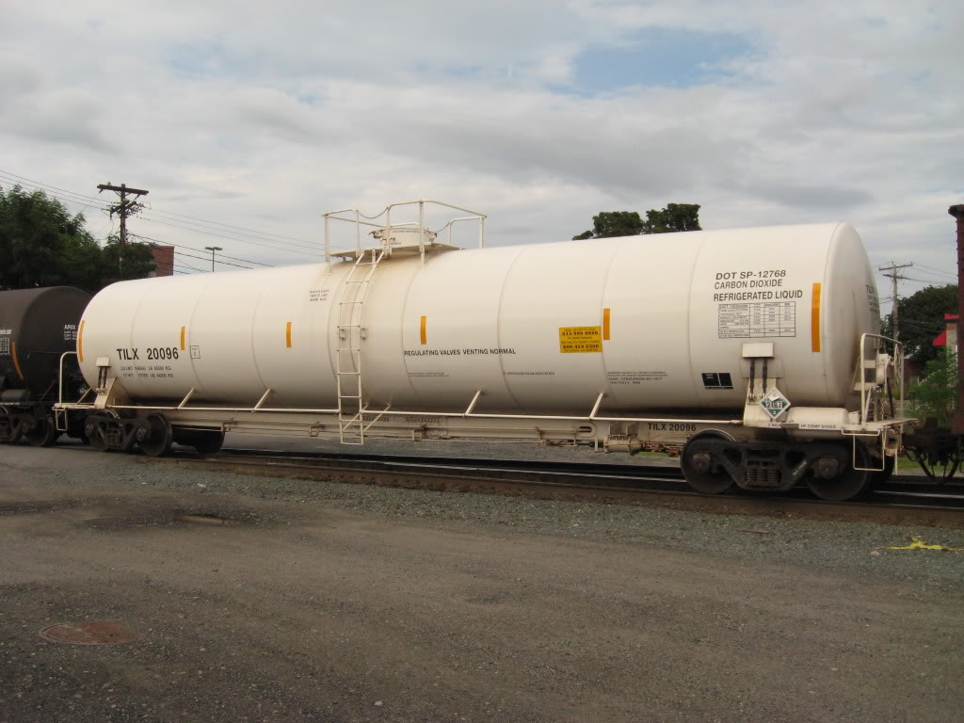
Cryogenic Liquid Cars
C-14

Slide 59
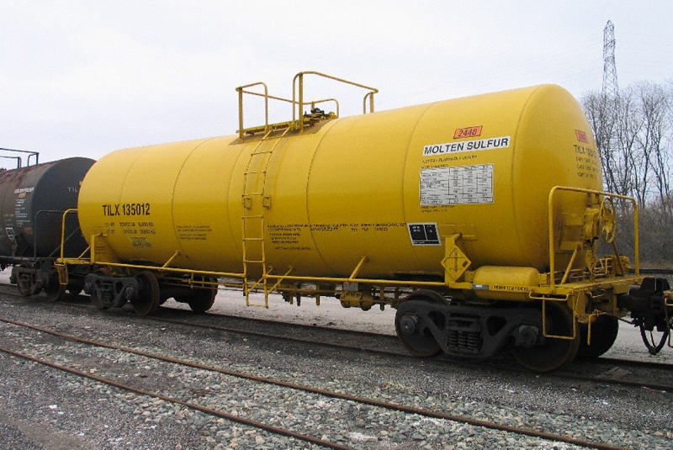
General Service Car
C-14

Slide 60
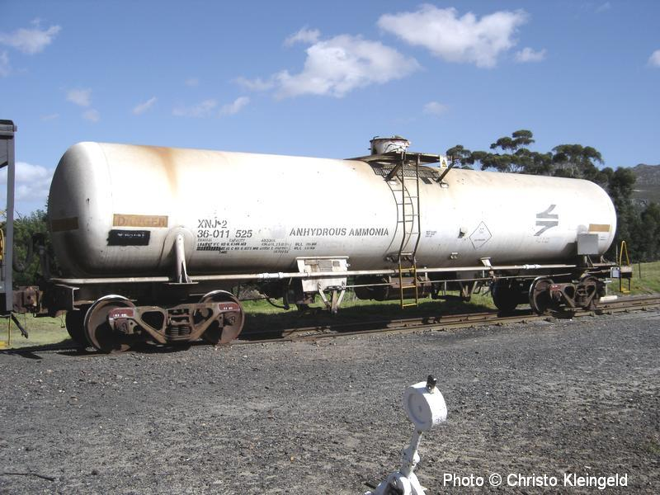
Pressure Car
C-14

Slide 61
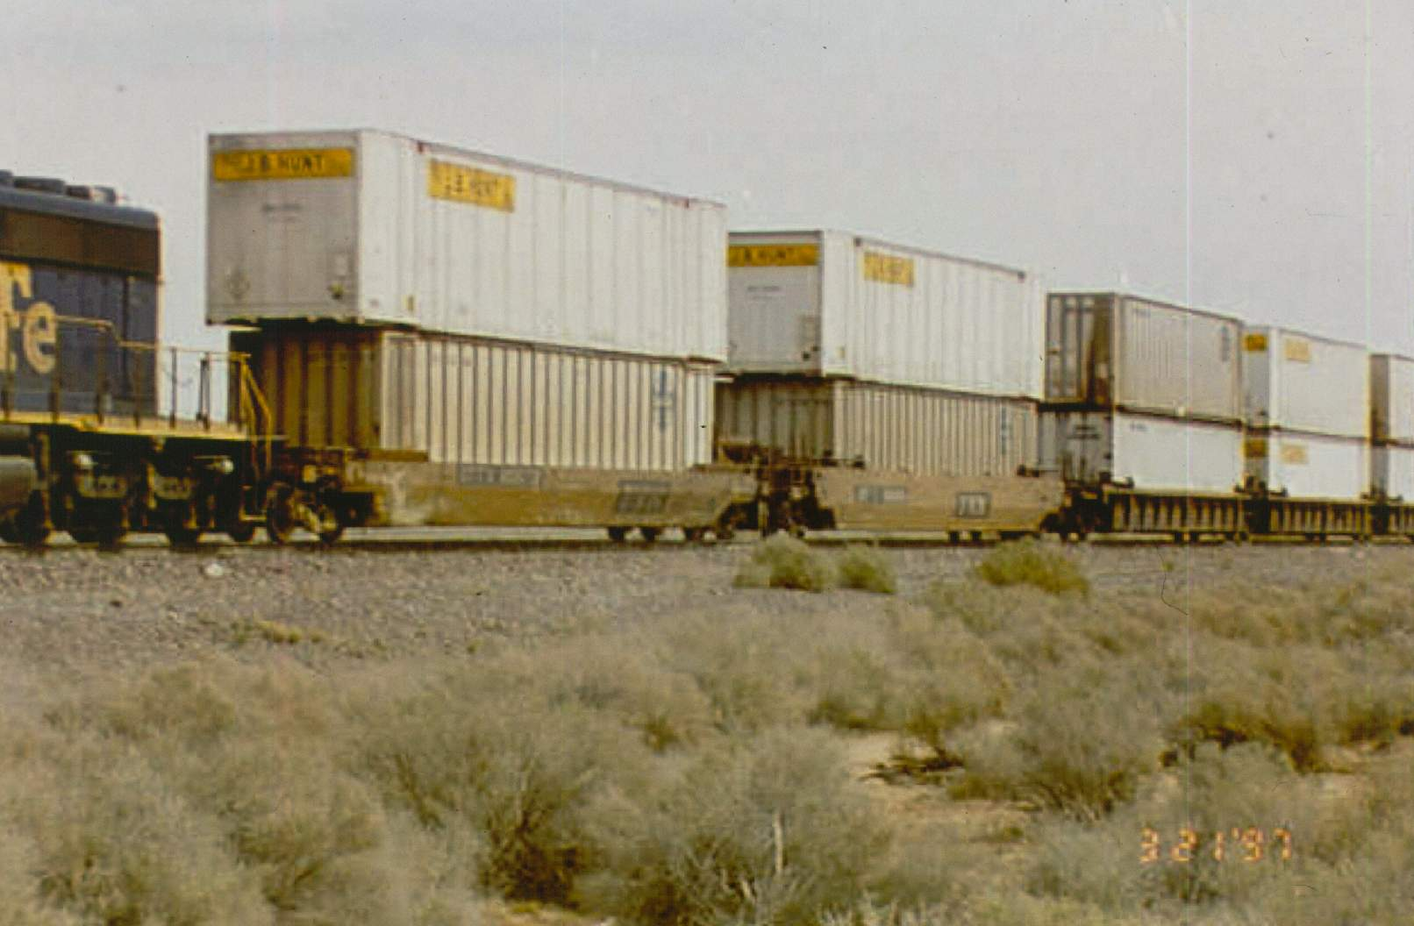
Container Stack Car
C-14

Slide 62
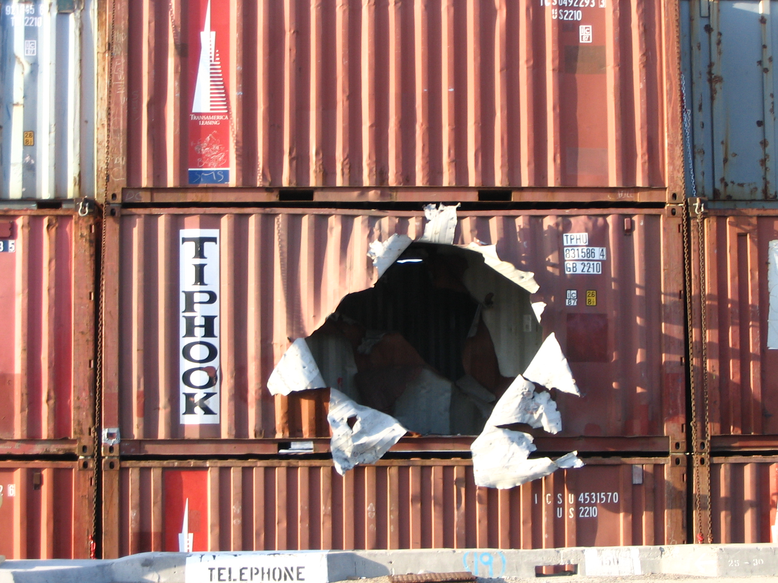
Intermodal Containers
C-16

Slide 63
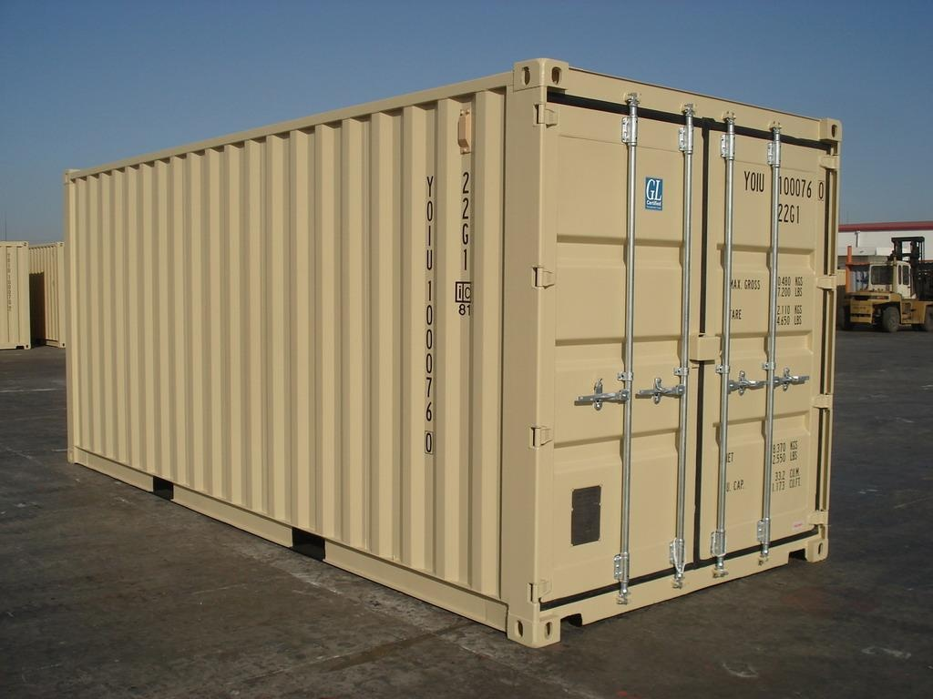
Non-Pressure Container
C-16

Slide 64
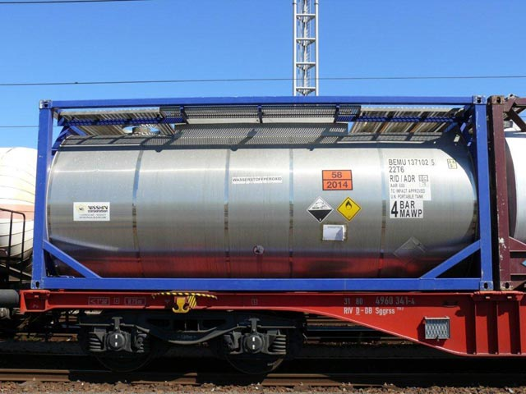
Low Pressure Container
C-16

Slide 65
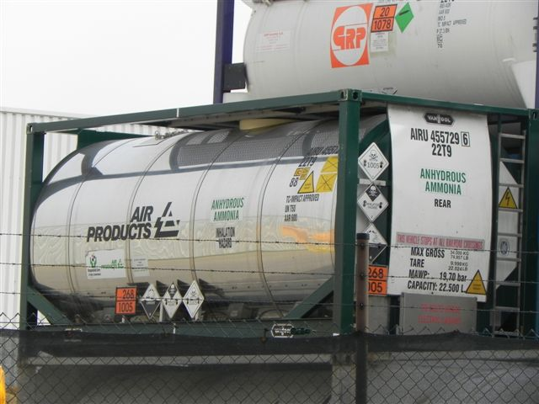
Pressure Tank Container
C-16

Slide 66
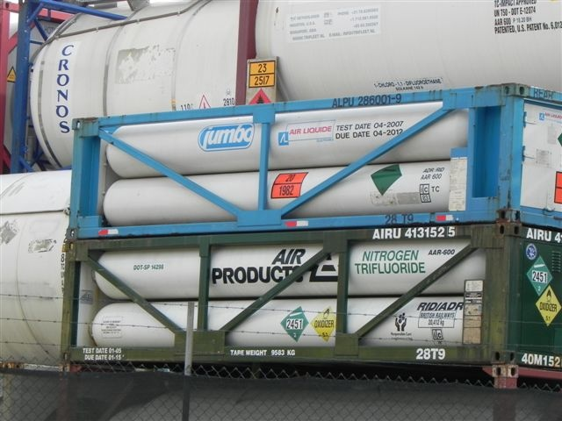
Specialized – Tube Trailer
C-16

Slide 67
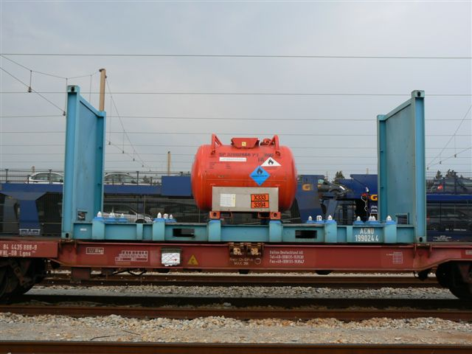
Specialized – Open Top
C-16

Slide 68

Specialized - Cryogenic
C-16

Slide 69

Markings and Colors

Slide 70
DOT Placards and Labels
Purpose of system
  Provide visible warning
  Warn of hazards present
C-18

Slide 71
Marking Requirements
Must have placard and ID number
  ID number may be on orange panel
Markings must be on each side and each end
C-18

Slide 72

C-18

Slide 73
Placards
Displayed on shipping vehicle
Diamond shaped
At least 11 inches X 11 inches
C-18

Slide 74

C-18

Slide 75
Components of Placards
Background
and Border
C-18

Slide 76
Components of Placards
Symbol
Background
and Border
C-18

Slide 77
Components of Placards
Symbol
Background
and Border
1654
ID Number and
Division Number
6.1
C-18

Slide 78
Labels
Displayed on “packages”
Diamond shaped
At least 4 inches X 4 inches
C-18

Slide 79

C-18

Slide 80
Placards and Labels
Background color, symbol and number at bottom all correspond to hazard class
C-18

Slide 81


Colors, Symbols & Examples

Slide 82

Explosives
1
C-20

Slide 83





Gases
2
C-20

Slide 84


Flammable Liquids
3
C-20

Slide 85



Flammable Solids
4
C-20

Slide 86

Oxidizers
5.1
C-20

Slide 87

Organic Peroxides
5.2
C-20

Slide 88



Poison/Toxic
6
C-20

Slide 89

Radioactives
7
C-20

Slide 90

Corrosives
8
C-20

Slide 91

Misc. Dangerous Substances
9
C-20

Slide 92
Specialized Placards
C-20

Slide 93
Placards Limits
Multiple and subsidiary hazards
“Dangerous” placard meaning
  (Table 1 & 2 commodities)
C-22

Slide 94

Compliance & Enforcement
On point?
Flammable?
C-22

Slide 95

Placard Limits
No placard doesn’t mean no hazard!
C-22

Slide 96
When They’re Required
Bulk shipments
Table 1 commodities
  Any amount
Table 2 commodities
  More than 1001 lbs aggregate amount
C-22

Slide 97
Placards versus Labels
Placards
  Affixed to shipping “containers”
Labels
  Affixed to shipping “packages”
C-22

Slide 98

Placards
C-22

Slide 99

Labels
C-22

Slide 100

Other Transportation Markings

Slide 101

Orange Panels
See the ERG
C-22

Slide 102

Stenciled Railcars
C-22

Slide 103



Package Labels
C-22

Slide 104

Pipeline Markers
C-22

Slide 105

Fumigant
C-22

Slide 106

Elevated Temperature Materials
C-22

Slide 107

Marine Pollutant
C-22

Slide 108

Orientation Markings
C-22

Slide 109

ORM-D Marking
C-22

Slide 110
Purpose of Markings
“Placards and labels are a method of communication for you!”
John Falat, California Highway Patrol

Slide 111
Senses
Last resort!
Highest danger!

Slide 112


Special Markings
C-24

Slide 113

NFPA 704
C-24

Slide 114

NFPA 704 – Scope
Addresses hazards of short-term exposure
  Health
  Flammability
  Instability
  Special hazards
C-24

Slide 115

NFPA 704 – Applicability
Facilities
  Industrial
  Commercial
  Institutional
Required by CA Fire Code
C-24

Slide 116

NFPA 704 – Purpose
Give basic info to responders
C-24

Slide 117

NFPA 704 – Locations
Stationary containers
Above-ground tanks
Entrance(s) to locations
Other as required by Fire Marshal
C-24

Slide 118

NFPA 704 – Limitations
Won’t tell you
  Quantity
  Specific location
  Material ID
C-24

Slide 119

Biohazards
Indicates material or microorganism(s) that pose a threat
C-24

Slide 120

PCB Markings
C-24

Slide 121
Location-Specific Markings
C-26

Slide 122

Industrial Pipe Markings
C-26

Slide 123
Military Markings
C-26

Slide 124

Railcar Markings
C-26

Slide 125

Pipeline Markers
C-26

Slide 126

Pipeline Markers
C-26

Slide 127

Hazcom Markings
C-26

Slide 128

Pesticide Labels
Must include signal word & active ingredient
C-26

Slide 129
Signal Words
Danger – highest toxicity
Warning – lesser toxicity
Caution – lowest level of toxicity
(Same for pesticides & consumer products)
C-26

Slide 130

Pesticide Application Signs
C-26

Slide 131

Global Harmonization System
C-28

Slide 132
Communicates Hazards
C-28
Labels
  Signal Words
  Hazard Statements
  Precautionary Statement
  Pictograms

Slide 133
Communicates Hazards
C-28
Safety Data Sheets
  More on this later
Signal Words
  Danger
  Warning

Slide 134
Communicates Hazards
C-28
Hazard Statements
  Standardized phrases
  Assigned to hazard class & category
  Describes nature of hazard

Slide 135

Communicates Hazards
Pictograms
  Hazard symbol
  Border
  Background
C-28

Slide 136

Shipping Papers & SDS
Preferred Hazmat Identification Source
C-30
Notes:
Truck: Bill of Lading (In cab near driver seat or with driver);
Air: Air Bill (With pilot, usually in cockpit);
Rail: Waybill and Consist (With crew, usually conductor);
Vessel: Dangerous Cargo Manifest (On bridge. For barges –
in accessible location).
20

Slide 137

Locations of Shipping Papers
Truck: Bill of Lading (In cab)
C-30

Slide 138

Locations of Shipping Papers
Air: Air Bill (In cockpit)
C-30

Slide 139

Locations of Shipping Papers
Rail: Waybill & Consist (With crew)
C-30

Slide 140

Locations of Shipping Papers
Vessel: Dangerous Cargo Manifest (On bridge)
C-30

Slide 141

Shipping Papers
Should include info about products
Not always accurate or complete
C-30

Slide 142
Safety Data Sheets
Should be available for each Haz Mat in the workplace
  Required by OSHA Hazard Communication Regs
Provides valuable info
SDS
Diforsuranol
Make out your will. It’s all over. Death imminent. No hope for you pal!
Bad stuff!
Touch this and you die.
Call 911 now!
C-30
Notes:
Chemical name.
Company identification.
Hazard identification.
Response information.
Chemical/physical properties, etc.

Slide 143
1st Operational Thought—Safety
Think safety with every breath you take
Must go slow in Haz Mat event
Have Positive vs. Negative safety attitude
C-32
Notes:
Think safety with every breath you take — or it may be your last (Think safety
first, last and always).
Must go SLOW in Haz Mat event — A quick vs. go SLOW Haz Mat response
can kill or injure you and others.
Inexperienced responders think safety is overkill. (Negative safety attitude.)

Slide 144

Negative Safety Attitude
“I’ve been handling this stuff for years…”
“This is the way we’ve always done it…”
“Nothing bad has happened yet…”
C-32

Slide 145
Positive Safety Attitude
Use recognized safety procedures
Develop awareness of possible secondary & tertiary hazards
Treat all Haz Mat events with respect & anticipate problems
C-32

Slide 146
First Operational Thought
Cross reference 3 or more sources
Ensure back-up plans are in place
Set up and use decon procedures early
C-32

Slide 147

Mental Safe Approach
Always keep your distance
Upwind, Upgrade and Upstream!
Be a responder, not an indicator
C-32
Notes:
26

Slide 148

Death and Injury?
Due to lack of safety
Follow safety guides for your health and safety
C-34

Slide 149

Ways Hazmats Can Kill
Toxicity
Radioactivity
Asphyxiation
Explosion
Flammability
Corrosion
C-34

Slide 150
Remember!
First Operational Thought = Safety!
C-34

