Slide 1

Basic Command, IDHA and Action Plans

Slide 2

ERP/SOG Will Identify Your Role
What position are you assigned to?
Who do you report to?
E-2

Slide 3
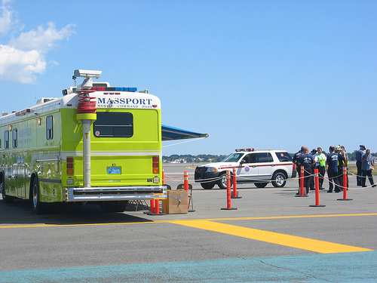
Purpose of ICS
Provide effective coordination at scene
E-2

Slide 4
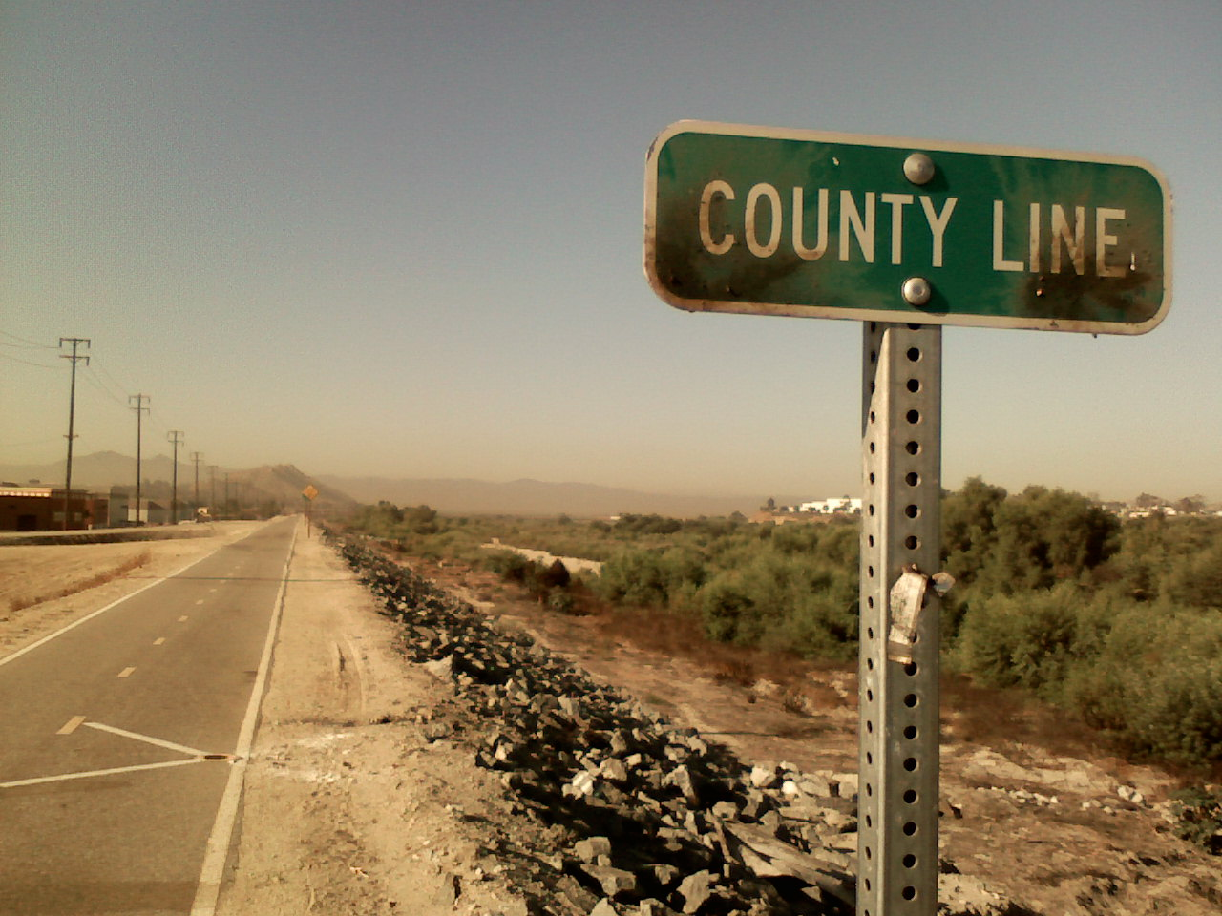
Need for ICS
Manage response
Hazmat incidents often cross jurisdictions
OSHA regs require it
E-2

Slide 5

Benefits of ICS
Standard organization
Coordinated response
Standard roles & responsibilities
E-2

Slide 6
The IDHA Process
Most critical aspect of a response
  All decisions flow from this
  Regs require IC to do it
  Can’t protect from the problem if you can’t identify the problem!
E-4
Notes:
Protect:
Life,
Environment,
Property.
In that order!

Slide 7
IDHA Process
Starts with initial discovery
Use recognition clues
  And common sense!
Caution!
  Initial reports may be wrong!
E-4

Slide 8

Basic FRA IDHA Process
Identify material(s)
Consult ERG/SDS
Follow employer’s policies
E-4

Slide 9

Basic IDHA Questions
Will something bad happen now?
  Is it on fire?
  Can it explode or burn?
  Is there a gas or vapor present?
E-4

Slide 10
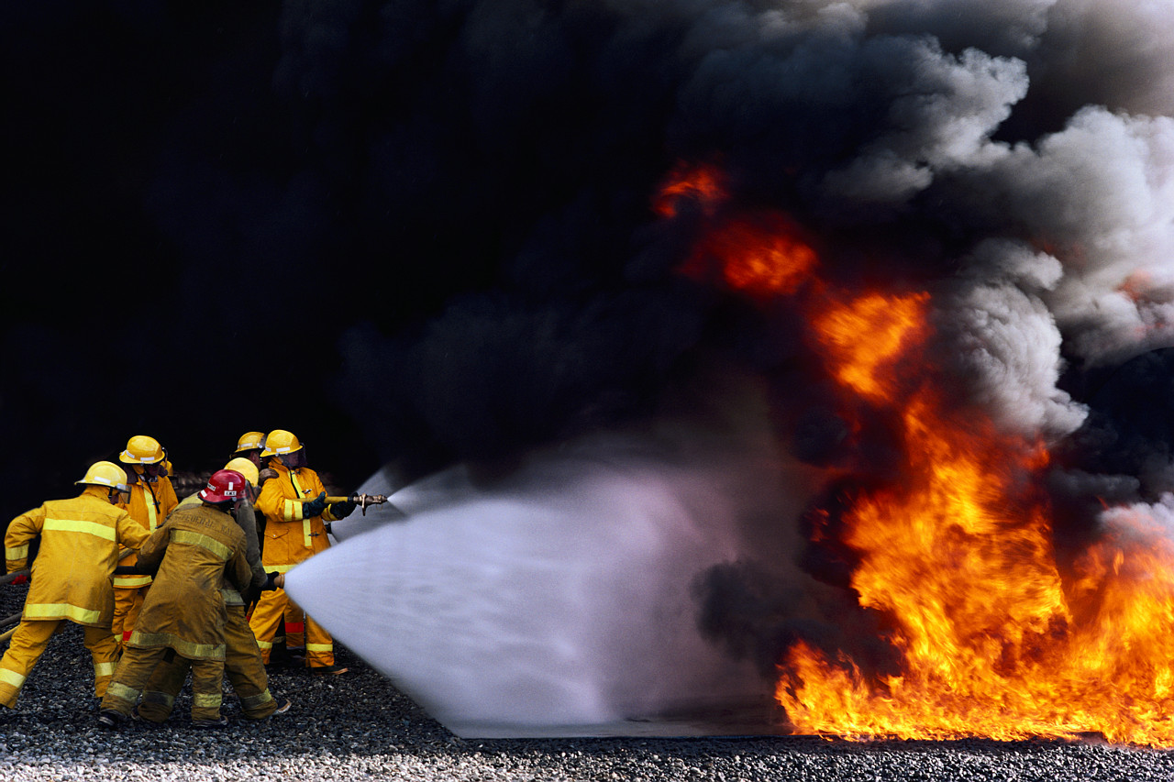
Basic IDHA Questions
Can it hurt me?
  Toxic
  Flammable
  Corrosive
  Radioactive
E-4

Slide 11
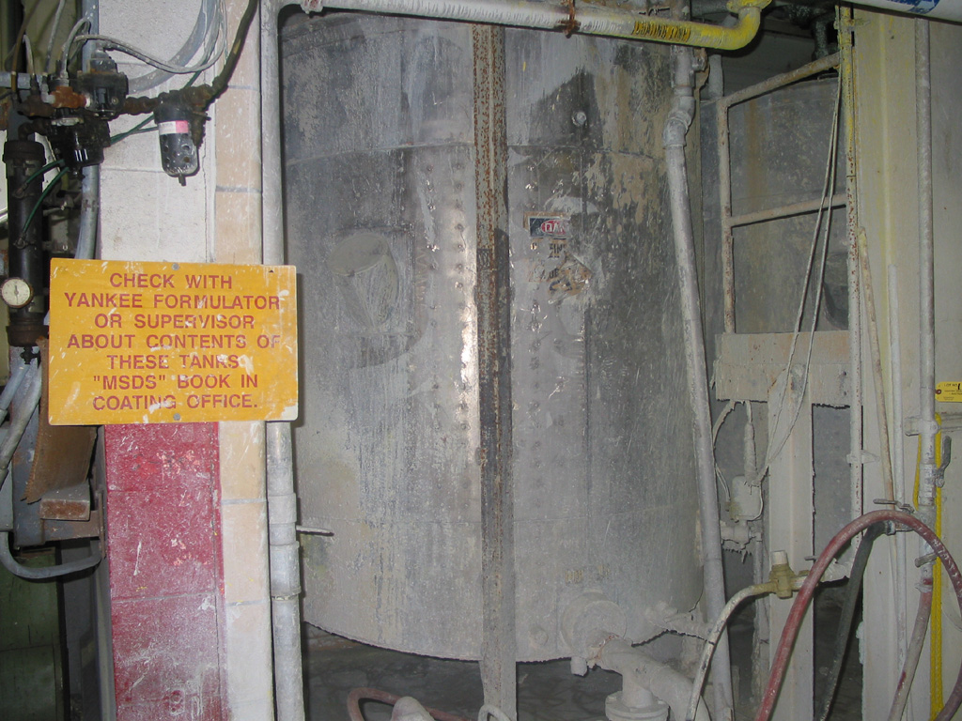
Info Sources to Aid IDHA
Safety Data Sheets
  S.D.S.
E-6

Slide 12
SDS - Who
Required by OSHA Hazcom Standard
  29 CFR 1910.1200
  Title 8 CCR 5194
E-6

Slide 13
SDS - Purpose
Informs employees of “hazardous chemicals”
Ensures all chemicals hazards are:
  Evaluated and
  Info is transmitted to employees
E-6

Slide 14
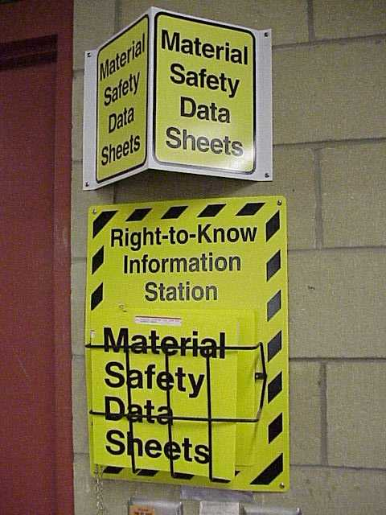
SDS - How
Transmits info via:
  Haz. Comm. Program
  Container labeling
  MSDS/SDS
  Employee training
E-6

Slide 15
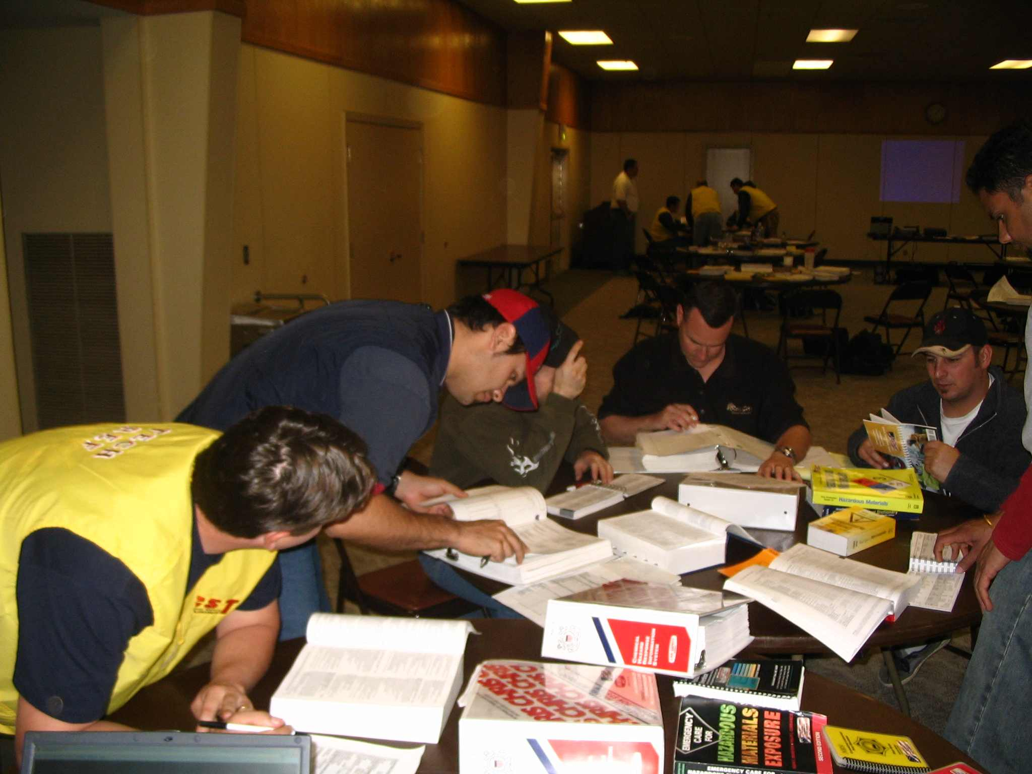
SDS
Major source of hazmat info
E-6

Slide 16
SDS Provides Info On…
Physical properties
Hazards of material
Signs & symptoms of exposure
Exposure levels
PPE recommended
Manufacturer contact info
E-6

Slide 17
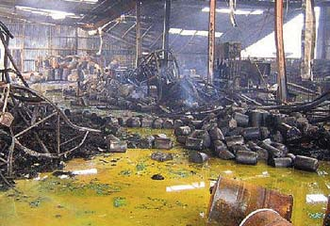
Who Can Provide an SDS
Workplace involved
Manufacturer/distributor
CHEMTREC
E-6

Slide 18



Hazard Identification Sources
DOT placards, labels & markings
E-8

Slide 19
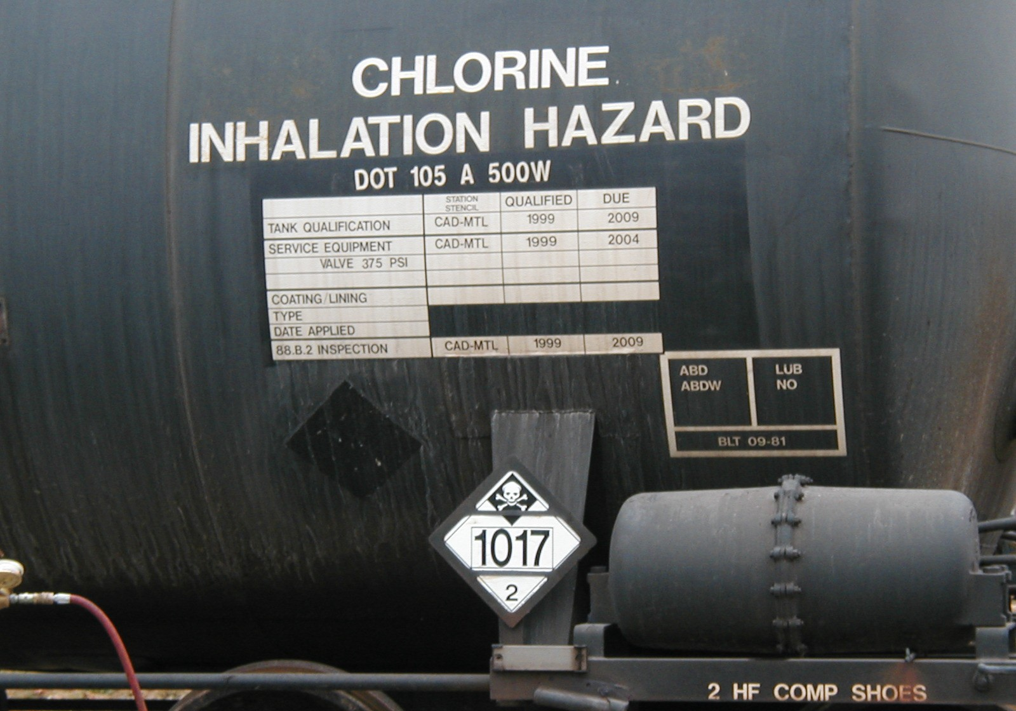
Hazard Identification Sources
Placards and labels
  Stenciled railcars
E-8

Slide 20
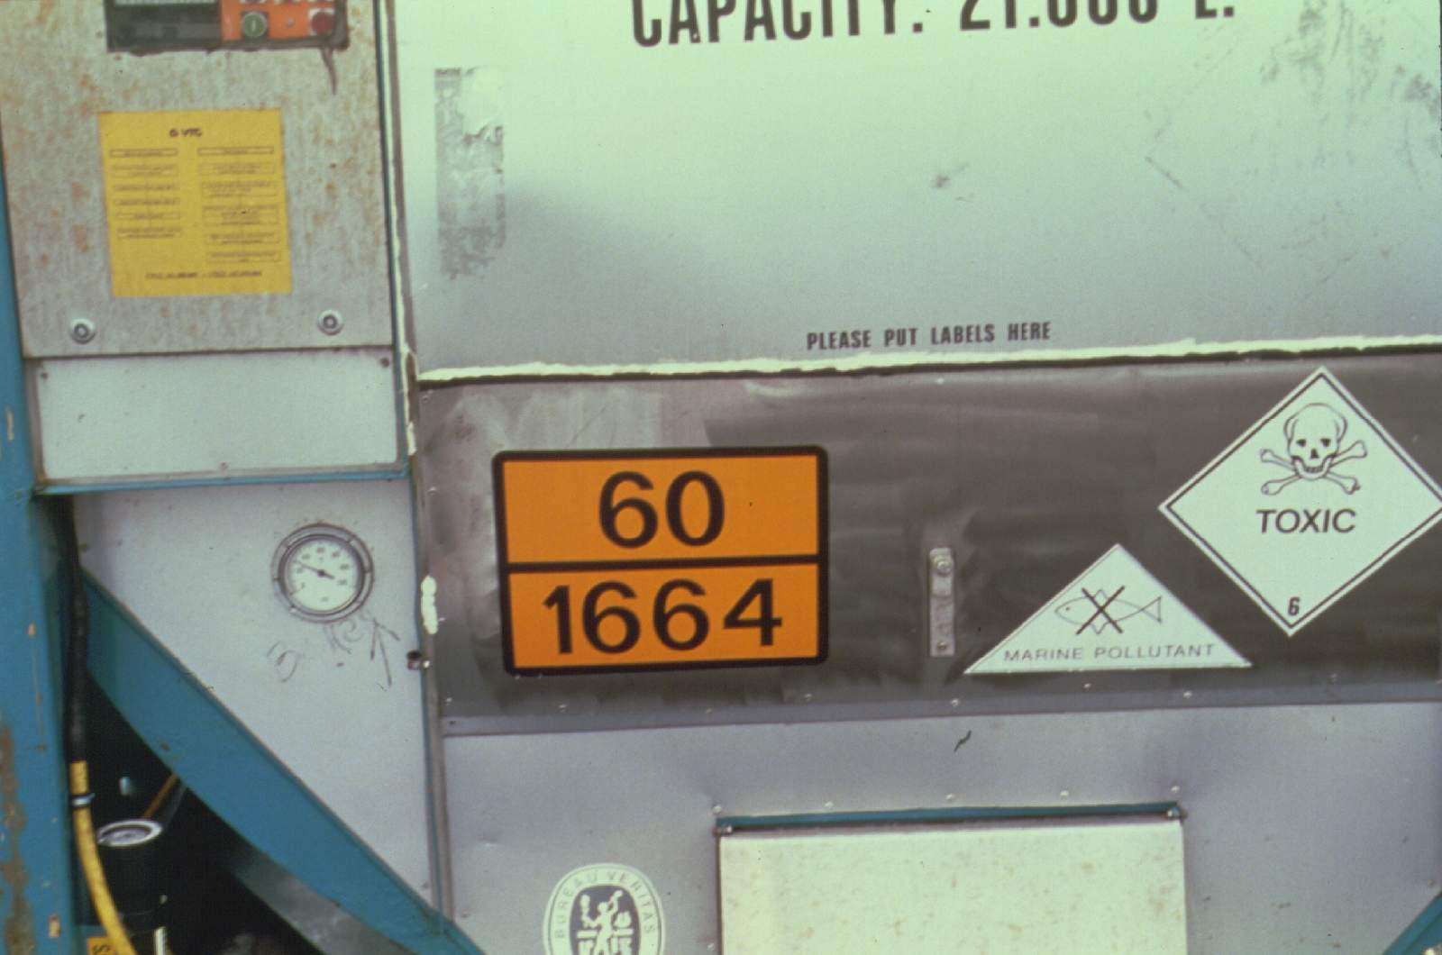
Hazard Identification Sources
Placards and labels
  ID # on placards & orange panels
E-8

Slide 21



Hazard Identification Sources
DOT Radioactive labels
  White I (lowest level of activity)
  Yellow II
  Yellow III (highest level of activity)
E-8

Slide 22
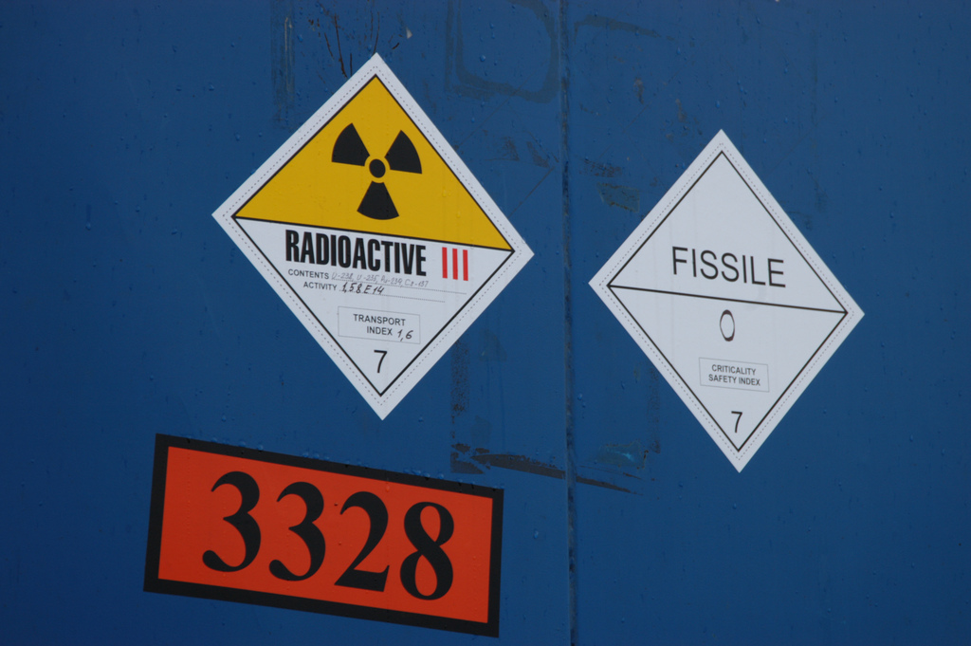
E-8

Slide 23
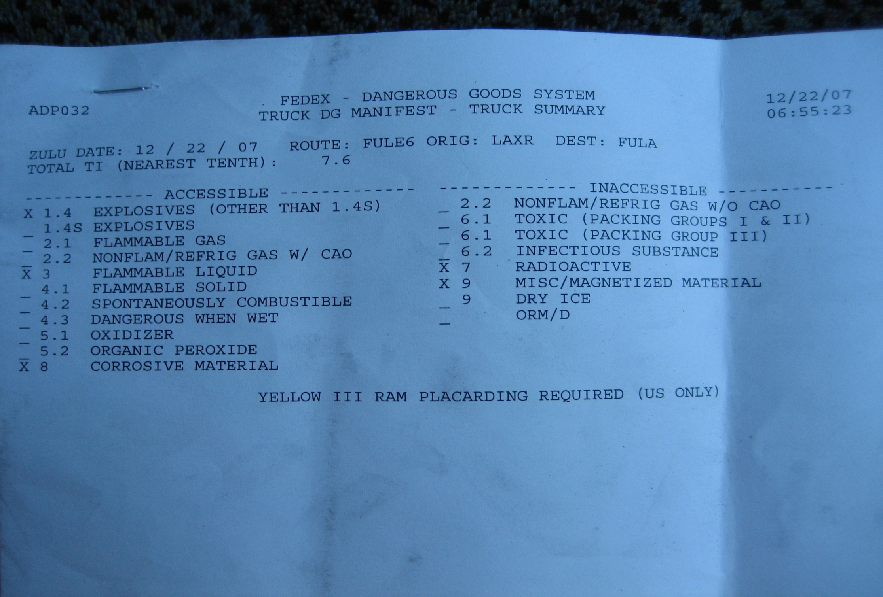
Hazard Identification Sources
Shipping papers
“X” marks the spot!
E-8

Slide 24
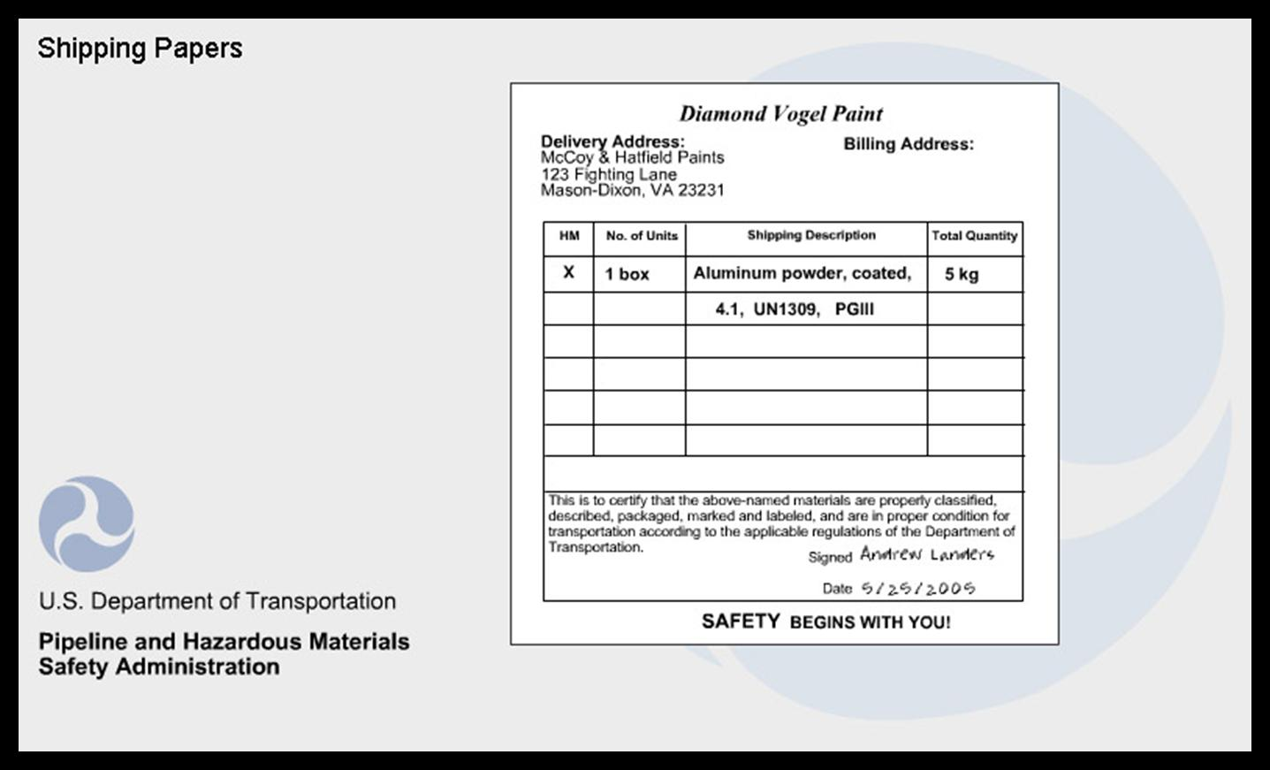
Proper Shipping Name
E-8

Slide 25
Hazard Class
E-8

Slide 26
ID Number
E-8

Slide 27
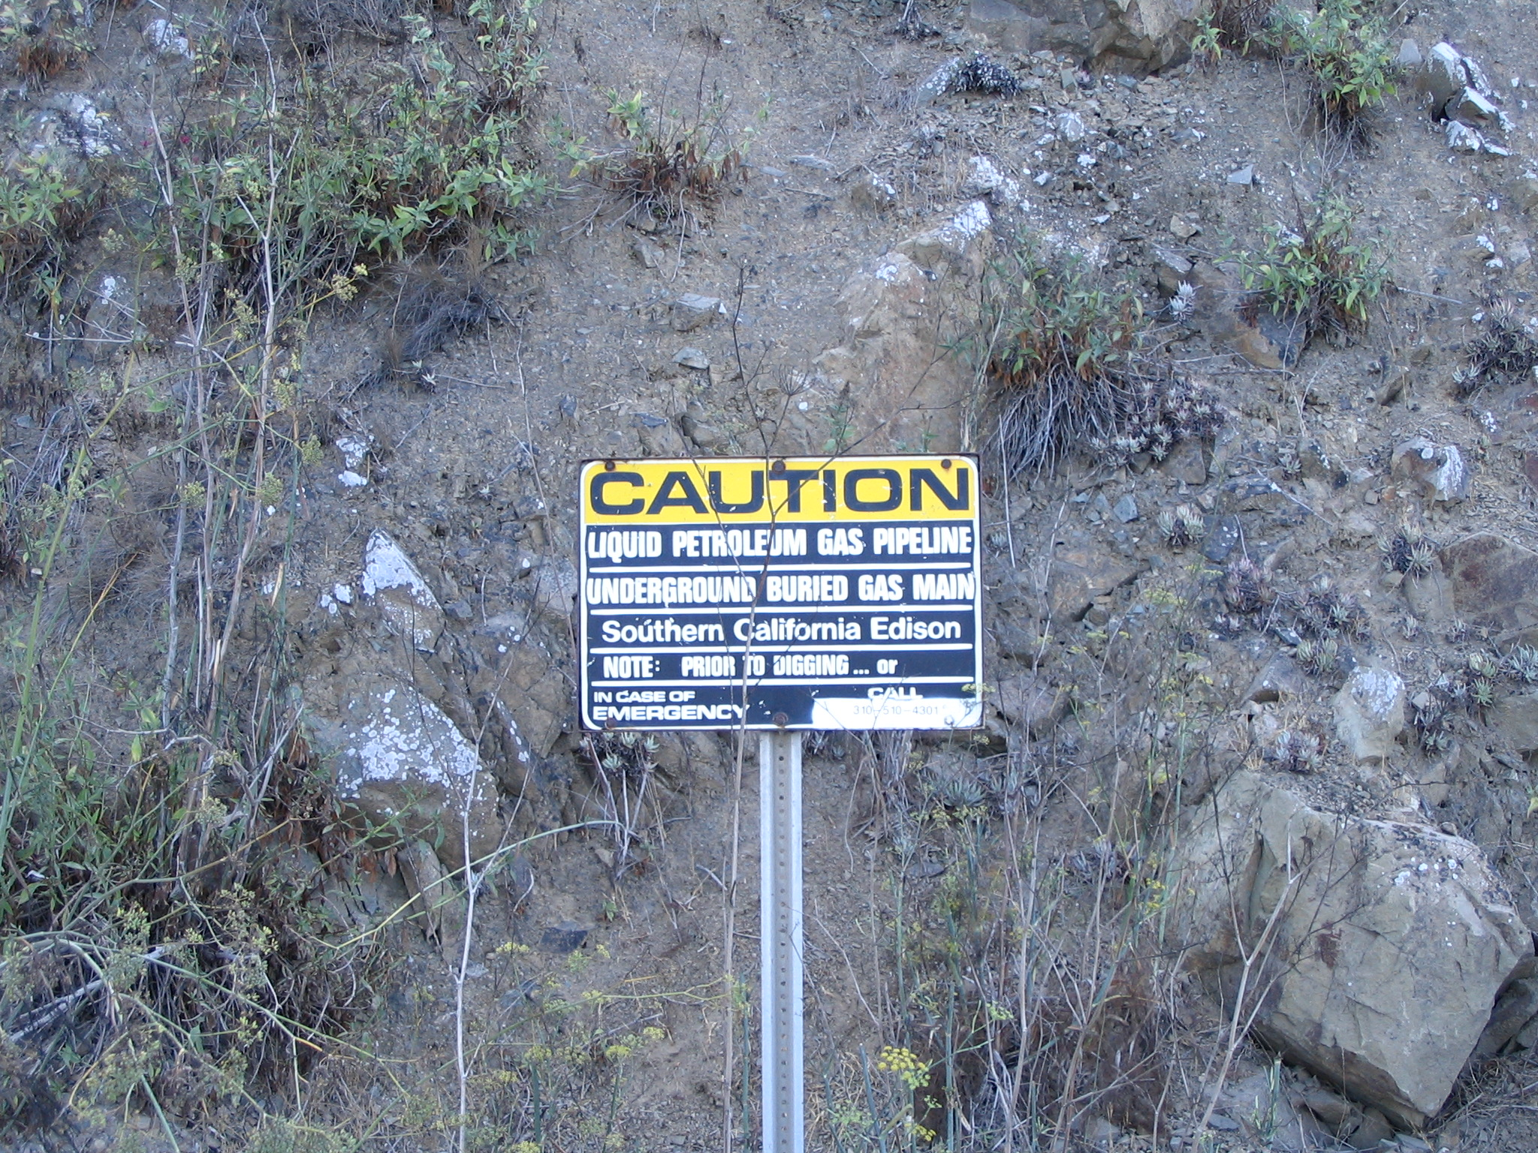
Hazard Identification Sources
Pipeline Markers
  Level of hazard
  Name of product
E-8

Slide 28

Hazard Assessment Sources

Slide 29

NFPA 704 System
Blue = Health
Red = Flammability
Yellow = Instability
No color = special hazards
E-10

Slide 30
Special hazard symbols
COR (corrosive)
POL (polymerization hazard)
OXY (oxygen or oxidizer)
Trefoil (radiation hazard)
W (water reactive)
E-10

Slide 31
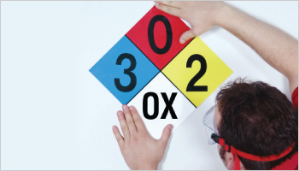
Numerical Rating Scale
0 – 4
  0= no hazard
  4 = highest hazard
E-10

Slide 32
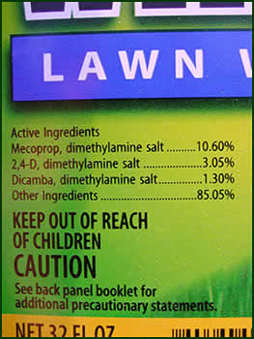
Pesticides & Consumer Products
Label must include
  Chemical Name
    Consumer products
  Ingredient Statement
    Pesticides
E-10

Slide 33
Product Label Signal Words
Pesticides & Consumer Products
  Danger (highest hazard)
  Warning (moderate hazard)
  Caution (lowest hazard)
Bad Stuff
E-10

Slide 34
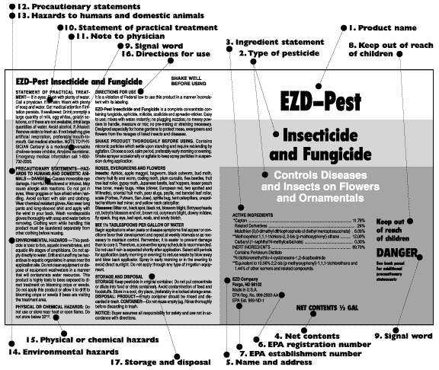

Slide 35
CHEMTREC
CHEMTREC
  Chemical Transportation Emergency Center
24 Hour technical information center
  (800) 424-9300
E-12

Slide 36
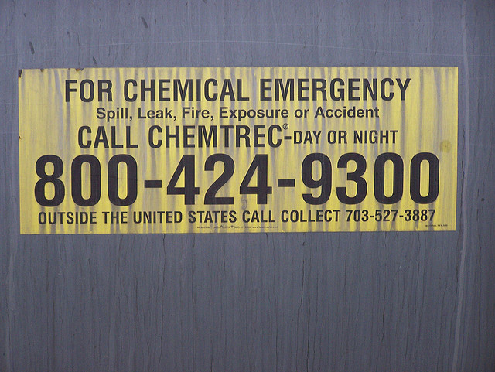
Can provide
  SDSs (from members companies)
  Access to specialized advice
E-12

Slide 37

Other Reference Guides
NIOSH Pocket Guide
E-12

Slide 38

Other Reference Guides
Poison Control System
E-12

Slide 39


Slide 40
Other Reference Guides
ChemTel, 3E Company, Infotrac
  24 hour info centers
  Provide SDS from member companies
  Dispatch company response teams
Phone numbers are in ERG
E-12

Slide 41

DOT Emergency Response Guidebook (ERG)
E-14

Slide 42
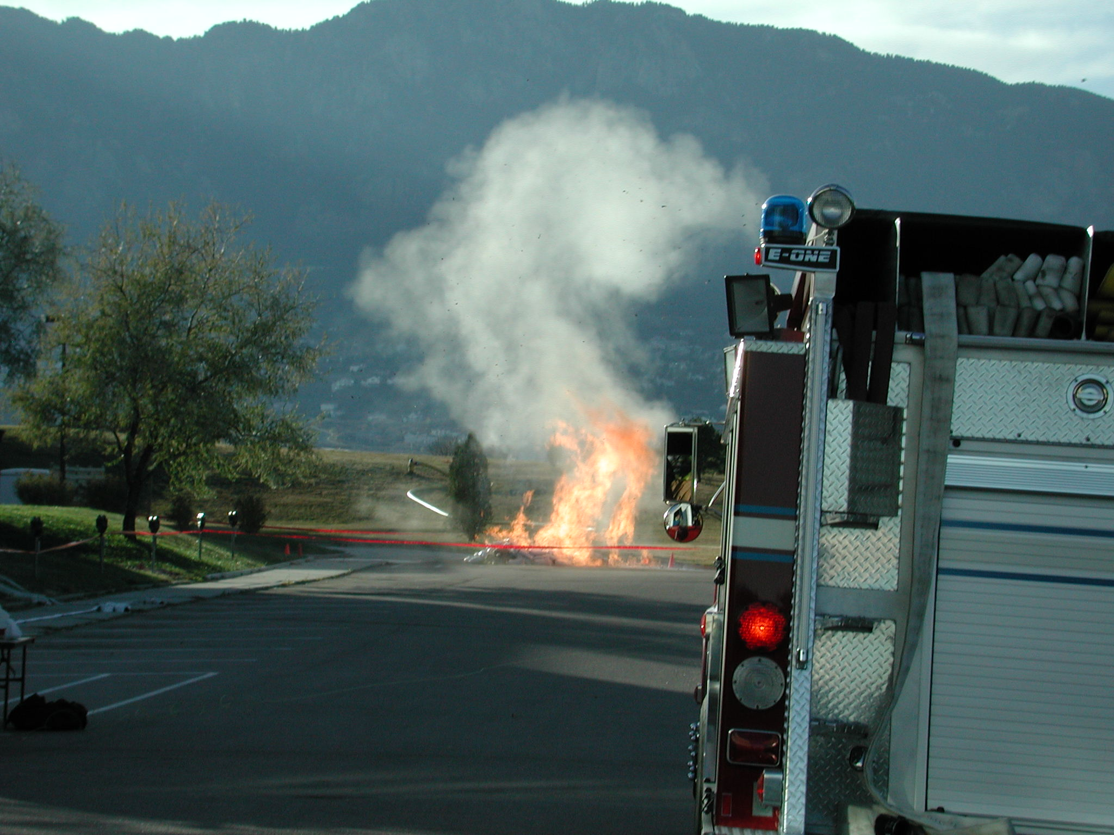
ERG Purpose
Basic safety tool
Basic identification
Initial actions
E-14

Slide 43
ERG versus SDS
ERG – transportation incidents
SDS – all other incidents
  If current version is available!
SDS
ERG
E-14

Slide 44

ERG Page Colors & Organization
E-14

Slide 45
ERG White Pages (part 1)
Instructions (page 1)
Safety Precautions (pages 2-3)
Hazard Classes (page 4)
Table of Placards (pages 5-7)
E-14

Slide 46
ERG White Pages (part 1)
Railcar & Road Trailer ID (pages 8-9)
Intermodal Container ID # (pages 10-13)
Pipeline ID & Info (pages 14-19)
E-14

Slide 47
ERG Yellow-Bordered Pages
Materials listed by ID number
E-14

Slide 48
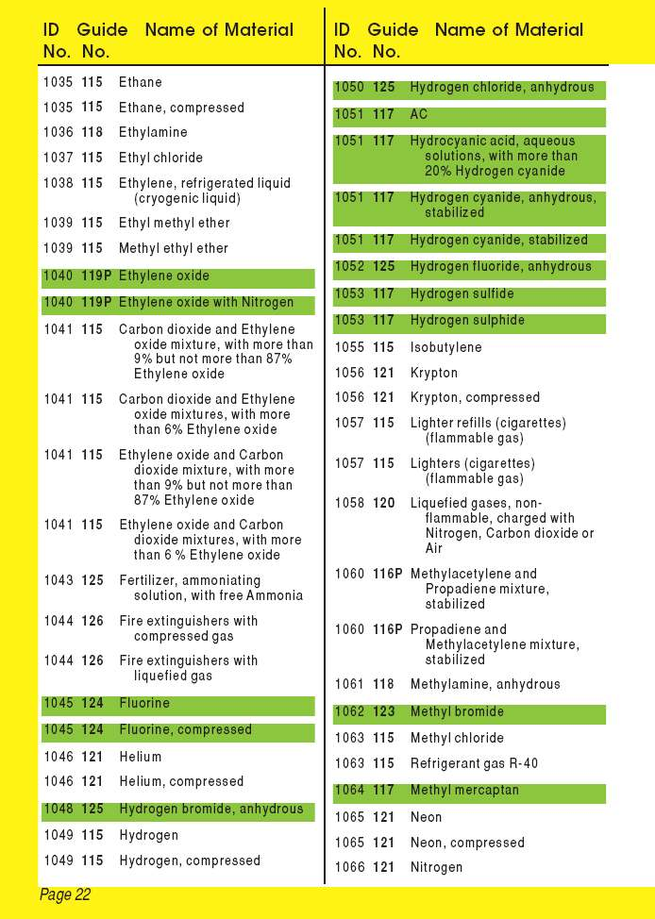
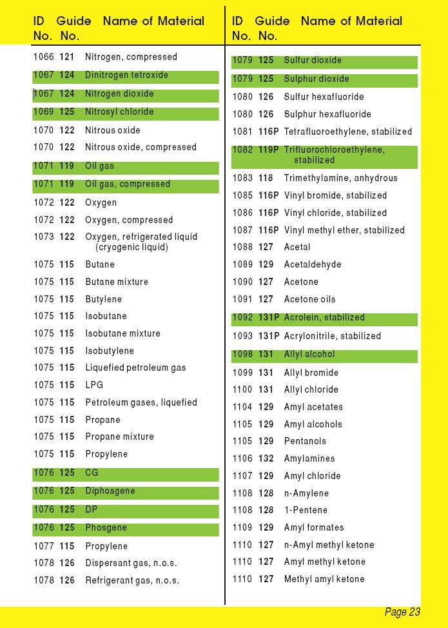

Slide 49
ERG Blue-Bordered Pages
Materials listed by name
E-14

Slide 50
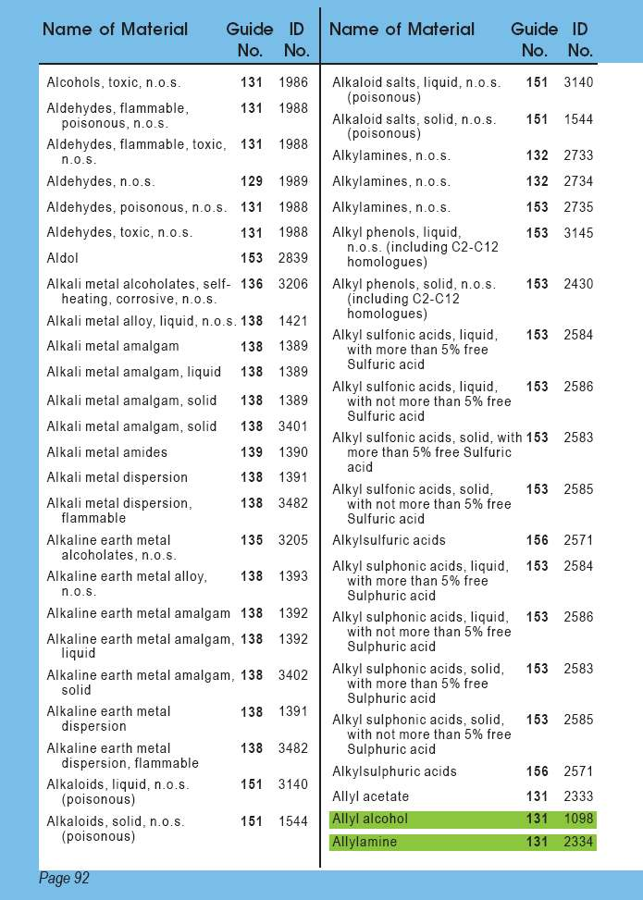
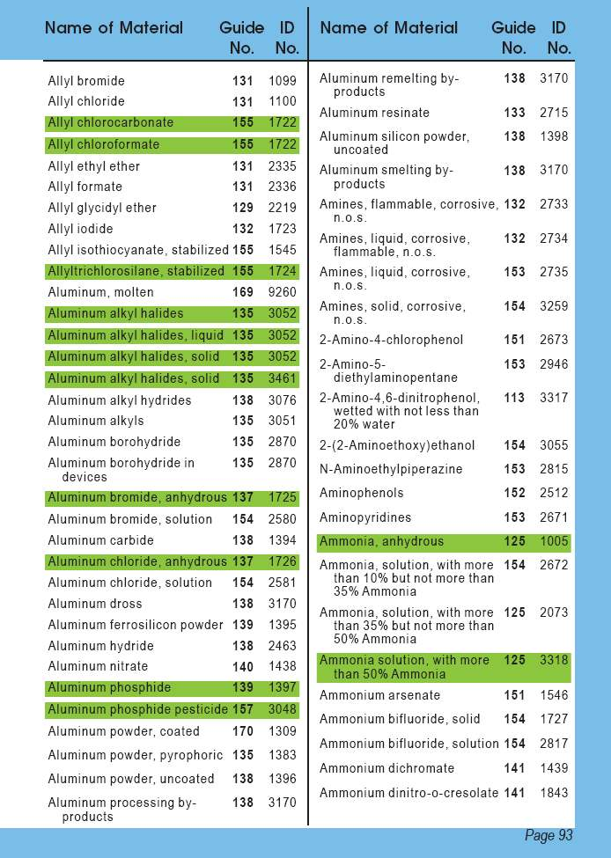

Slide 51
ERG Orange-Bordered Pages
Number guide pages
E-14

Slide 52
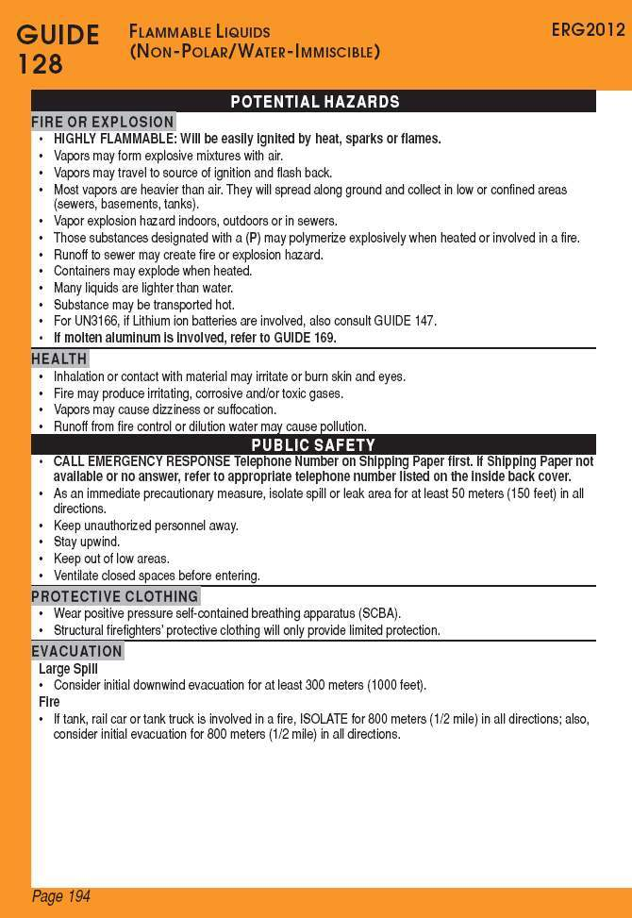
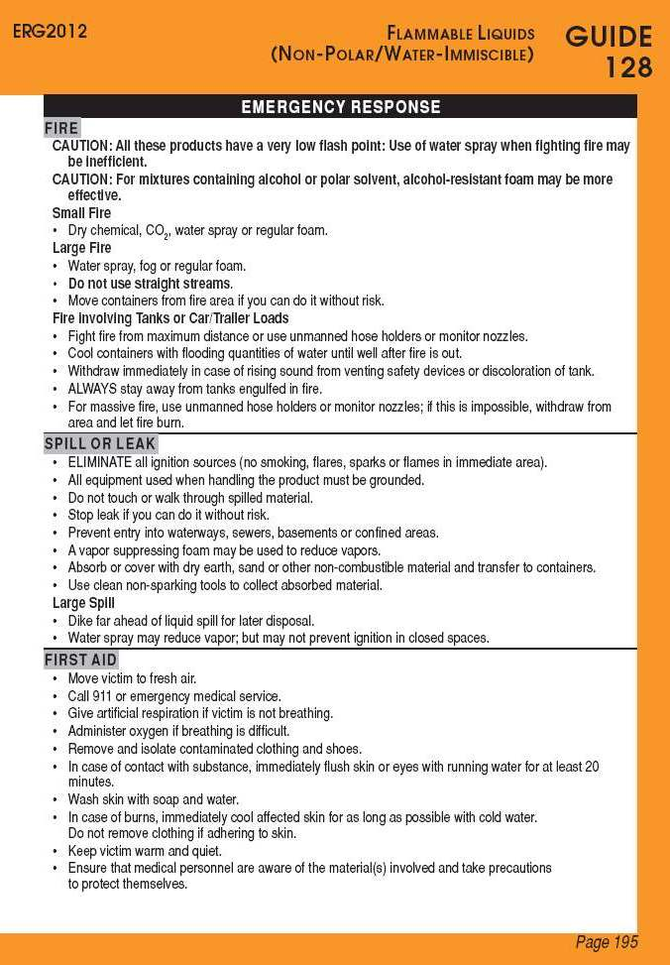

Slide 53
ERG Green-Bordered Pages
Isolation & Protective Actions
  Toxic Inhalation Hazards
  Water Reactive Substances
  Six Most Common Substances
E-14

Slide 54
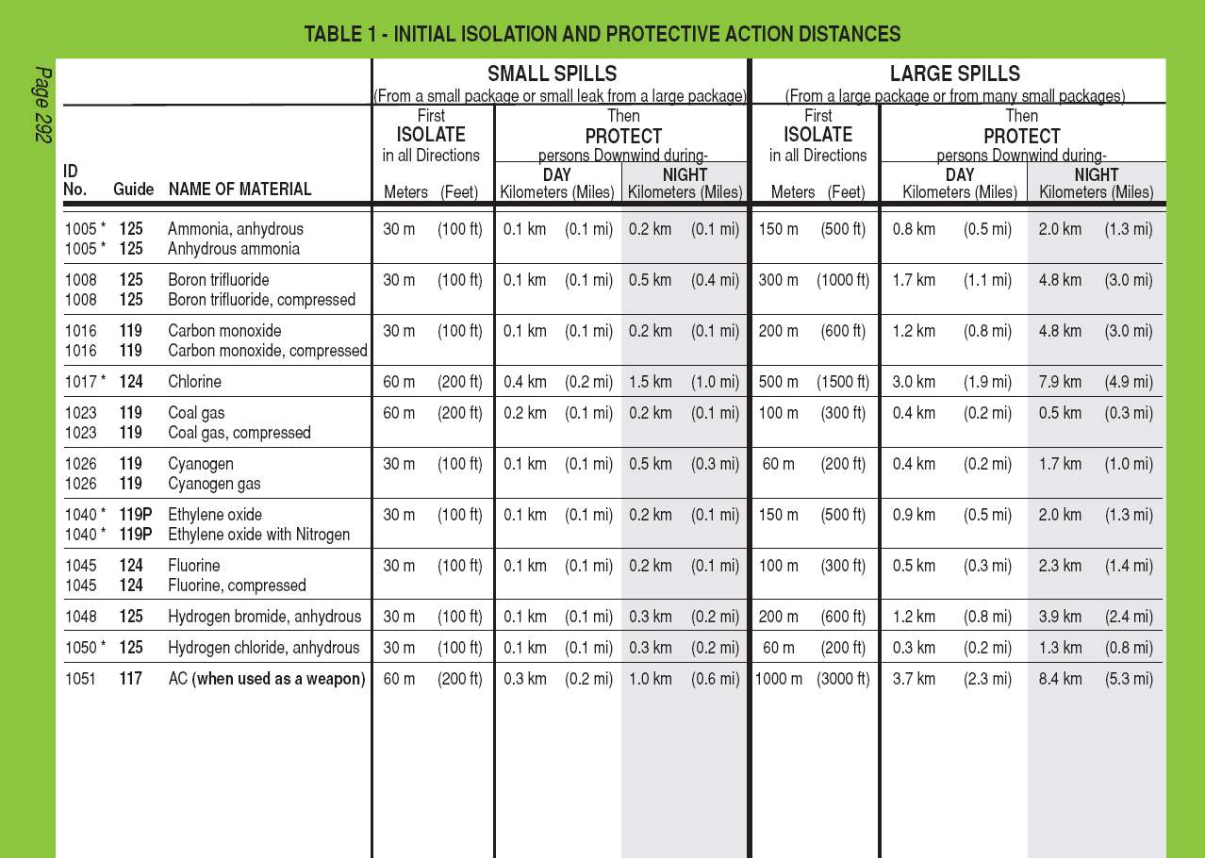

Slide 55
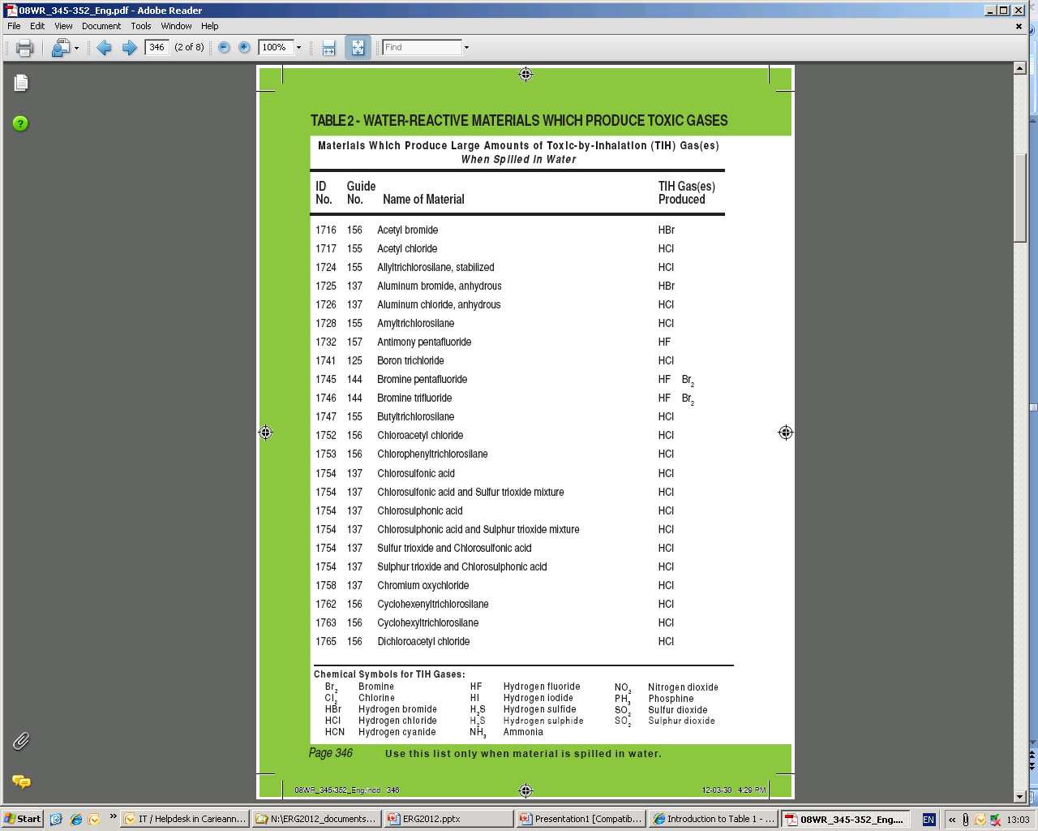
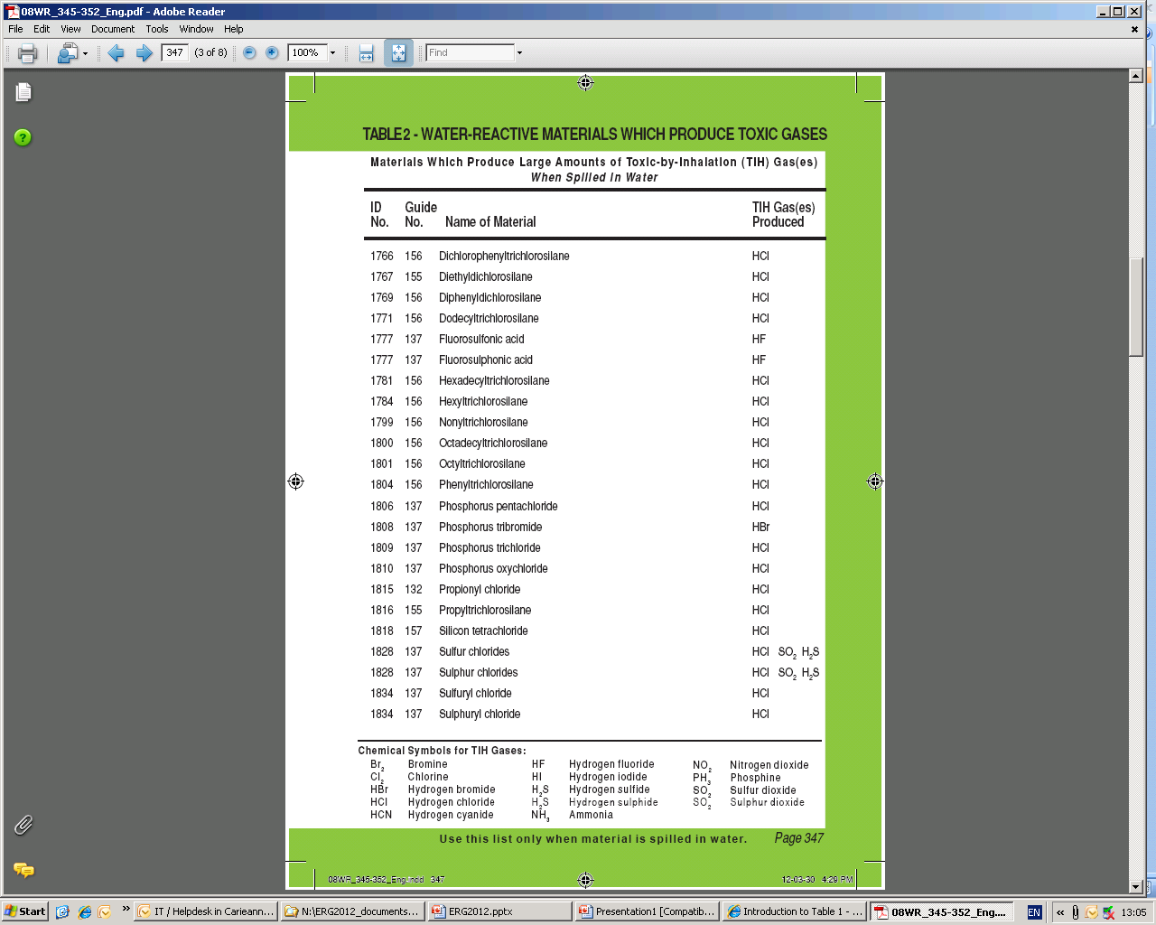

Slide 56
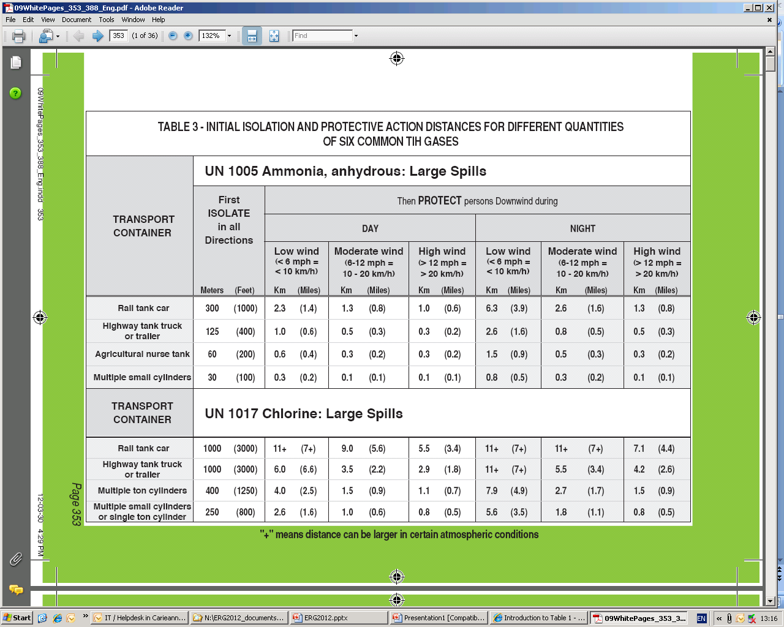

Slide 57
ERG White Pages (part 2)
Response Info
BLEVE Safety Precautions
Glossary
E-14

Slide 58
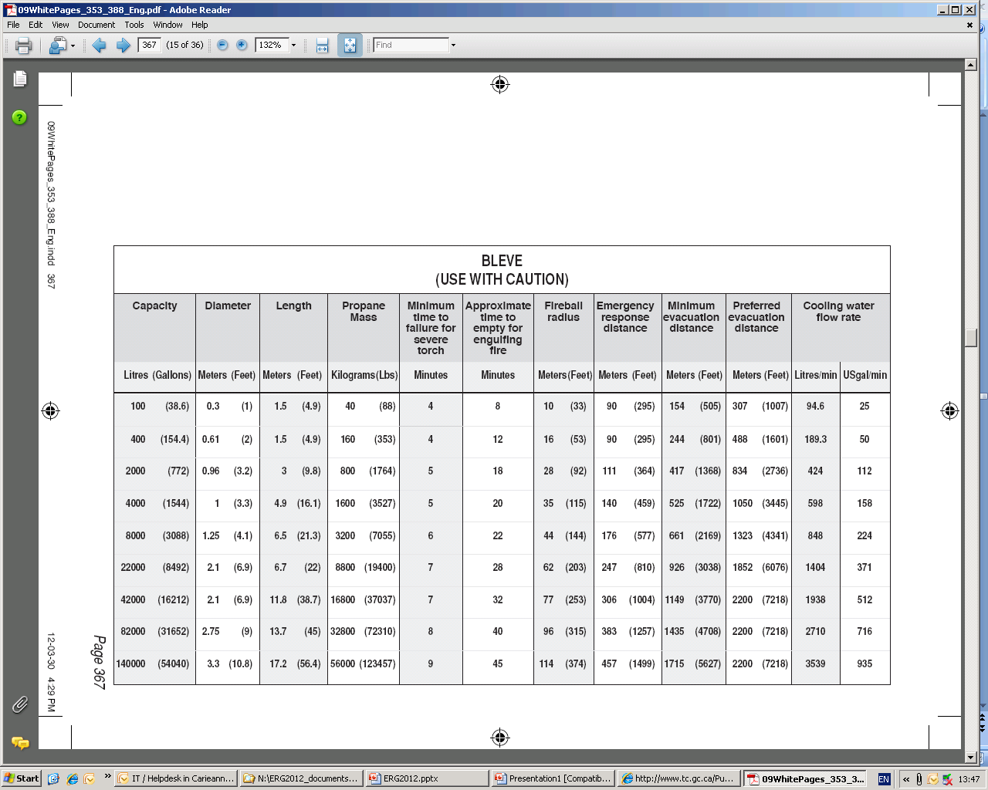

Slide 59
ERG—Good But Limited
Classification of hazard
Guides — “most essential guidance”
Isolation/evacuation distances — guides
Use table of placards only if no ID
Intended use
  “initial phase”
E-16

Slide 60
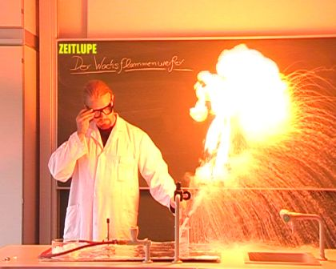
ERG Specialized Info
“P”: polymerization hazard
Dangerous Water–Reactive Materials
Guide 111
E-16

Slide 61
ERG Caveats
Distances are guides
Use table of placards if you can’t ID material
Intended use
  Transportation-related incidents
  Initial phase of incident
E-16

Slide 62
ERG Use
So let’s use it!
ERG

Slide 63
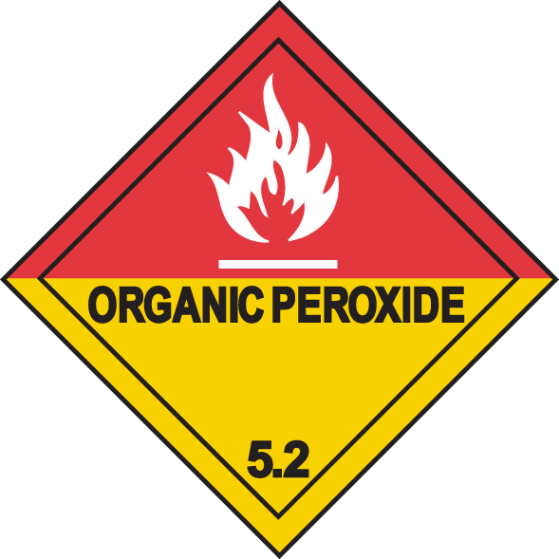
What Should This Stuff Not Do?
Notes:
Guide 148 – Don’t let it warm up.

Slide 64
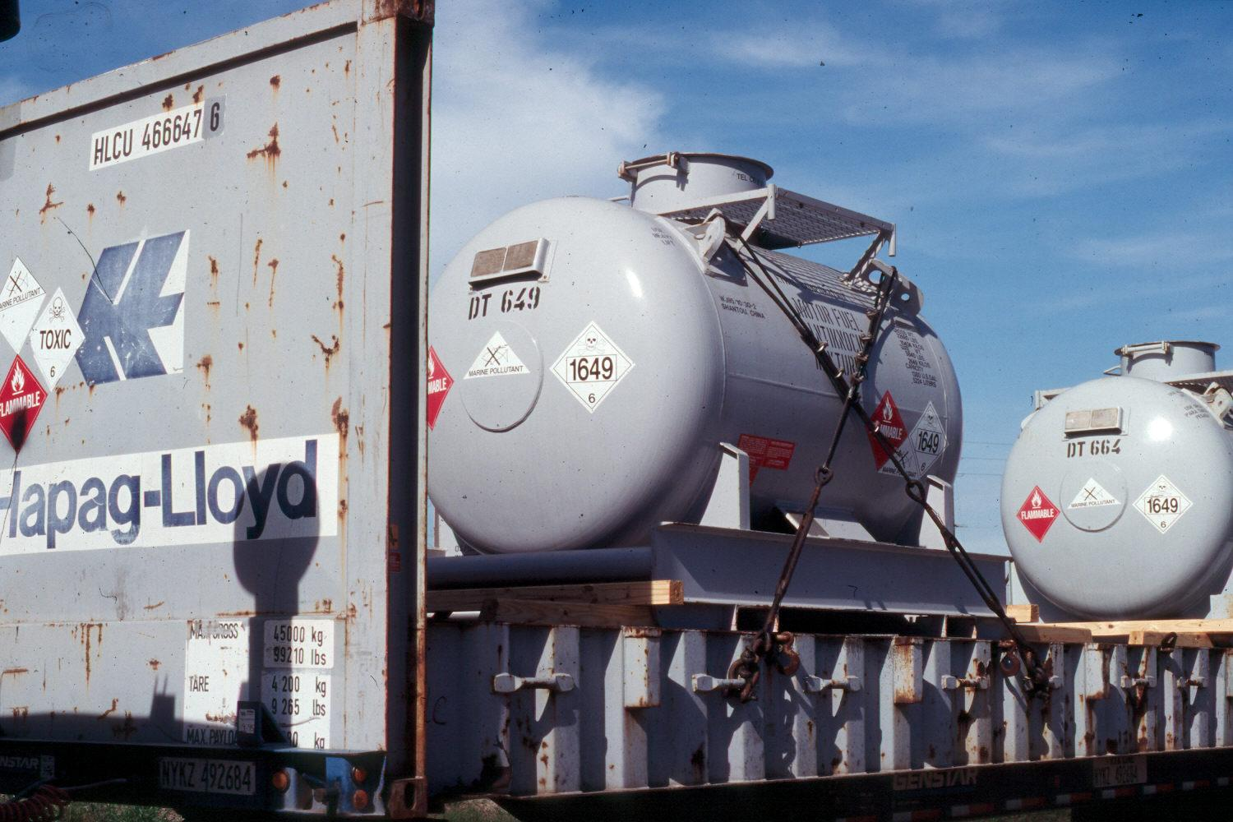
What’s This?
Which guide do you use?
Notes:
1649 = Motor fuel anti-knock mixture. Guide 131

Slide 65
What are the hazards?
Notes:
Toxic (very) and Flammable (highly)

Slide 66
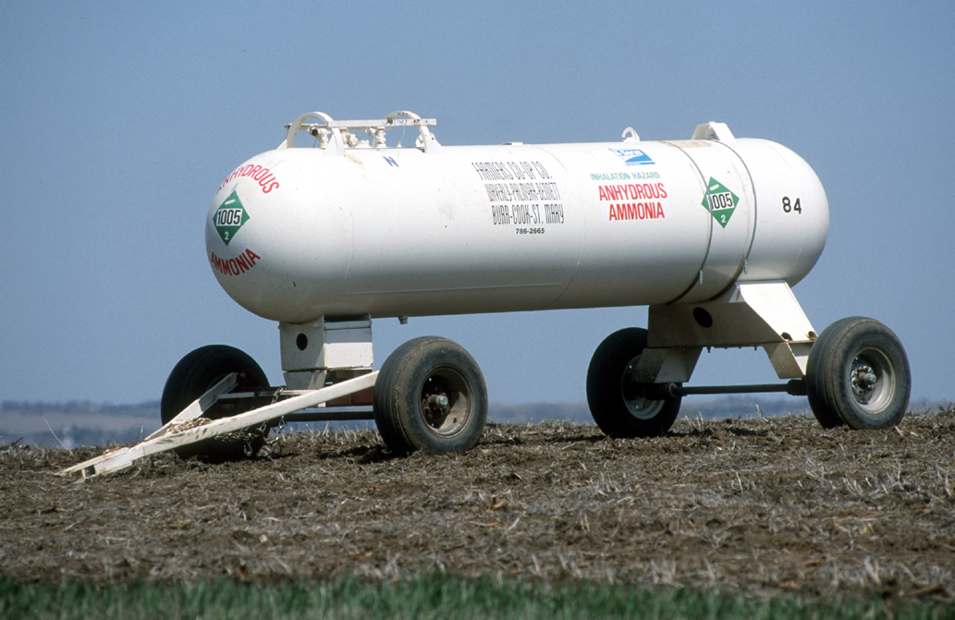
What’s the Initial Isolation Distance?
Notes:
200 feet. Table 3. It’s an agricultural nurse tank.

Slide 67
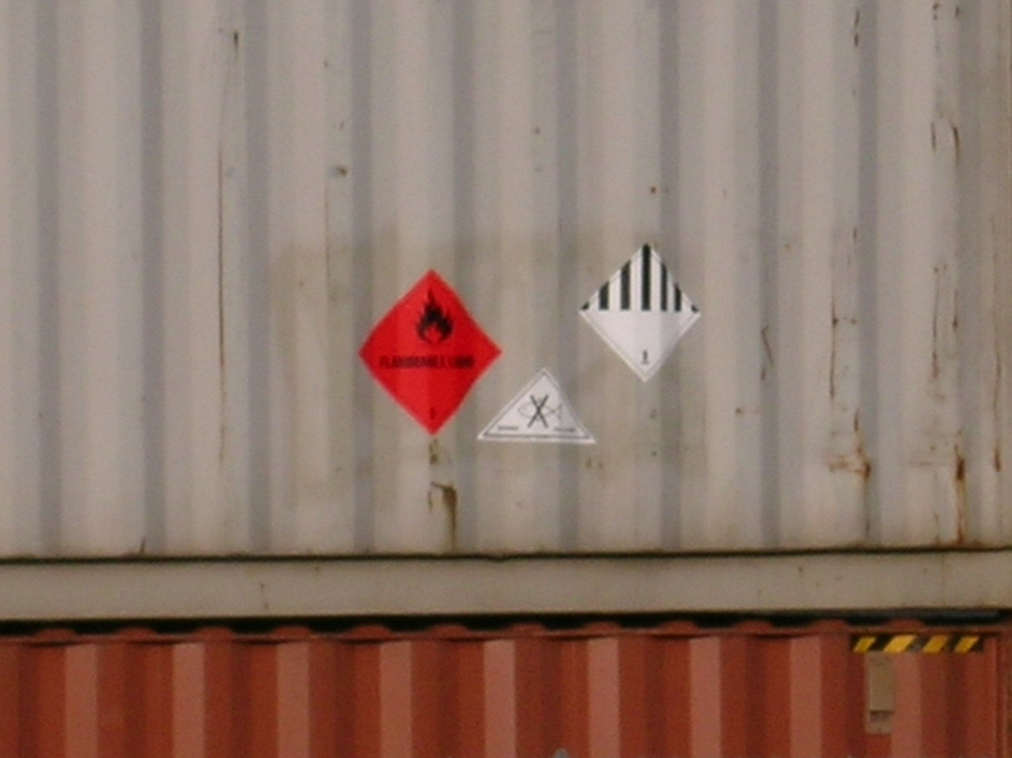
What Guide Page?
Notes:
Page 5 of the ERG: “If multiple placards point to more than one guide, initially use the most conservative guide(i.e., the guide requiring the greatest degree of protective actions).” In this case, that would be the Flammable placard.

Slide 68
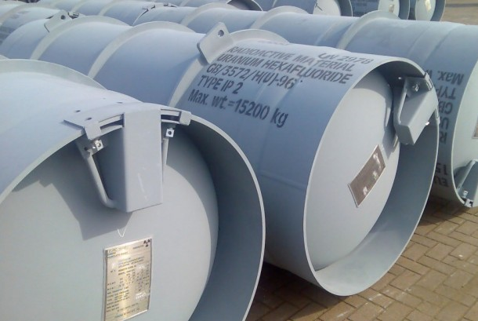
What if it Gets Wet?
Notes:
Table 2 Green-bordered pages. Gives off hydrogen fluoride.

Slide 69
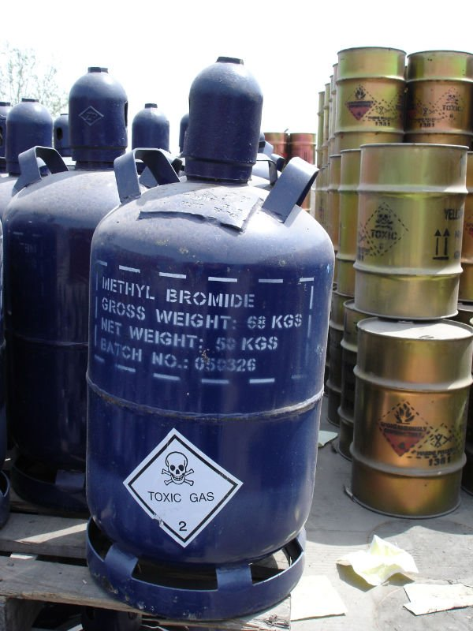
Protective Action Distance?
Small spill
At night
Notes:
Table 1. Green-bordered pages. 0.2 miles.

Slide 70
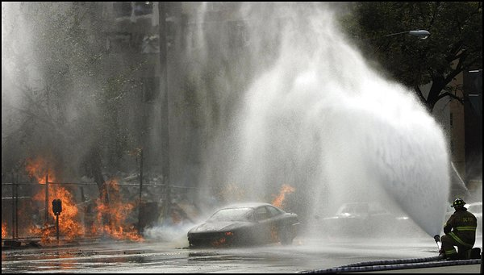
Container Stress & Behavior
E-18

Slide 71
Container Stress & Behavior
Hazmats are released when container fails
  Failure can be minor or catastrophic
  Nature of failure determines potential harm
    Kingman BLEVE vs. Tokyo Sarin
E-18

Slide 72
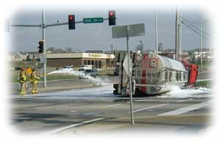
Hazmat Release Process
Stress on container
Container weakens & fails
Material released
Material disperses
E-18

Slide 73
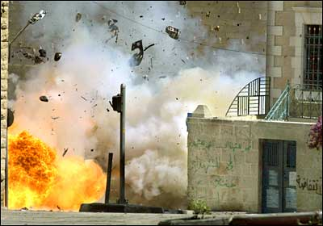
Hazmat Release Process
Hazard to you depends what step the process is on when you arrive!
E-18

Slide 74
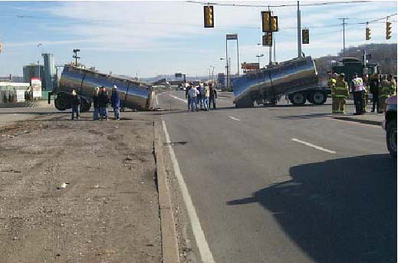
Types of Container Stress
Thermal
  Hot or cold
Mechanical
Chemical
E-18

Slide 75
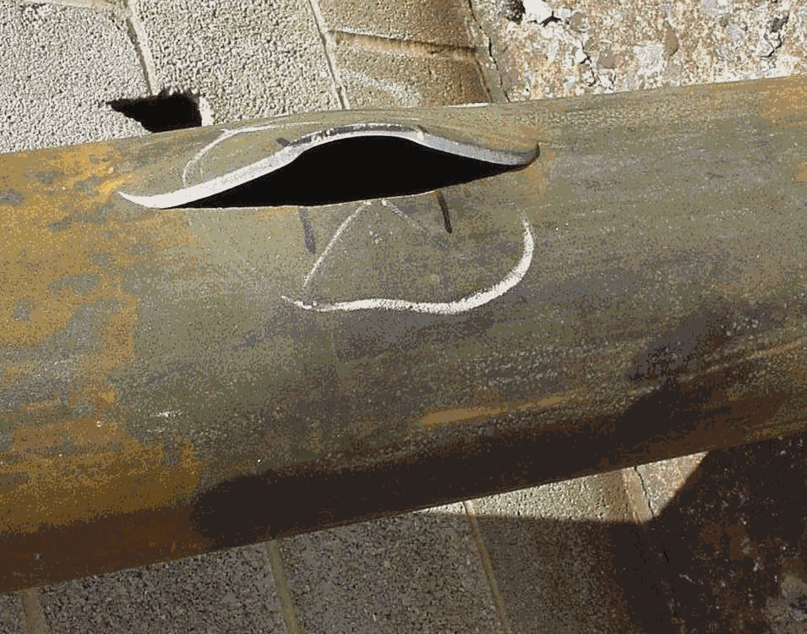
Evaluating Container Stress
Type of stress?
What will container do?
When will it do it?
E-18

Slide 76
Action Planning for FRAs
Pay attention to container stress
Follow ERG recommendations
E-18

Slide 77
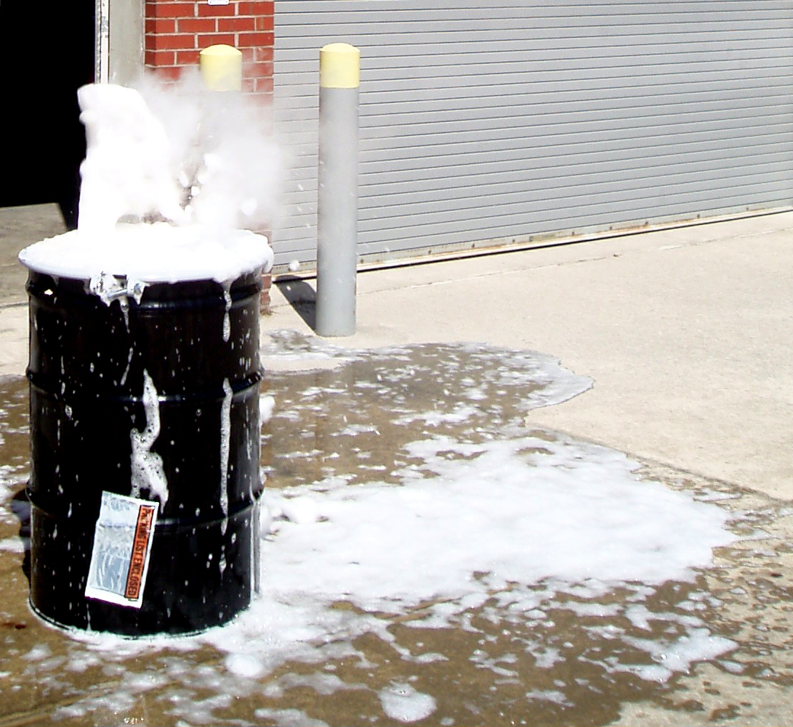
Types of Container Failure
Catastrophic
Fracture
Puncture
Degradation
E-20

Slide 78
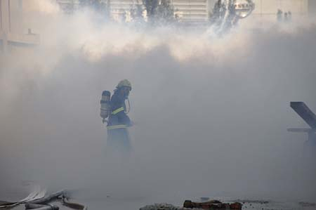
Types of Product Dispersion
Instantaneous release
  Spreads in all directions
  Gases/vapors can ignite immediately
E-20

Slide 79
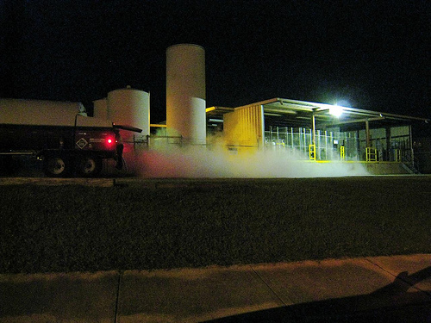
Types of Product Dispersion
Rapid release
  Spreads downwind/downstream
E-20

Slide 80
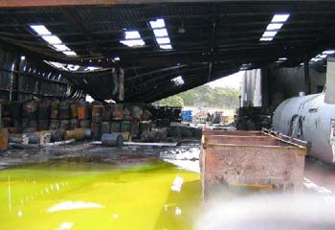
Types of Product Dispersion
Slow release
  Spreads slowly downwind/downstream
E-18
E-20

Slide 81
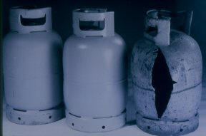
BLEVE
Cause – Thermal stress on container
  Stress weakens container
  Container breeches
  Near-instantaneous release
E-20

Slide 82
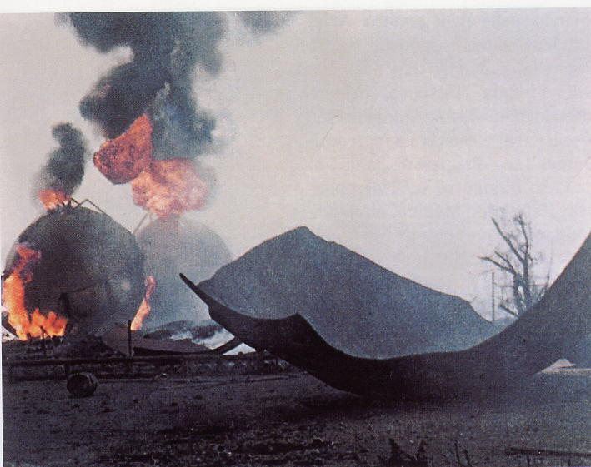
BLEVE
Hazards
  Flying debris
E-20

Slide 83
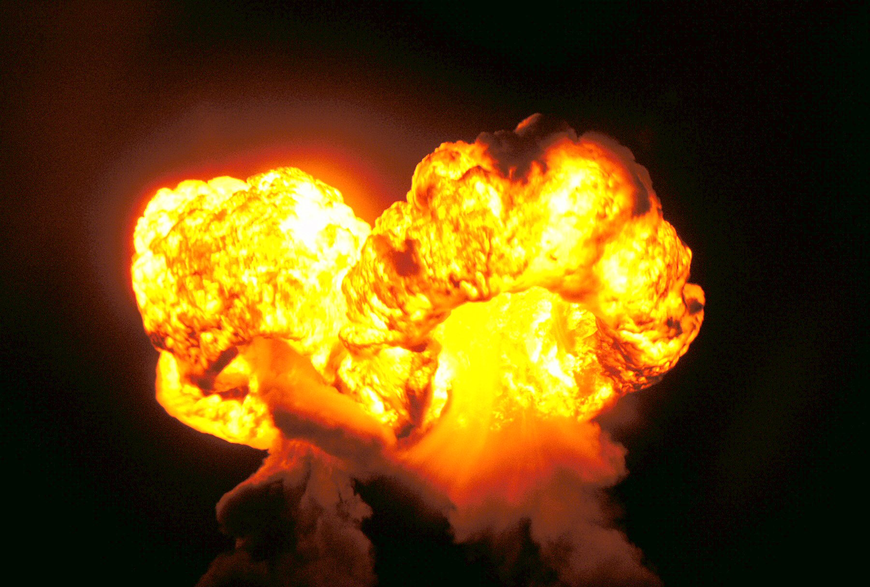
BLEVE
Hazards
  Large fireball
E-20

Slide 84
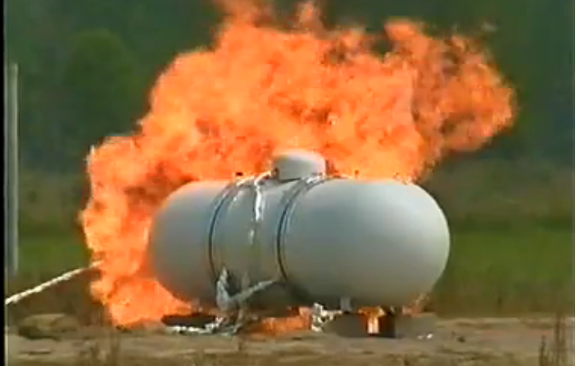
BLEVE
Timeframe
  Less than 10 minutes
E-20

Slide 85

Rating Risks
Low
Moderate
High
Unacceptable
E-22

Slide 86
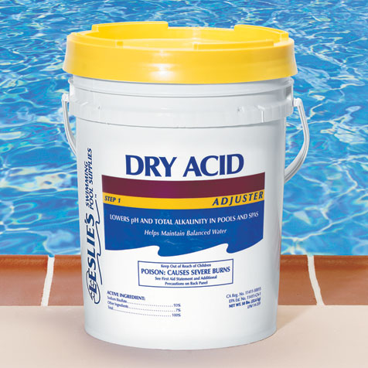
Low Risk
Small quantities
Inert solid materials
Undamaged container
E-22

Slide 87

Moderate Risk
Smaller quantities
Low vapor-pressure liquid materials
Undamaged/slightly damaged container
E-22

Slide 88

High Risk
Large quantities/multiple containers
Low vapor-pressure liquids or gases
Slightly/moderately damaged container
E-22

Slide 89

Unacceptable Hazmat Risk
Larger quantities and/or gas cylinders involved
High vapor-pressure liquids, gases, explosives and/or reactive materials
Visibly stressed container and/or flame impingement on a gas cylinder
E-22

Slide 90

Unacceptable Hazmat Risk
An unacceptable risk here is:
E-22

Slide 91
IDHA Complications
Many variables affect IDHA
May influence physical properties
E-24

Slide 92

Variables & Modifying Conditions
Location can influence dispersion
  Stuff goes downhill
  Buildings can trap and/or redirect airborne contaminants
E-24

Slide 93

Variables & Modifying Conditions
Time of day can affect:
  Evaporation rate
  Flammability
  Reactivity
E-24

Slide 94

Variables & Modifying Conditions
Weather
  Gases/vapors will usually go downwind
  Vapor clouds can take longer to disperse in cold weather
E-24

Slide 95
Variables & Modifying Conditions
Nature of materials
  Semi Bad Stuff or
  Bad Stuff or
  Really Bad Stuff
E-24

Slide 96

Variables & Modifying Conditions
Type of Release
  Slow leak?
  Fast leak?
  Catastrophic leak?
E-24

Slide 97

Variables & Modifying Conditions
Size of problem
  Bad stuff? How much?!?!?
E-24

Slide 98

Variables & Modifying Conditions
Type, condition & behavior of container
E-24

Slide 99

Reactivity & Combustion
Substances can react with
  Each other
  Air
  Water
E-24

Slide 100

Reactivity & Combustion
Difficult to predict
ERG Green pages, Table 2 can help
E-24

Slide 101

Bottom Line…
Same material
Different variables
Different response
E-24

Slide 102

There Is No Cookbook
Use your head!
E-24

Slide 103

Questions?

