Slide 2
ENABLING OBJECTIVES
DEFINE a major conflagration
IDENTIFY safety requirements to be followed while performing abnormal/degraded shipboard fire fighting tasks when combating a Major Conflagration
STATE the responsibilities, planning, training and equipment required to combat a Major Conflagration
DESCRIBE abnormal fire fighting tasks required to combat a Major Conflagration

Slide 3
REFERENCES
SURFACE SHIP FIREFIGHTING S9086-S3-STM-010/CH-555V1
SURFACE SHIP SURVIVABILITY NTTP 3-20.31

Slide 4
MAJOR CONFLAGRATION
Major Conflagration is damage of a magnitude that cannot be readily handled by the conventional damage control organization; therefore all-hands participation is required to save the ship.
Fire department personnel will be required to assist and at times operate independently of ships force.

Slide 5
MAJOR CONFLAGRATION
Responsibilities
-Commanding officer
-Senior personnel at reorganization site
-Medical personnel
-IFLOP
-Company Officers
-Law enforcement

Slide 6
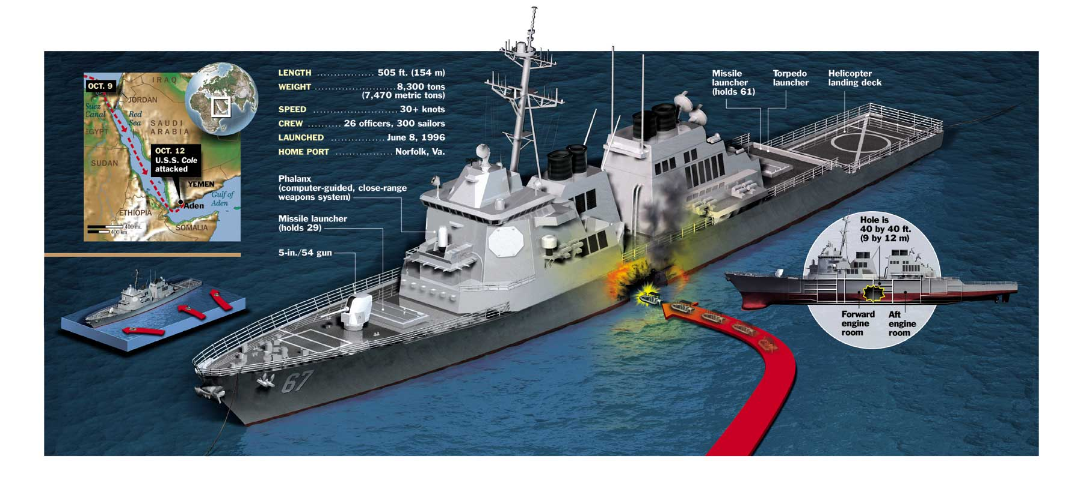
MAJOR CONFLAGRATION
Planning
Major Conflagration responses must include an assessment of all potential threats.
Threats vary from
Terror attacks,
Oceanographic
Air-delivered weapons
Under-water delivered weapons

Slide 7
MAJOR CONFLAGRATION
Training
Maintain minimum shipboard firefighting standards
Identification of experienced personnel and utilize them accordingly
Further training that will increase Fire department success in the event of a mass casualty
Cross Training - Worst case scenario
Emergency egress - Ship integration
Awareness of electrical hazards
Awareness of rapid fire/ flooding growth

Slide 8
MAJOR CONFLAGRATION
Equipment
ICS should be fully expanded in the event of a Major conflagration.
The equipment needed should be discussed and budgeted.
If the USS Cole happened at 32nd st. would we be ready?
What side of the line do you want to be on?

Slide 9
ENABLING OBJECTIVES
DEFINE a major conflagration
IDENTIFY safety requirements to be followed while performing abnormal/degraded shipboard fire fighting tasks when combating a Major Conflagration
STATE the responsibilities, planning, training and equipment required to combat a Major Conflagration
DESCRIBE abnormal fire fighting tasks required to combat a Major Conflagration

