Slide 1
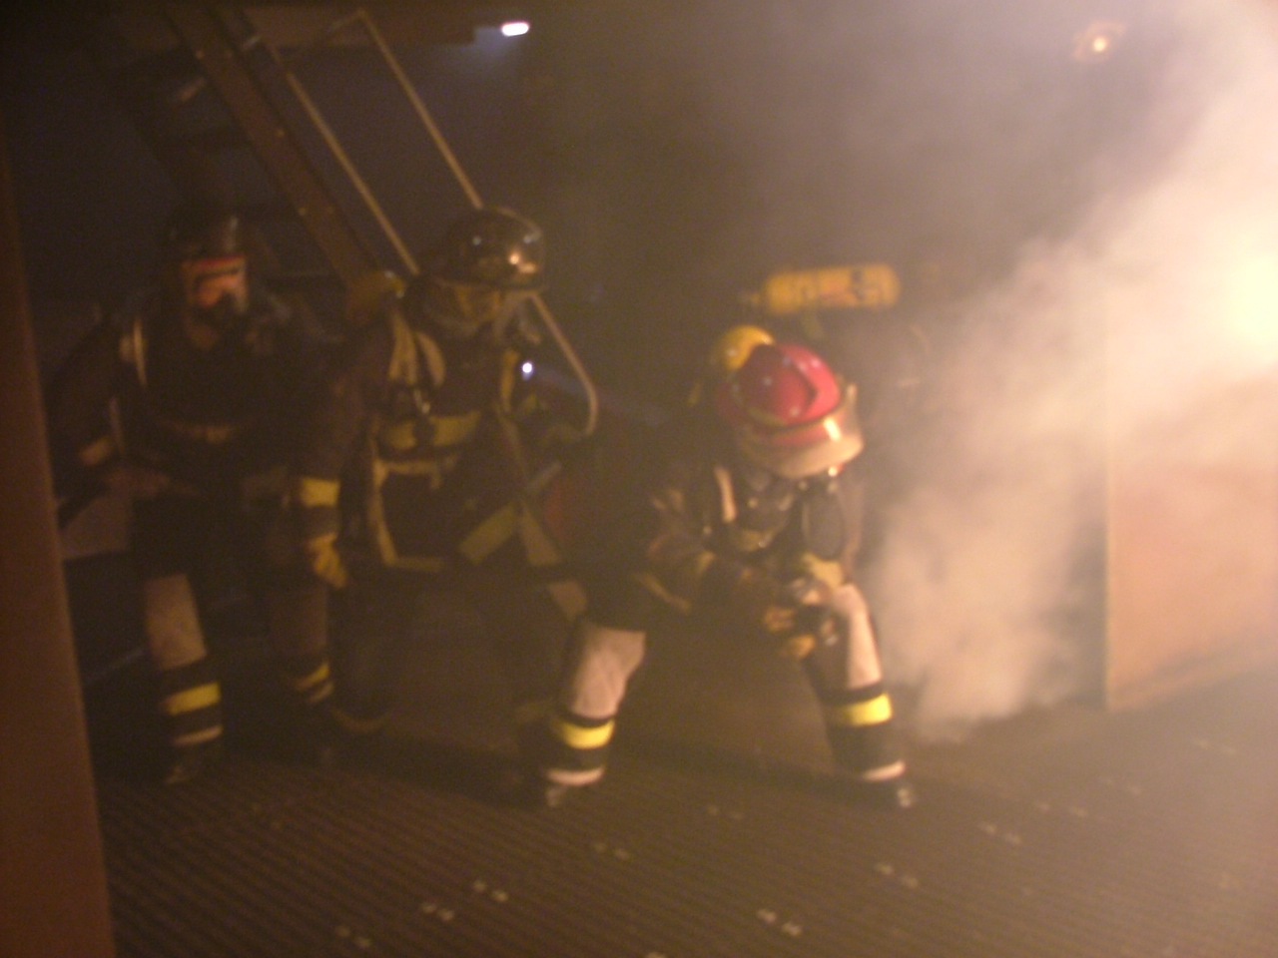
Shipboard Firefighting Training
Check In will start at 0830!
$1.00 All you Can Drink
Need Coffee?
(Don’t be cheap)
Please Silence all cell phones.

Slide 2
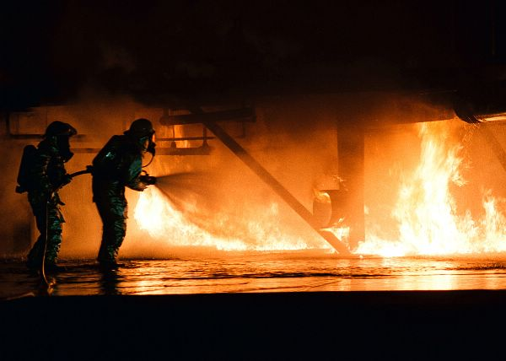
RTC NORTH ISLAND
FEDERAL FIRE SAN DIEGO
OUR MISSION IS TO PROVIDE YOU WITH REALISTIC HANDS-ON TRAINING AND TO FAMILIARIZE YOU WITH GENERAL SHIPBOARD FIRE FIGHTING TACTICS FOR THE LAND BASED FIREFIGHTER.

Slide 3
SAFETY TIME OUT
Due to the hazardous nature of live fire fighting training, Trainees shall request a Safety Time Out whenever they are apprehensive about their personal safety or that of another.
An instructor shall effect a STO for similar reasons. The purpose of the STO is to clarify a situation of concern and to receive or provide additional instruction as appropriate.
A STO is requested by a member raising a hand over the head.
If the members signal is not acknowledged by the instructor the member shall shout “SAFETY TIME OUT”.
When engaged in live fire fighting training the instructor shall attempt to relieve the member requesting the STO and direct the member out of the structure. If this is not practical for some reason, the instructor shall back the group out of the structure.

Slide 4
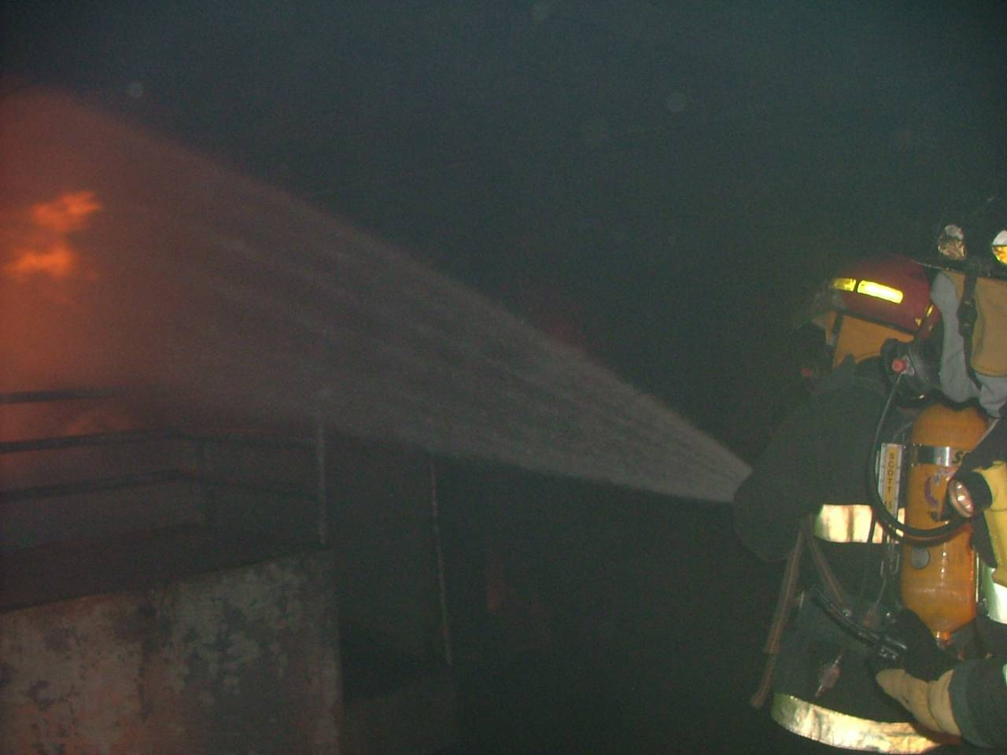
Heat Exhaustion/ Heat Stroke
Dizziness
Lightheadedness
Headache
Nausea
Vomiting
Cool Clammy/ Hot Dry Skin
Excessive or Lack of Sweating
Rapid Pulse
Difficulty Breathing
Confusion/ Loss of Consciousness
IF YOU BELIEVE AT ANYTIME THAT YOU NOTICE ANY OF THE FOLLOWING SIGNS OR SYMPTONS IN YOURSELF, OR SOMEONE ELSE, CALL A SAFETY TIME-OUT (STO) IMMEDIATLEY!!!
PREVENTION
Members are required to drink a minimum of 8 oz or one cup
of water before training and during breaks on the fire ground
Coffee and Soda do not count!!!
Members are also encouraged to eat some form of food prior to training and to drink up to 1 quart of water per hour of training.

Slide 5

CLASS SAFETY !
All members must stay with their groups.
Do not enter any structure without an Instructor present.
NO HORSEPLAY!!
DO NOT STRADDLE FIRE HOSES. STEP ON ALL FIRE HOSES.

Slide 6
FACILITIES
SMOKING AREA
RESTROOMS
COFFEE
TELEPHONE CALLS

Slide 7
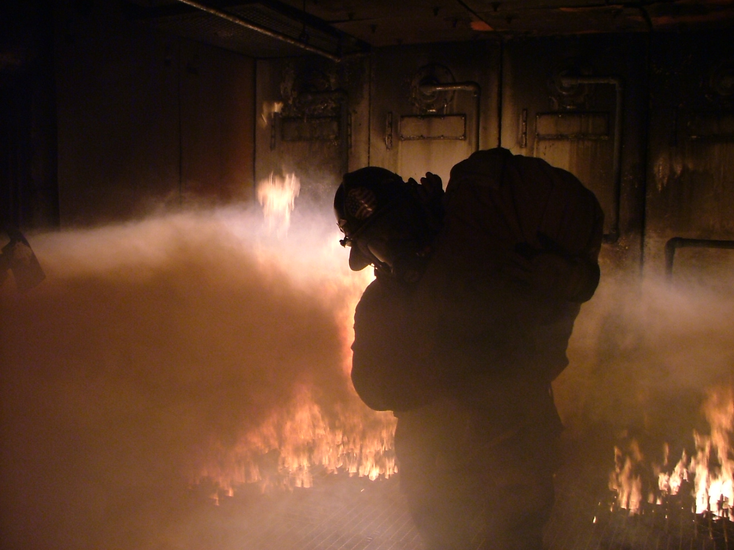
Course Schedule
Classroom
  Intro
  Review
Fire Ground
  Walk thru of the Fire Trainer
Live Fire Exercise # 1
  Class C fire in electrical console room
  Critique

Slide 8
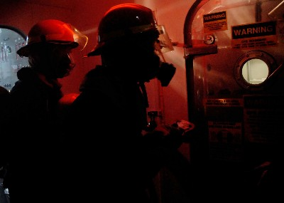
ANY QUESTIONS ?

